Slide 1

Data Analysis and Visualization:
A Worked Example
Elsa Ermer, PhD
Data Assessment and Accreditation Specialist
June 11, 2021

Slide 2
Elements of Data Analysis
Data Collection
Analysis of Data
Application of results and development of conclusions
Development of action plan
Example: Cardiology course grades
Notes:
analysis is the study of compiled or tabulated data interpreting correlations and trends, with the subsequent understanding and conclusions used to validate current practices or make changes as needed for program improvement
4 elements, according to ARC-PA
Data collection: study of compiled or tabulated data
Analysis of data: interpreting correlational relationships and trends
Application/development: with subsequent understanding and conclusions used to validate current practices or make changes as needed for program improvement

Slide 3
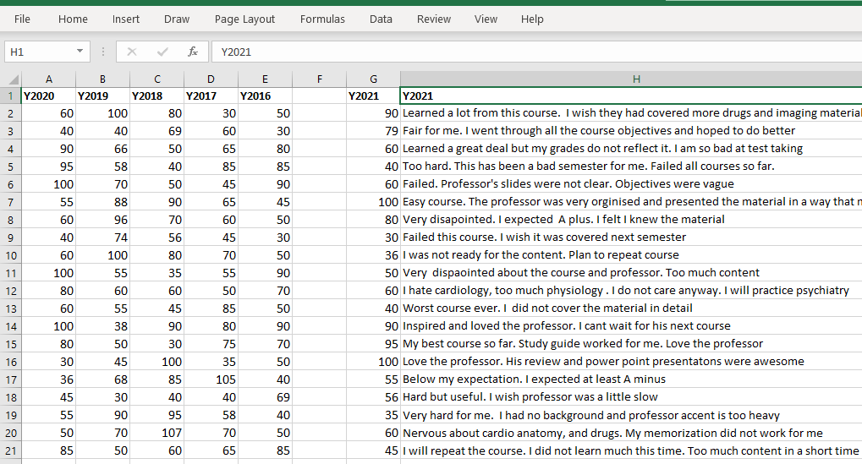
Data Collection: Cardiology Grades
Notes:
Cardiology grades, passing is 70% (75 multiple-choice questions)

Slide 4
Data Analysis Methods
Data cleaning
Quantitative
  Descriptive statistics
  Visualization
Qualitative
  Coding
  Summarization
Interpretation

Slide 5
Cardiology Grades:
Descriptive Statistics
Statistic | 2016 | 2017 | 2018 | 2019 | 2020 | 2021 | All
n | 20 | 20 | 20 | 20 | 20 | 20 | 120
Median | 50 | 63 | 65 | 63 | 60 | 60 | 60
Mean | 61 | 62 | 67 | 65 | 66 | 63 | 64
SD | 20.6 | 18.6 | 23.3 | 21.0 | 23.2 | 23.0 | 21.6
# passed | 8 | 7 | 9 | 8 | 8 | 7 | 47
% passing | 40 | 35 | 45 | 40 | 40 | 35 | 39
Min | 30 | 30 | 30 | 30 | 30 | 30 | 30
Max | 90 | 105 | 107 | 100 | 100 | 100 | 107

Slide 6
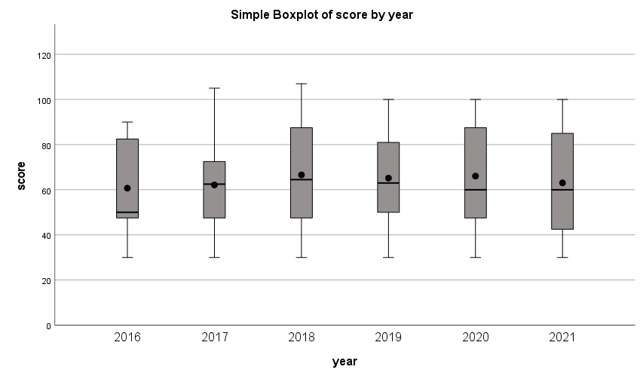
Cardiology Grades Over Time
Score
Year
Notes:
Box plot
Box-and-whiskers plot
Note scale: goes above 100, ok in this case
Using 0=100 scale, which is arbitrary but very familiar
Created with SPSS

Slide 7
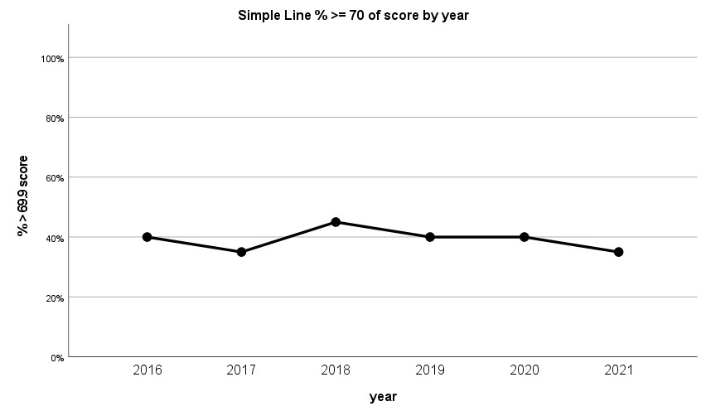
Cardiology Grades: Percent Passing
Percent of Students Passing
Year
Notes:
Created with SPSS

Slide 8
Quantitative Course Grades:
Interpretation
Performance in the cardiology course has been stable over time, with approximately 40% of students passing the course each year
Notes:
Could compare this to an appropriate benchmark

Slide 9
Qualitative Course Ratings
Students’ course summaries (n=20)
Overall View
  Positive
    “Inspired and loved the professor. I cant [sic] wait for his next course”
  Neutral
    “Fair for me. I went through all the course objectives and hoped to do better”
  Negative
    “Very dispaointed [sic] about the course and professor. Too much content”
Summary
  5 positive comments, 3 neutral, 12 negative
    Passing: 5 positive, 1 neutral, 1 negative
    Not passing: 0 positive, 2 neutral, 11 negative

Slide 10
Qualitative Course Ratings
Students’ course summaries (n=20)
Perceived Difficulty
  Yes
    “Too hard. This has been a bad semester for me. Failed all courses so far.”
  No
    “My best course so far. Study guide worked for me. Love the professor”
Summary
  13 perceived course as difficult, 7 did not
    Passing: 1 perceived difficulty, 6 did not
    Not passing: 12 perceived difficulty, 1 did not

Slide 11
Qualitative Data:
Cross Tabulations
 |  | Overall View
 |  | Positive | Neutral | Negative | Total
Perceived Difficulty | Yes | 0 | 2 | 11 | 13
 | No | 5 | 1 | 1 | 7
 | Total | 5 | 3 | 12 | 20

Slide 12
Qualitative Course Ratings: Interpretation
Overall view and perceived difficulty were strongly associated with each other
Both were strongly associated with passing the course
Performance in the course greatly predicted students’ course summaries
Notes:
Association with Passing (Spearman’s rho)
Positive: 0.77
Difficulty: -0.78
Positive & difficulty: -0.77
~In this data, we cannot readily differentiate these concepts…
Students who passed the course had more positive feedback…
Students who did not pass perceived it to be difficult…

Slide 13

Contact: Elsa Ermer, eermer@umaryland.edu

Slide 14
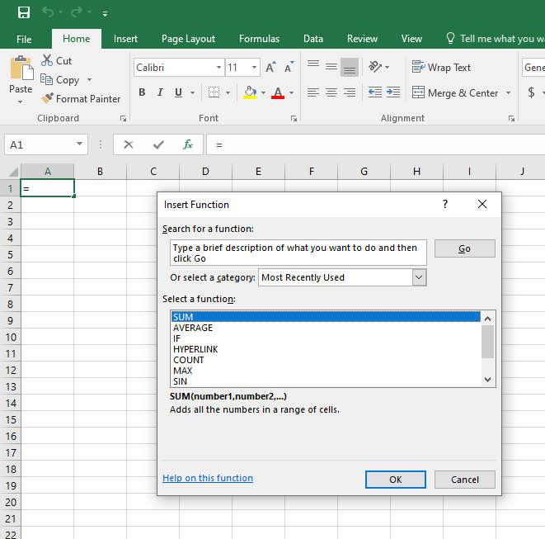
Statistics in Excel
Notes:
N = COUNT(range)
Median = MEDIAN(range)
Mean = AVERAGE(range)
Standard Deviation = STDEV(range)
# Passing = COUNTIF(range, “>=70”)
% Passing = #passed / N * 100
Minimum = MIN(range)
Maximum = MAX(range)

Slide 15
Descriptive Statistics:
Excel Formulas
Statistic | Excel Formula | Result (example)
n | =COUNT(range) | 20
Median | =MEDIAN(range) | 63
Mean | =AVERAGE(range) | 62
SD | =STDEV(range) | 18.6
# passed | =COUNTIF(range, “>=70”) | 7
% passing | = #passed / n * 100 | 35
Min | =MIN(range) | 30
Max | =MAX(range) | 105
Notes:
N = COUNT(range)
Median = MEDIAN(range)
Mean = AVERAGE(range)
Standard Deviation = STDEV(range)
# Passing = COUNTIF(range, “>=70”)
% Passing = #passed / N * 100
Minimum = MIN(range)
Maximum = MAX(range)

Slide 16
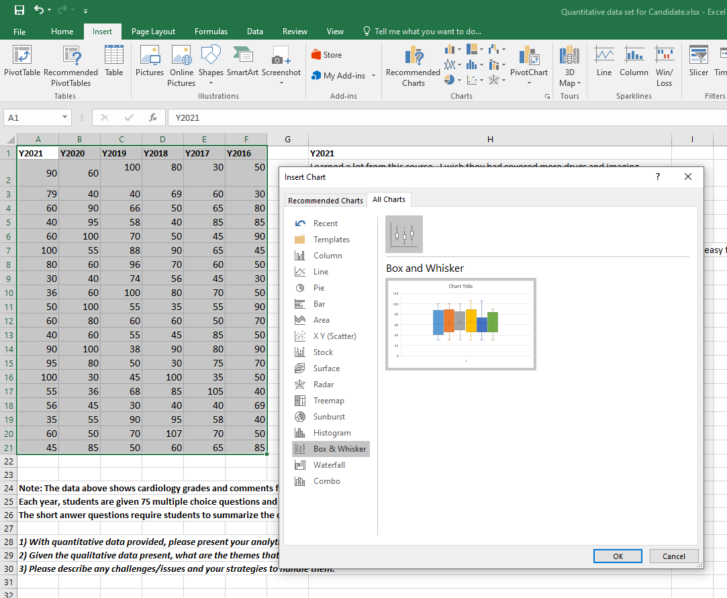
Charts in Excel

