Slide 1

What Gets Measured Gets Done. Or Does It?
Program Self-Assessment
Equity, Diversity, and Inclusion

Slide 2


Identify Barriers

Slide 3

Benefits of Equity, Diversity, and Inclusion in PA Education

Slide 4
Accreditation Standard A1.11
The sponsoring institution must demonstrate its commitment to student, faculty and staff diversity and inclusion by:
  supporting the program in defining its goal(s) for diversity and inclusion,
  supporting the program in implementing recruitment strategies,
  supporting the program in implementing retention strategies, and
  making available, resources which promote diversity and inclusion.

Slide 5
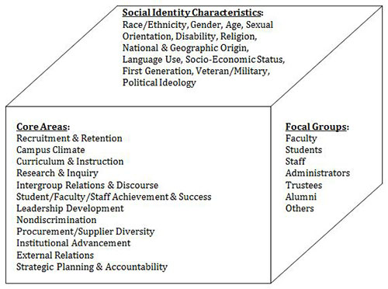
Three Dimensional Model of Higher Education Diversity Adapted from “Advancing Scholarship for the Diversity Imperative in Higher Education: An Editorial,” by R. L. Worthington, 2012, Journal of Diversity in Higher Education, 5, p. 2. Copyright 2012 by the National Association of Diversity Officers in Higher Education.

Slide 6
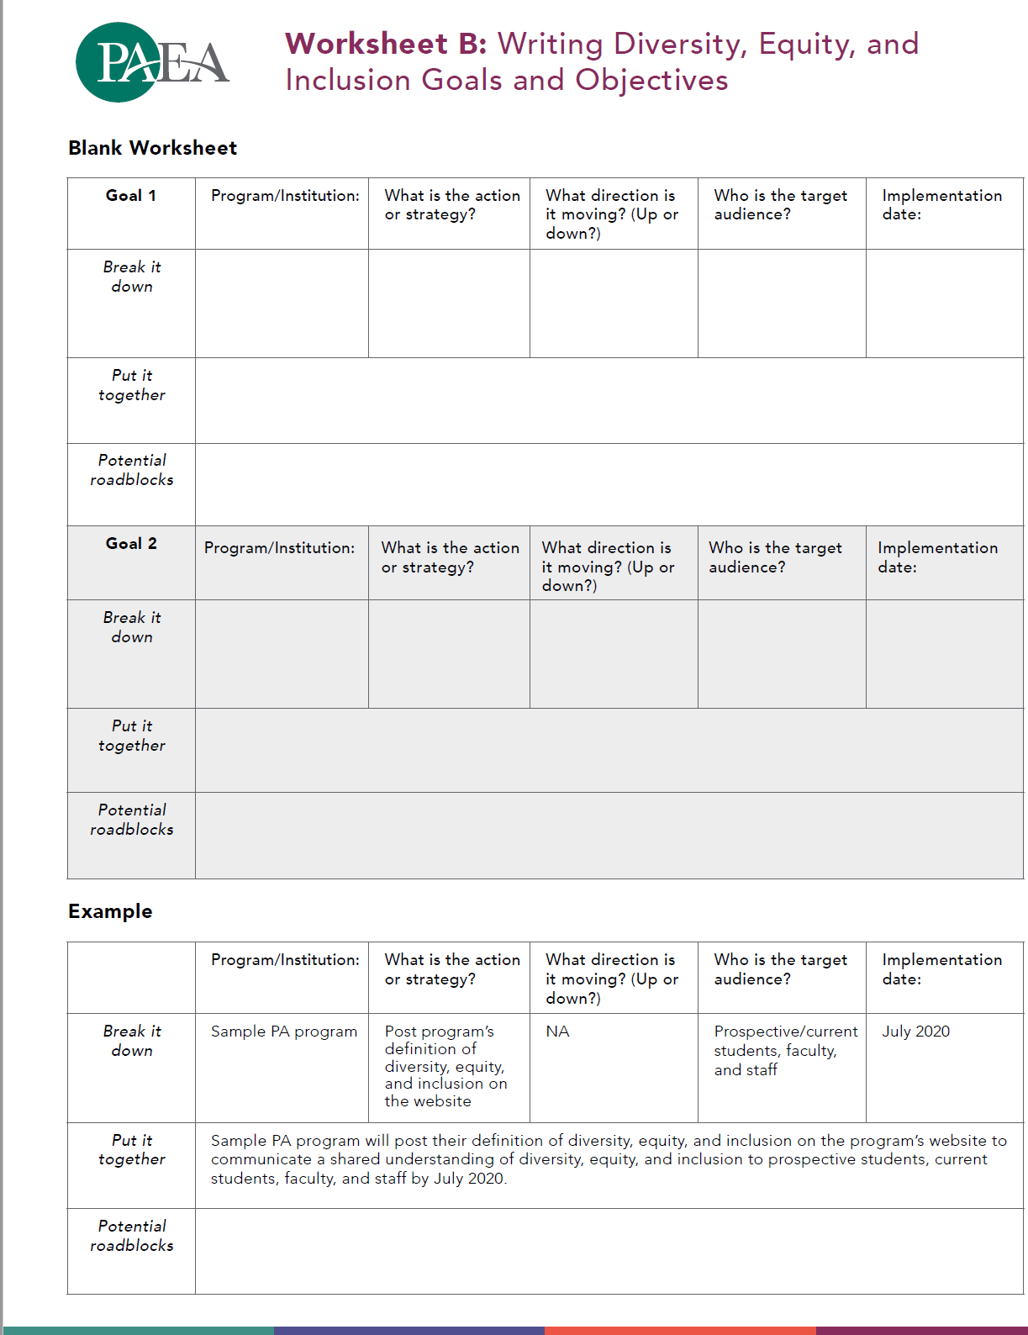
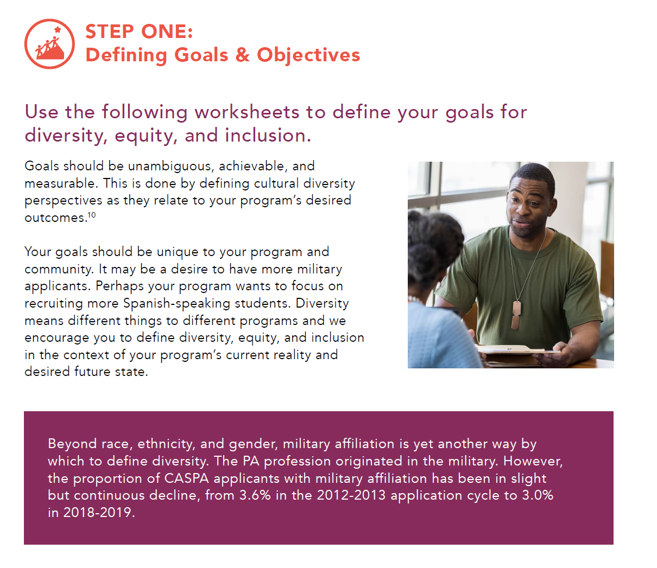
Defining its goal(s) for diversity and inclusion

Slide 7
Defining its goal(s) for diversity and inclusion
To establish partnerships with two Historically Black College and University and two Hispanic Serving Institutions.
  XYZ PA program will establish a Memorandum of Understanding (MOU) with a local Historically Black College and University (HBCU) Morgan State to establish a pre-PA program by August 2021.
 | Who’s Responsible | Deadline
Identify POC at Morgan State
Meeting to establish shared vision
Craft goals, vision, objectives, outcomes, schedule, activities
Generate MOU
Ratify the contract

Slide 8
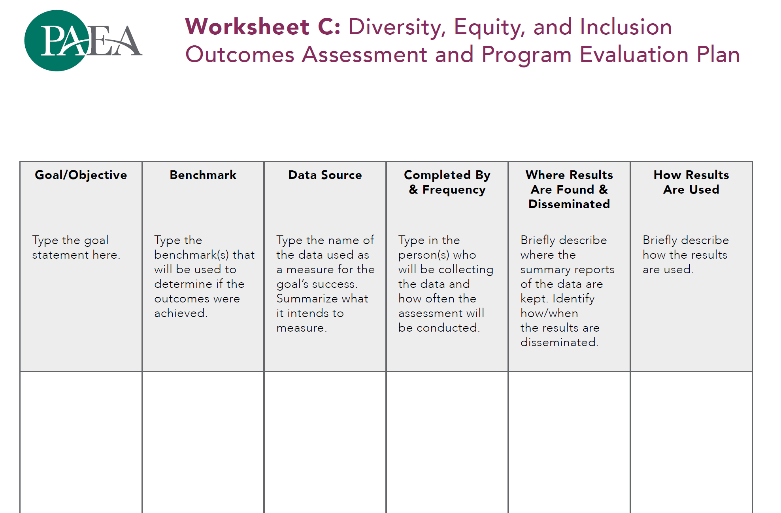
Implementing recruitment strategies
Hire a full or part-time FTE (carve out time for existing FTE)
Monthly sessions with Morgan Pre-PA group
Connect with Morgan affinity groups to establish monthly sessions
Recruitment events at UMBC, ABCRMS, local HBCUs/HSIs,
Establish mentorship program for future applicants

Slide 9
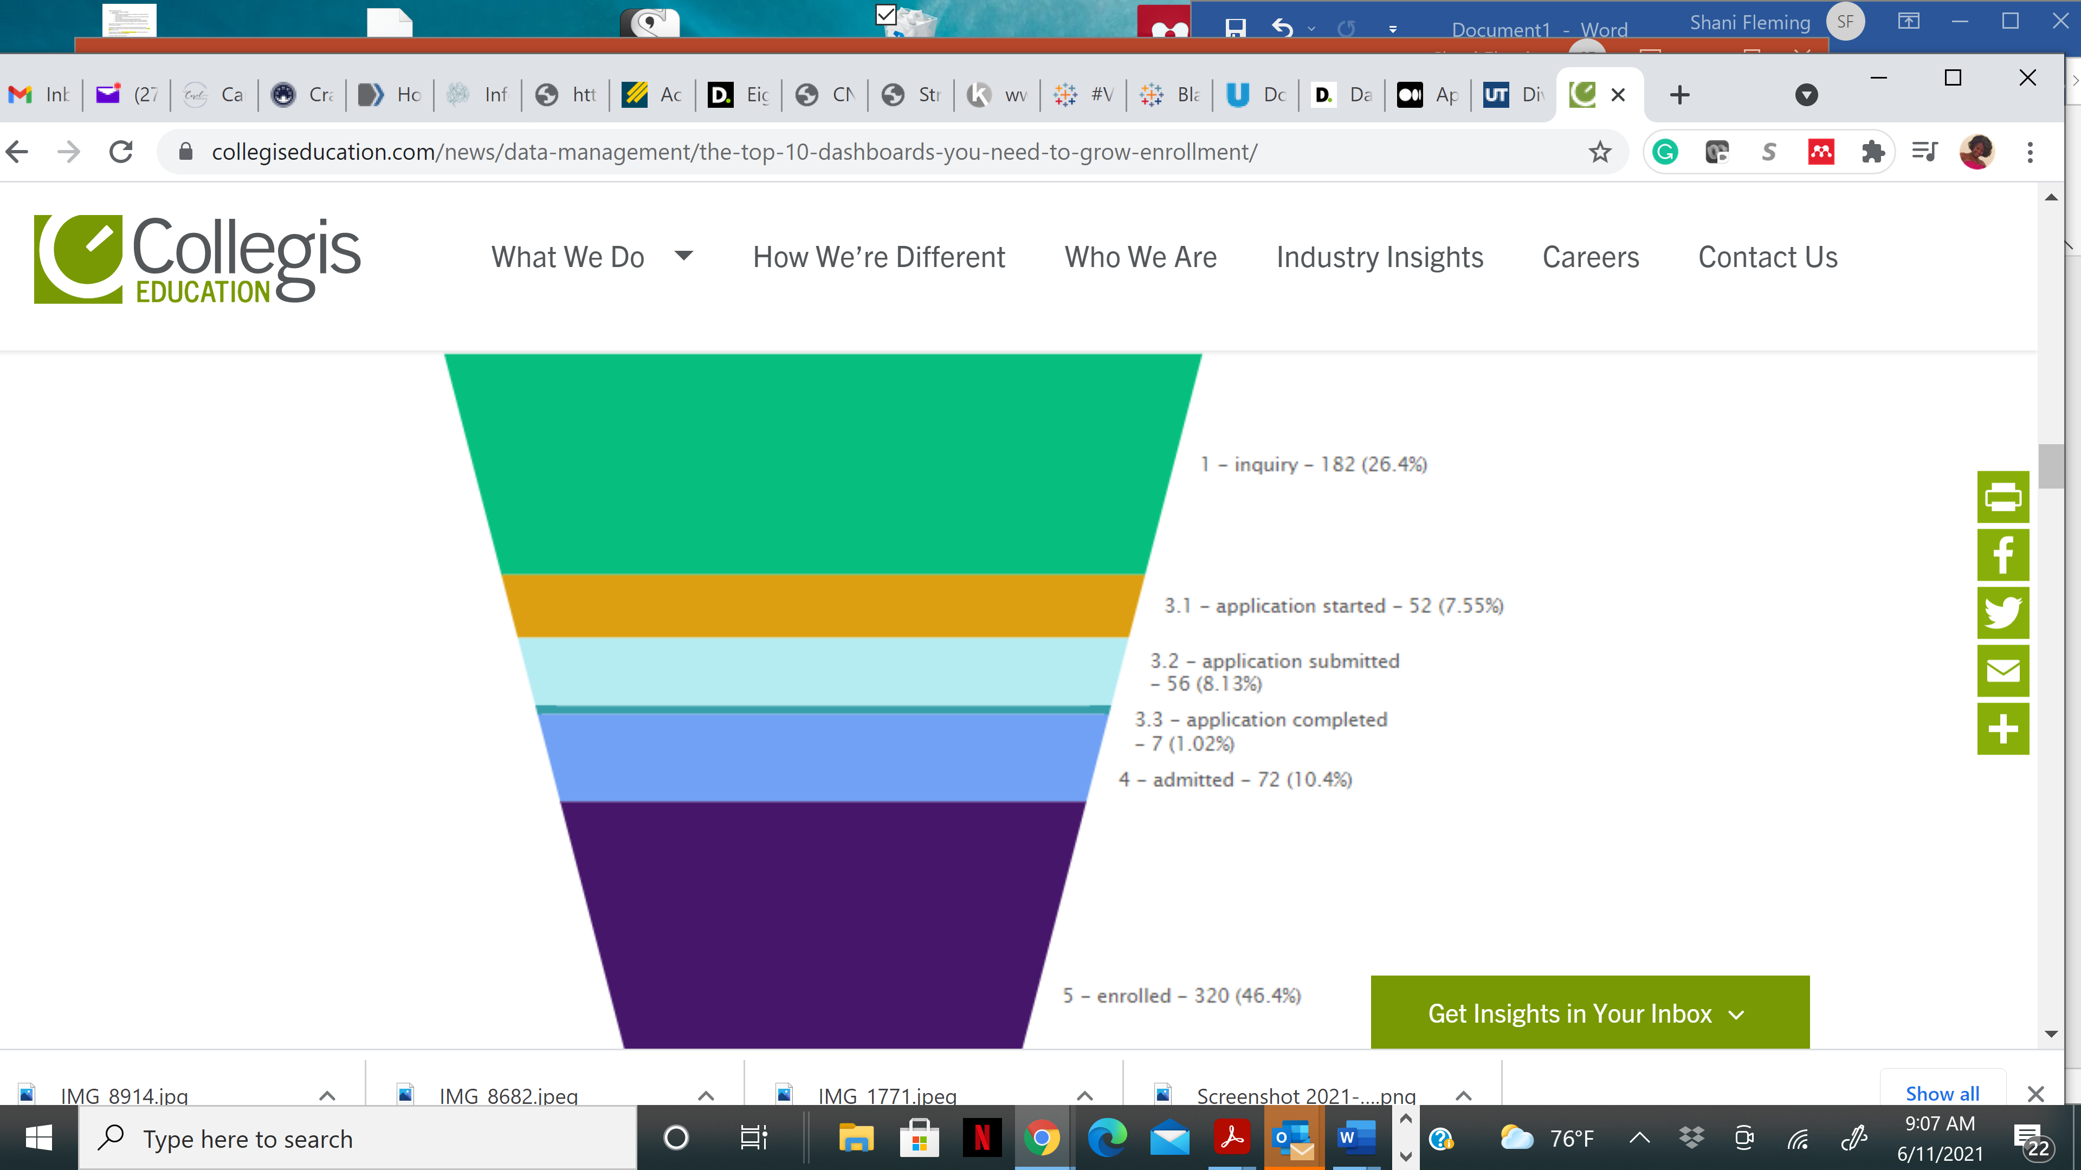
Implementing recruitment strategies
Metrics
Attend at least 6 recruitment events in 2022.
Collect at least 25 inquiries into the PA program
Receive at least 5 applications from connections made during recruitment events
Admit at least 3 students from recruitment strategies

Slide 10
Implemeting retention strategies
Hire a full or part-time FTE (carve out and attach scholarship/financial for existing FTE)
Intentional advising strategies
Climate surveys with follow up/follow through
Exit interviews with follow up/follow through
Ongoing leadership and faculty development

Slide 11
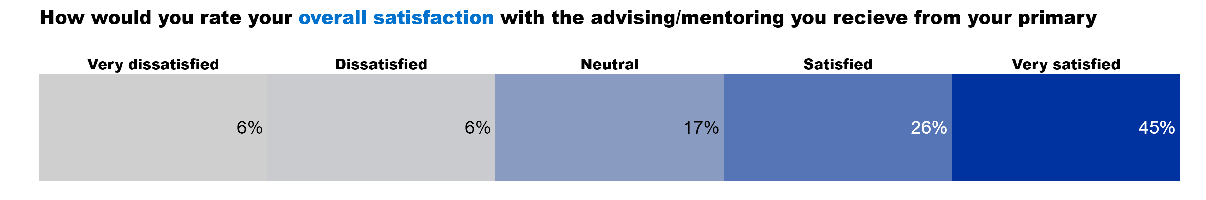
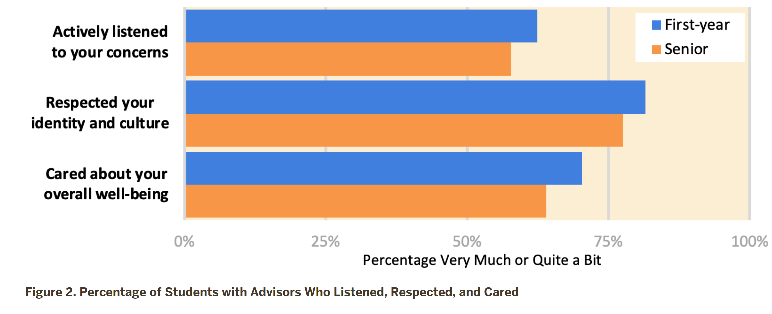
Implemeting retention strategies
Metrics
Conduct at least 6 advising sessions in 2022.
Discuss and document student academic progression and experience monthly
Receive at least 80% student satisfaction with advising experience
At least 90% retention of “Equity Advancement Recruitment Program” participants

Slide 12
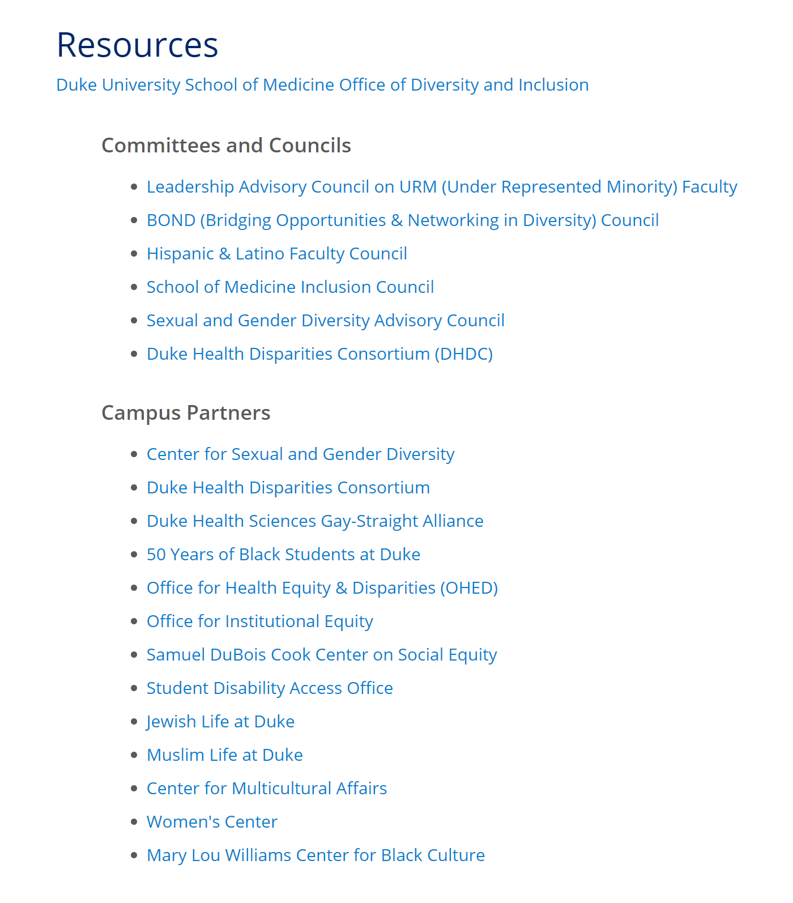
Making available, resources which promote diversity and inclusion
Hire a full or part-time FTE (carve out and attach scholarship/financial for existing FTE)
Ongoing leadership and faculty development
Institutional resources
Financial resources-Scholarships/Grants

Slide 13
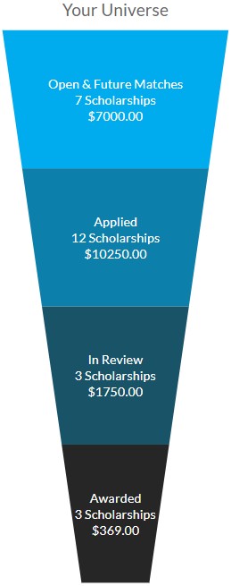
Making available, resources which promote diversity and inclusion
Metrics
Research at least 10 internal and external scholarship student opportunities
Facilitate at least 2 students completion of scholarship applications

Slide 14

Data metrics: A measure of EDI
Data
Metrics
KPIs
Actionable steps

Slide 15
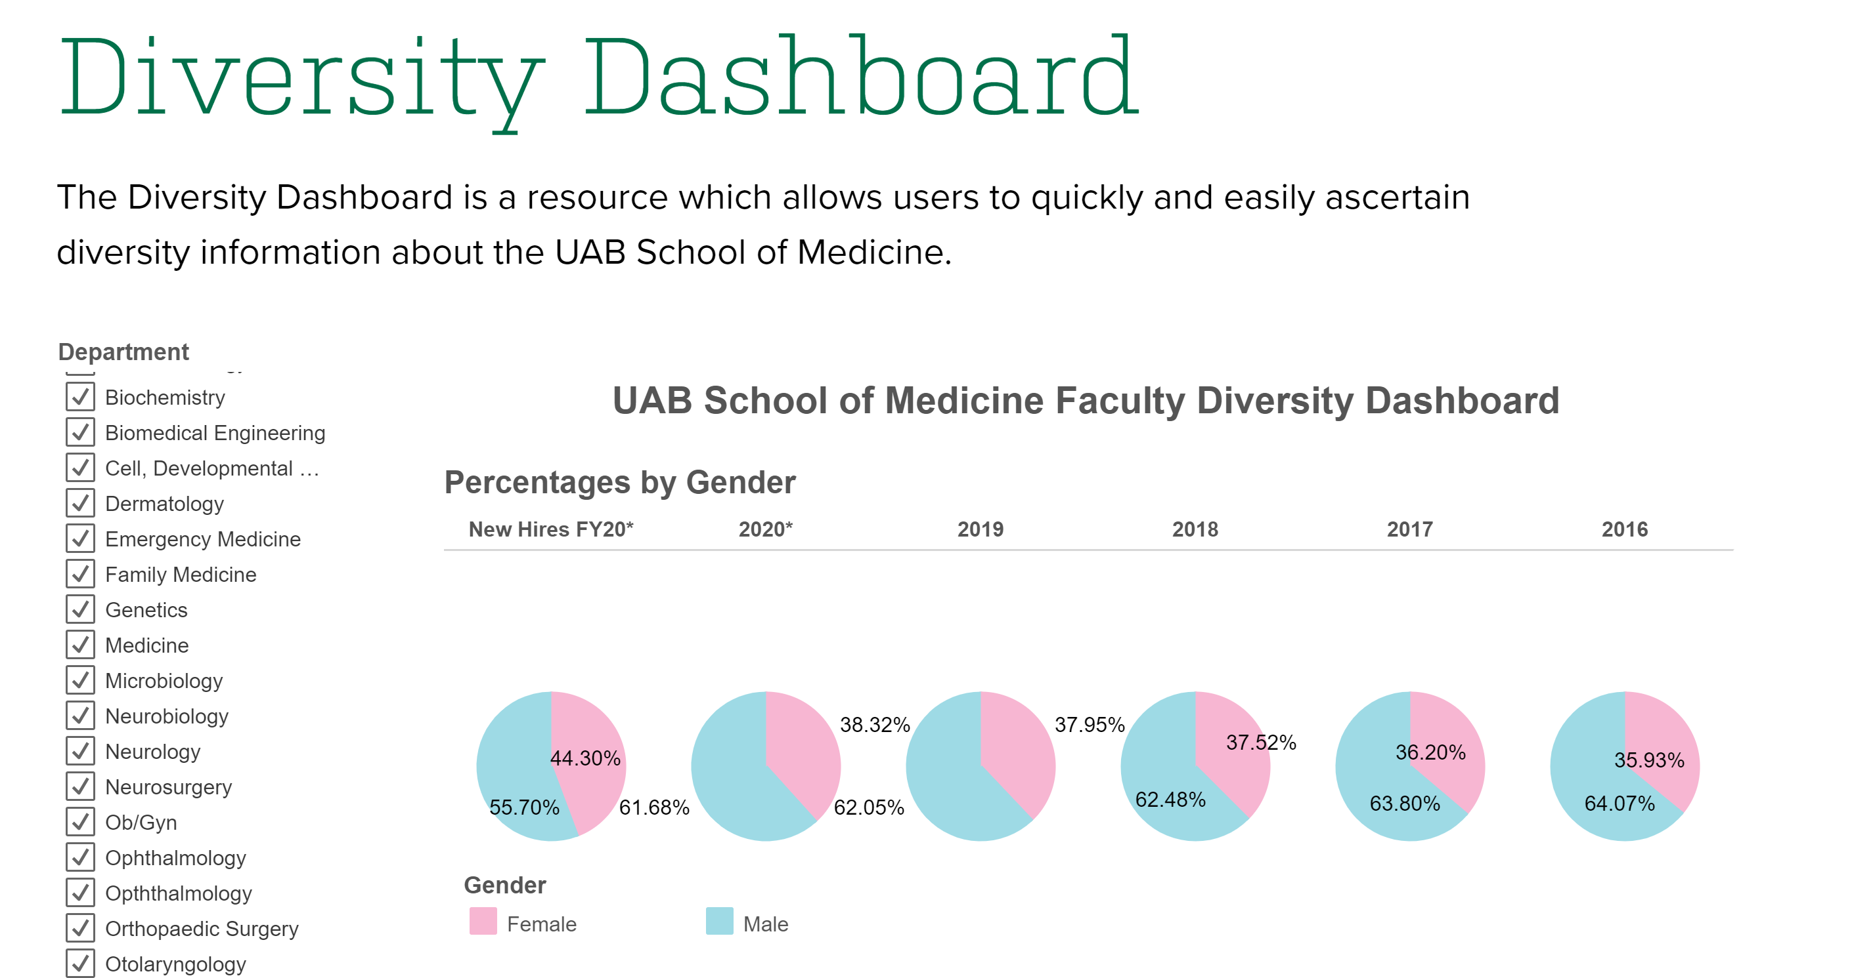
Data visualization: A picture of EDI
Storytelling
Clarity
  Careful not to mislead and misrepresent
The big picture
Reflecting lived experience

Slide 16

Questions?
Shani Fleming, MSHS, MPH, PA-C
Associate Professor
UMB Graduate School Chief Equity, Diversity, Inclusion Officer

