Slide 1

A Commitment to an Inclusive UMB Community
Title IX Program
The Office of Accountability and Compliance

Slide 2


Today’s objectives
2024 Title IX overview
Sex Discrimination
Expanded Scope
Privacy
Pregnant & Parenting
UMB’s Title IX Policy
Confidential Resources

Slide 3

2024 Regulations: Title IX of the Education Amendments of 1972
Went into effect on August 1, 2024
Fundamental changes to Title IX operationalization
New definitions
Formal reports standard has been removed
Expanded pregnant and pregnancy-related protections

Slide 4
‘On the Basis of sex’
  Sex stereotypes
  Sex characteristics
  Sexual orientation
  Gender identity
  Pregnancy or pregnancy-related conditions

Slide 5
Jurisdiction & locations
  In the education program or activities
      On campus
      Campus housing
      Program locations
      School sponsored events
  Impacting the education program or activities
      Anywhere if the effects meet the hostile environment definitions within the education program or activities
      This can include outside the United States
  Parties
      Complainants can include members of the public if they have a connection to or are involved in education program or activities
      Respondent must be under UMB’s control

Slide 6
Sex based discrimination
Sexual harassment
  Quid pro quo
  Hostile environment
          Unwelcome
          Sex-based
          Severe OR Pervasive
          AND objectively offensive
Dating Violence
Domestic Violence
Sexual Violence
Stalking
Retaliation

Slide 7

Privacy
  Confidentiality of Complaints
  Information Restricted Access
  Disclosure Consent
  Personal Information Protection
  Supportive Measures

Slide 8
PREGNANT AND PARENTING STUDENTS
Pregnancy & Pregnancy-related Conditions
  Equal access
  Confidentiality
  Prohibits discrimination
  Reasonable modifications or accommodations
  Lactation Accommodations
  Leaves of absence
Parenting
Equal access
Prohibits discrimination
  Gender role parenting stereotypes

Slide 9

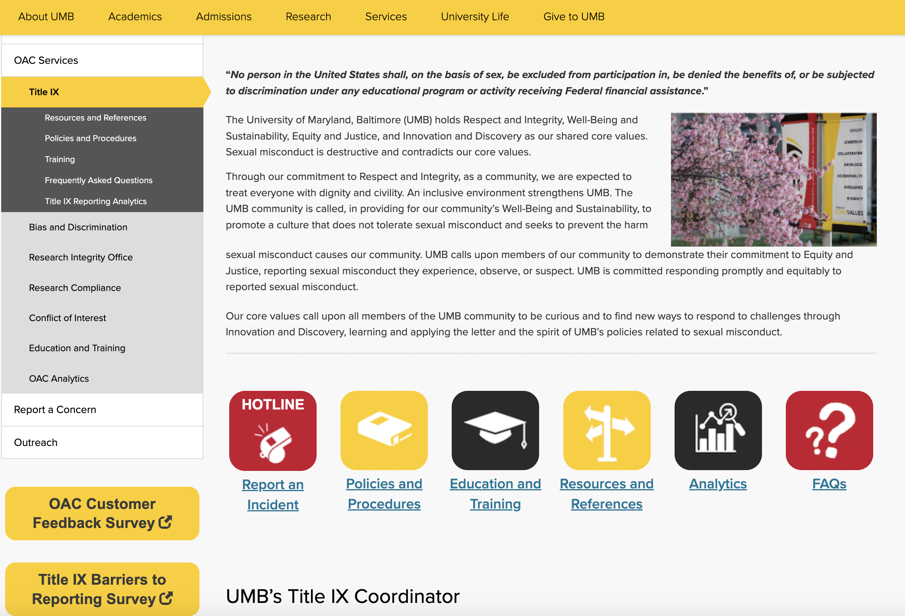
UMB’S Title IX program

Slide 10
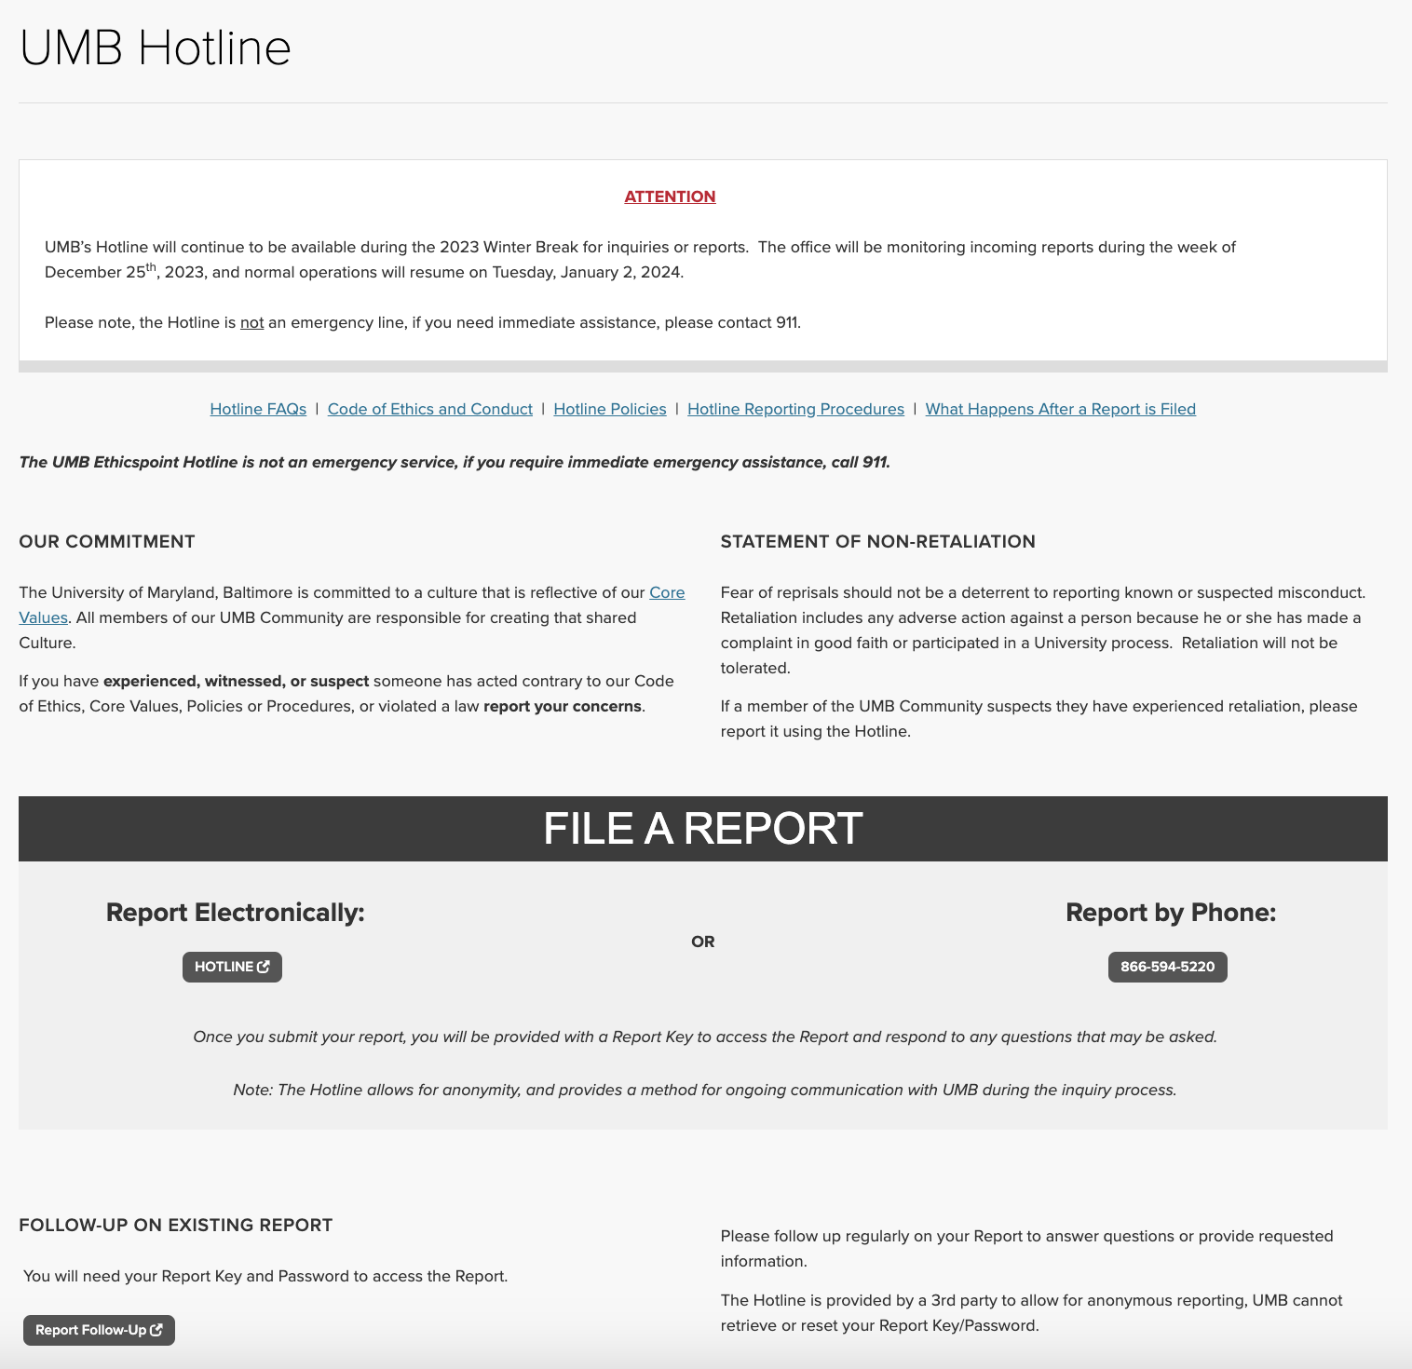

Title IX: Reporting
UMB Hotline
umaryland.edu/umbhotline
866-594-5220
Title IX Coordinator:
Stephanie Suerth, Acting
410-706-5212 (Direct)
ssuerth@umaryland.edu
titleix@umaryland.edu

Slide 11
Title IX: employee Reporting
UMB Hotline
umaryland.edu/umbhotline
866-594-5220
Title IX Coordinator:
Stephanie Suerth, Acting
410-706-5212 (Direct)
ssuerth@umaryland.edu
titleix@umaryland.edu
Employees, with the exception of Confidential Employees, are required to notify Title IX when someone discloses incidents that may constitute sex discrimination.
Confidential employees must provide contact information for Title IX Coordinator.

Slide 12
UMB CONFIDENTIAL AND NON-CONFIDENTIAL EMPLOYEES
UMB CONFIDENTIAL EMPLOYEES
  Student Counseling Center
  Student and Employee Health
  Employee Assistance Program (EAP)
NON-CONFIDENTIAL EMPLOYEES
Administrators
Advisors
Faculty
Staff

Slide 13
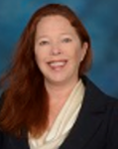
Stephanie Suerth
Acting Title IX Coordinator
Office of Accountability and Compliance
410-706-5212
titleix@umaryland.edu

