Slide 1

Student Counseling Center
Monday – Friday
8:30 a.m. to 5:00 p.m.
(410) 328-8404
https://www.umaryland.edu/counseling
3rd floor of the Campus Center
621 W. Lombard St. Suite 302
Wednesday appointments are virtual ONLY until September 2023
Presenter:
Tierra Major Kearney
Referral Specialist
Prevention & Outreach Coordinator

Slide 2
What We Do
We provide brief interventions, solution-focused treatment, and psychiatric services for currently enrolled full-time and part-time UMB students.
Our mission is to help promote and maintain the emotional well-being of UMB students and serve as a consultation resource to the entire university community.

Slide 3

2022-2023 Survey Says: Top 5 Reasons Why Students Visit the SCC
To improve emotional resilience/wellbeing
To reduce burnout and better manage academic stress
To better deal with anxiety symptoms
To have a confidential space to express myself
To receive help with depression symptoms
To cope with the adjustment to professional school

Slide 4
What Every Student Needs to Know…
Counseling services are strictly confidential: If not a danger to self or others, we only communicate with other people if the student give us explicit permission.
RECORDS ARE REQUIRED BY LAW TO BE SEPARATE FROM ACADEMIC RECORDS & CANNOT BE VIEWED BY ANYONE IN THE PROGRAM.
  NO FEES/NO INSURANCE: We do not bill students for any services or report to their insurance (may need to use insurance for medications only).
  Records are DESTROYED seven years after your last date of service.
  Title IX exempt, meaning we are not mandated to report issues

Slide 5
How to Access SCC Services
Call our number (410-328-8404)
  If after hours: Option 3 to leave a voice message. Leave your full name (please spell), phone number, & email
  Same day appointments can be requested on the website. Please request on the day that you are available to meet. A small amount of paperwork is required.

Slide 6
Services Available from SCC
Crisis Support Line: 410-328-8404, option 7
  Phone consultation with a clinician for self or others
  Available after-hours, including nights, weekends, and holidays
  For non-life-threatening crisis mental health situations for self and others
Same-Day Counseling Appointments: Rapid access
  Available weekdays at 2:00pm. Form opens at 7:30am weekdays.
  30-45 minute, first come, first served appointments
  If no appointments are available, please try on another day unless you have an urgent situation then please call and request to speak to the clinician on coverage.

Slide 7
Services Available from SCC
Individual Therapy: Free and Confidential
  Flexible individual counseling
    Typically, 45-minute sessions every two to three weeks working on one or two treatment goals
  No session limit
  Offered after completing a phone triage and initial evaluation
UWill: Therapy available outside of business hours (also free)
  Evening and/or weekends
  Eight, 30-minute appointments
  Solution focused model; Very good for building skills
  Can return to SCC afterwards if you need further services

Slide 8
Services Available from SCC
Psychiatry (Student must participate in counseling with SCC to be eligible)
  May be available after initial evaluation
  Is never required as part of treatment but can be quite helpful for some
  Sessions are free but medications require payment and/or use of insurance
  Certain medications require a psychoeducational evaluation
  1st psychiatry session must be in person
Consultation for Others (also confidential)
  If you are concerned for another student, you can call and speak to a counselor. Be sure to mention that you are calling about a concern for another student.

Slide 9
Services Available from SCC
Referral Assistance: Assistance in finding appropriate referrals
  If a student would benefit from a service that the SCC does not offer such as:
    Weekly or long-term counseling
    Long-term medication management only
    Couples/Relationship counseling
    Wanting a therapist from a specific social identity / demographic group
    Specialized mental health treatment
  SCC may be able to offered limited bridge sessions for counseling
  Student will need to use their insurance for services outside of the SCC
  Request referral assistance during the phone triage with SCC clinician

Slide 10
In Person and Virtual Services
All counseling and psychiatry services are offered both in-person and through tele-health via Zoom
In-person services may be recommended for clinical reasons
Maryland law requires that students physically be in Maryland and have a private and safe place For tele-health services
If students would like tele-health but does not have a private location, ask about the SCC Zoom Room, offered only for SCC virtual services
Wednesday appointments are ONLY virtual until September 2023
  Starting in September, the SCC will offer both in-person and virtual options on Wednesdays, for questions please call (410) 328-8404

Slide 11
Workshops
Anxiety Workshop Group
  A group workshop that meets for one hour three times across three weeks
  Specifically designed to using cognitive behavioral therapy to develop skills to manage stress and anxiety
  Usually small groups (under 10 people)
  Conducted via telehealth on Zoom
Emotion Regulation Toolbox
  60-minute lecture style workshop focused on teaching two specific skills on how to relate to your thoughts and emotions
  Incorporates elements of dialectal behavioral therapy, acceptance and commitment therapy, and psychoanalytic therapy
  Conducted via tele-health on Zoom: No camera or mic is necessary
Please see website for sign up and scheduled dates.

Slide 12
SCC’s Website
https://www.umaryland.edu/counseling/
Our website includes a lot of helpful resources including…
  More information about our Services and Upcoming Events
  Therapy and Self-Help Resources: Includes how to Find a Therapist, Self-Care Apps, online mental health assessment, substance use resources, resources for grief and loss, and more
  Crisis Care Resources and Resources to Help Others
  Prevention and Outreach Information and Request Form

Slide 13
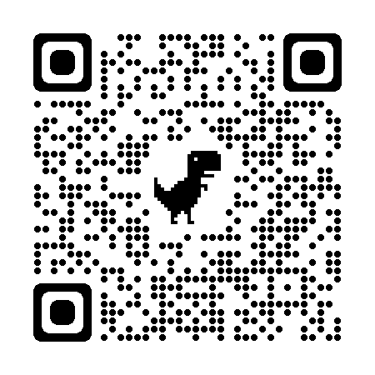
Thank you!
Any questions?
Please review the website for any SCC updates

