Slide 1

Conflict of Interest

Slide 2
Primary Responsibility
Manage the Process for Financial Conflict of Interest Review and Management under:
U.S. Federal Public Health Services Regulations
State Ethics Law

Slide 3
U.S. Federal Public Health Services (PHS) Regulations

Slide 4
U.S. Federal Public Health Services (PHS) Regulations
New regulations pertaining to financial conflicts of interest in research sponsored by the U.S. PHS went into effect on August 24, 2012.
Anyone participating in the design, conduct, or reporting of PHS funded research must disclose all significant financial interests relating to their UMB responsibilities and receive training on PHS regulations.
Small Business Innovation Research Program (SBIR) and Small Business Technology Transfer Program (STTR) Phase 1 applications are exempt

Slide 5
U.S. PHS Funding Agencies
National Institutes of Health (NIH)
Agency for Healthcare Research and Quality (AHRQ)
Agency for Toxic Substances and Disease Registry (ATSDR)
Health Resources and Services Administration (HRSA)
Substance Abuse and Mental Health Services Administration (SAMHSA)
Centers for Disease Control and Prevention (CDC)
Food and Drug Administration (FDA)
Indian Health Service (IHS)
Office of the Assistant Secretary for Preparedness and Response (OASPR)- new
Office of Global Affairs (OGA)- new
Notes:
Any research which is funded by the following agencies

Slide 6
PHS Requirements
Significant Financial Interest Disclosure
PHS Conflict of Interest Training
Notes:
Completion of COI Training and disclosure form

Slide 7
Significant Financial Interest
(SFI) Disclosure

Slide 8
What must be disclosed?
Investigators must disclose all Significant Financial Interests of any monetary value that are or appear to be related to the Investigator’s Institutional Responsibilities such as:
Examples:
Consulting fees, paid authorship, intellectual property rights, equity interest, reimbursed travel etc.
Notes:
Including spouse/dependent children
On the disclosure form Demographics, amount, date, description, relationships if any and relevant documents

Slide 10
Significant Financial Interest Disclosure
When?
At or before the time of submission of an application for PHS-Funded Research
Annually
Within 30 days of acquiring a new Significant Financial Interest (SFI)

Slide 11
PHS Conflict of Interest Training

Slide 12
PHS Conflict of Interest Training
When?
Prior to engaging in PHS-Funded Research
Every four years
What?
PHS FCOI regulations
Institution’s COI Policy
Investigator responsibilities

Slide 13
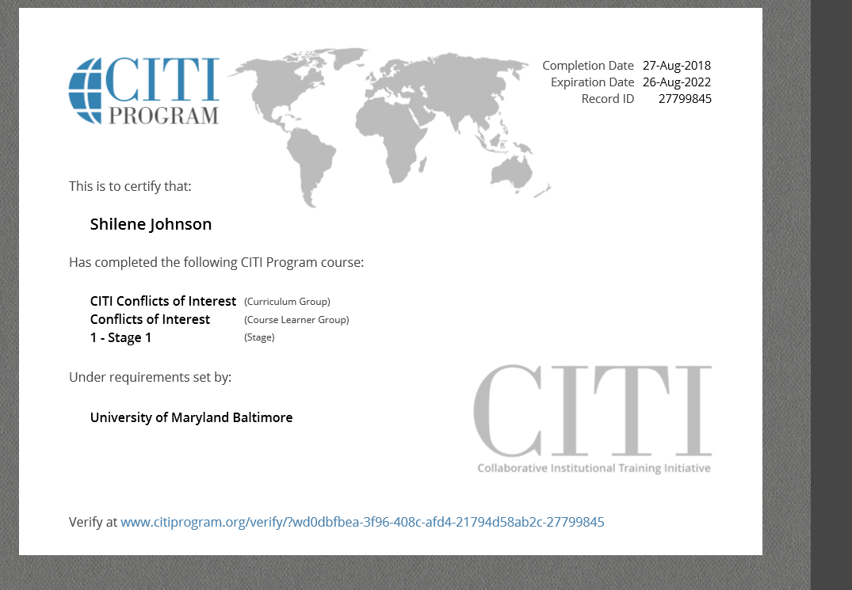
PHS Conflict of Interest Training

Slide 14
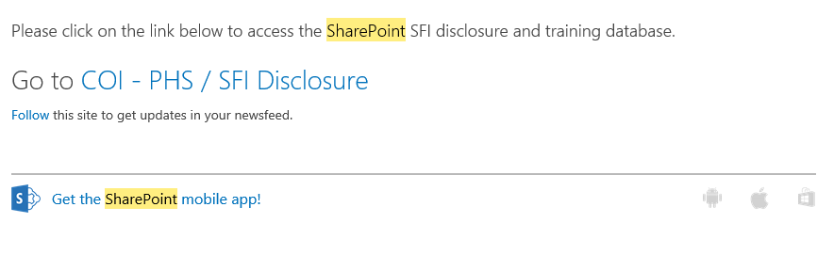
PHS Disclosure and Training Database
SharePoint Access

Slide 15
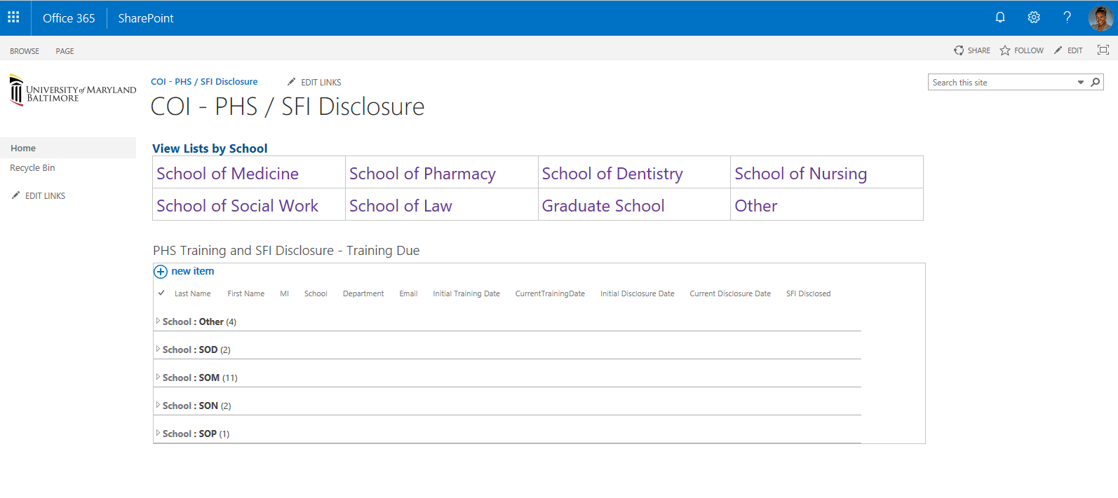
Share Point Database

Slide 16
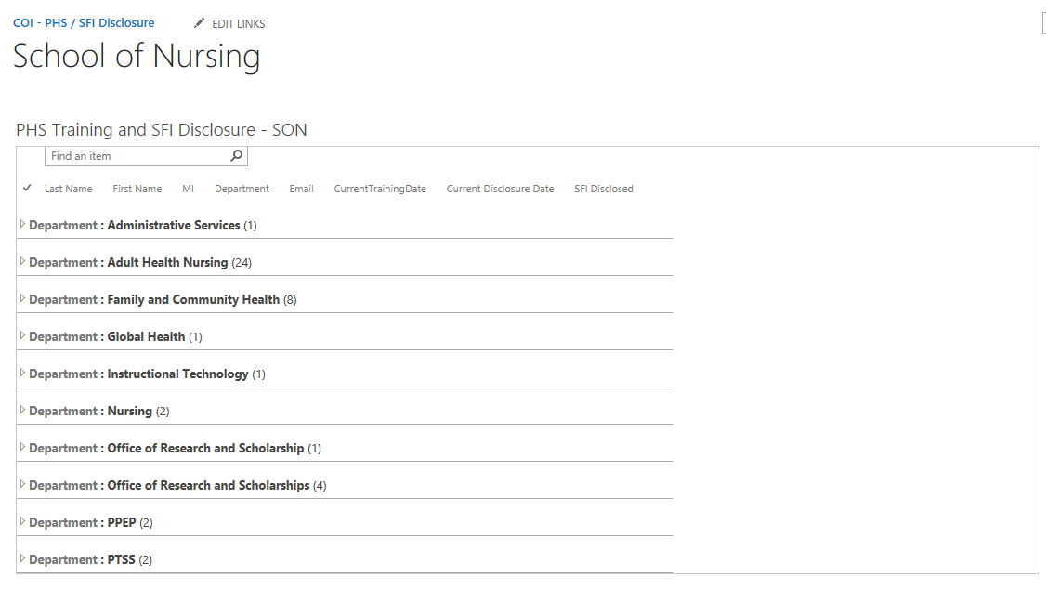
PHS Disclosure and Training Database
SharePoint

Slide 17
OFFICES
Human Research Protection Office(HRPO)
Institutional Animal Care and Use Committee(IACUC)
Office of Research and Development (ORD)

Slide 18
Non-Compliance
It shall be considered a violation of UMB policy, subject to disciplinary action in accordance with applicable policies, if an Investigator:
(a)fails to comply with an established Management Plan; (b)fails to provide timely annual report information or other required information; or
(c)fails to comply with any other requirement of this Policy
Notes:
Discuss the non-compliance list

Slide 19
Graduate Student Expectation
If you are participating or plan to participate in the design, conduct, or reporting of any PHS funded research.
You ARE Required to complete
YOU MUST complete an SFI disclosure form even if you have nothing to disclose.
YOU MUST include interests of “any” monetary value (UMB $0 minimum threshold).
YOU MUST complete a SFI disclosure form annually (within 30 days of acquiring new interest).
YOU MUST complete COI PHS training every four years.

Slide 20
For Additional Questions Please Contact:
Alison Watkins
AVP for Enterprise Risk and Policy Oversight
UMB Conflict Of Interest Officer
Office of Accountability and Compliance
620 W. Lexington Street, Fifth Floor
410-706-1266
athom001@umaryland.edu
Shilene Johnson
Research Compliance Specialist
Office of Accountability and Compliance
620 W. Lexington Street
410-706-4934
Shilene.Johnson@umaryland.edu
Erin Burch
Research Integrity Specialist
Office of Accountability and Compliance
620 W. Lexington Street
410-706-6951
erin.burch@umaryland.edu
Notes:
The COI Officer, myself or colleage

