Slide 1
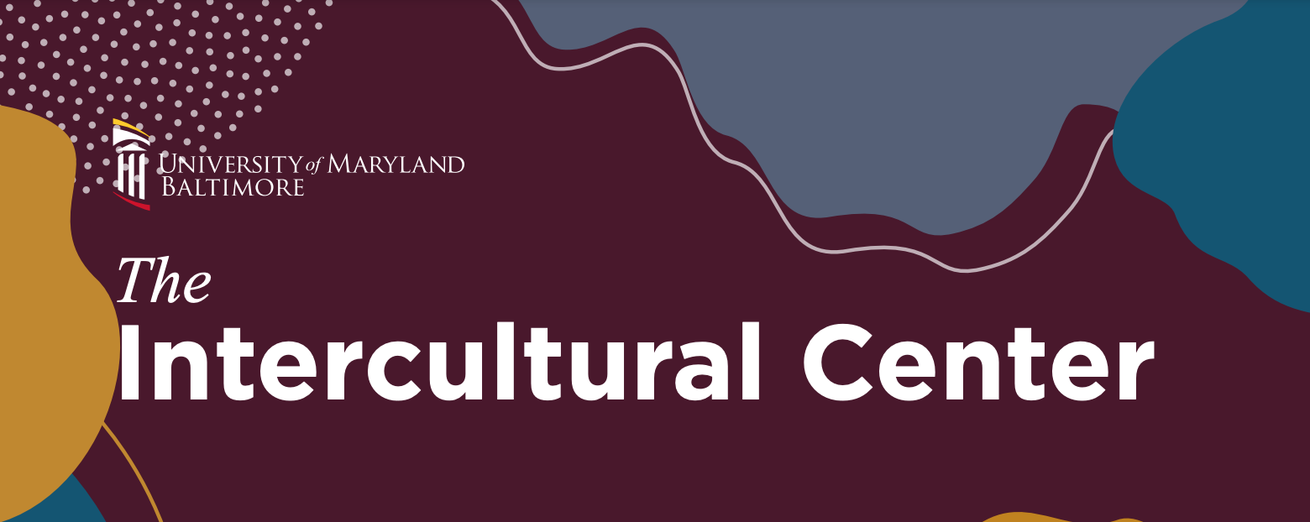

Slide 2
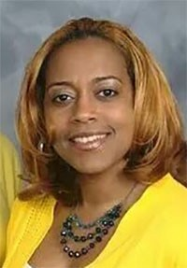
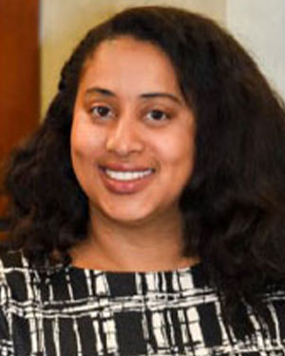
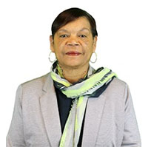
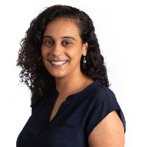
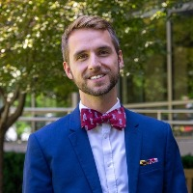
Intercultural Leadership and Engagement Unit Staff
Dr. Courtney Jones Carney
Executive Director of the Intercultural Leadership and Engagement unit,
Director of the Intercultural Center
Cyndi Rice
Director, ​Student Leadership and Organizations
Rosemary Ferreira
Associate Director,
Intercultural Center
Dr. Greg Brightbill
Associate Director for Student Leadership and Engagement, Liaison for LGBTQ+ Students
Jole' Ruff
Program Coordinator,
Intercultural Center

Slide 3
Mission
The mission of the Intercultural Center is to develop initiatives and resources that foster a sense of belonging and acknowledge the needs and lived experiences of historically marginalized and excluded students, staff, and faculty at UMB. We are also deeply committed to developing anti-racism and anti-oppression educational programs that will inform the practice of our current and future health care, law, and human services professionals.
Vision
The vision of the Intercultural Center is to develop spaces of belonging, courage, and critical thinking.

Slide 4
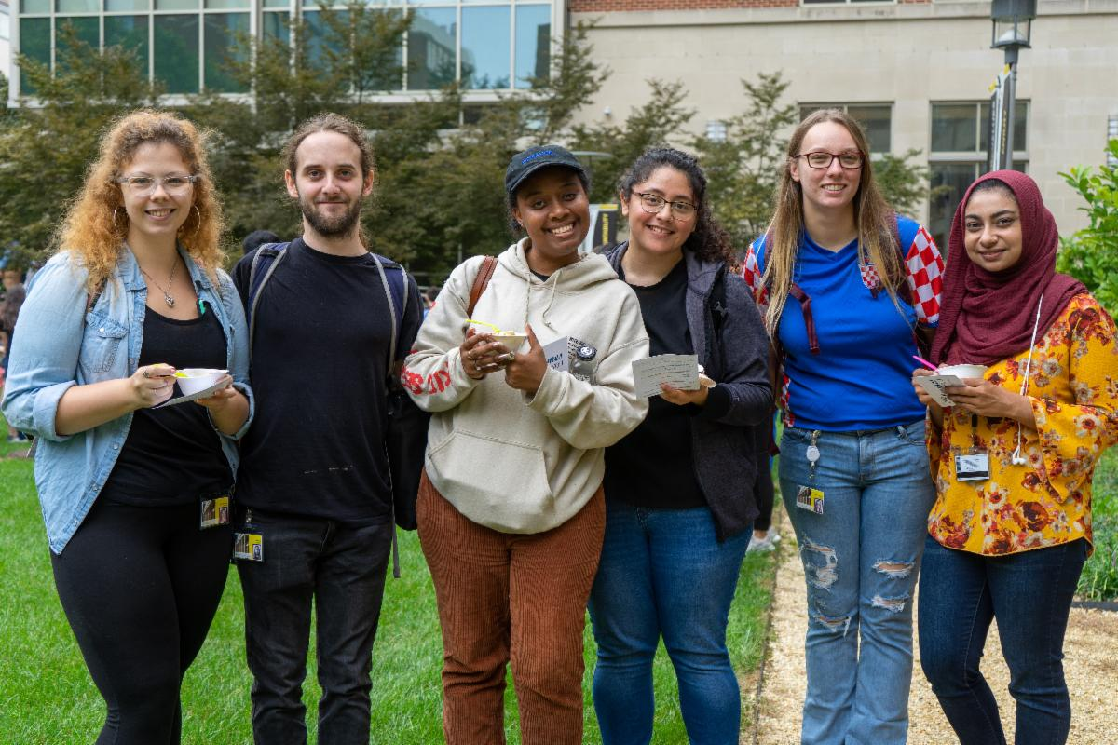
Upcoming Events with the Intercultural Center
Programs and Initiatives with the Intercultural Center
UMB Student Pantry
The Table Podcast
The Table Dialogue
Heritage Month Programming
Identity-Based Resource Webpages
Identity-Based Social Hours
Critical Conversations Dialogue Program
Student Advisory Groups
Student Climate for Diversity Survey
Poverty Simulation
Office Hours

Slide 5
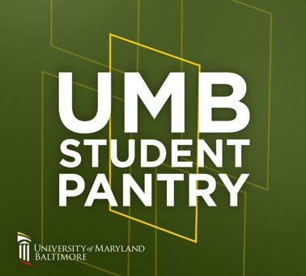
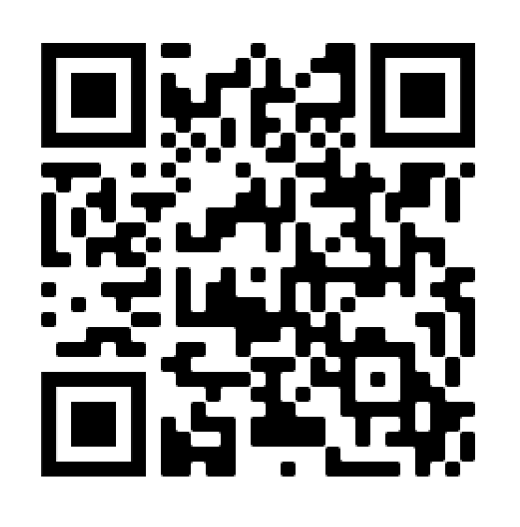
Upcoming Events with the Intercultural Center
UMB Student Pantry
All students at UMB are eligible to place orders from the UMB Student Pantry. Use the QR code below to access the request form. You'll find items such as shelf stable foods, grab and go snacks, and hygiene items.
Once your order has been bagged for you, you will receive an email with pick-up instructions. The current pick-up location is at the SMC Campus Center, located at 621 W. Lombard Street.
Please contact Jole' Ruff at jruff@umaryland.edu with any questions about the pantry.

Slide 6
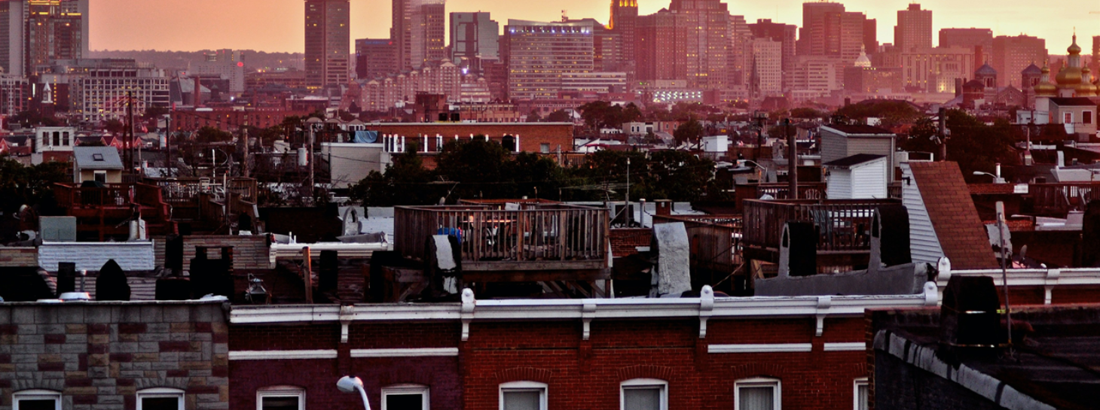
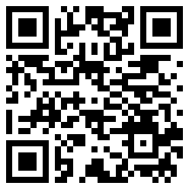
BMore for Baltimore: Community Leaders Panel and Dialogue
Tuesday, September 12 | 5:30 – 7 pm | SMC Campus Center (621 W Lombard Street)
Baltimore is UMB’s home. It's where we fulfill our passions in serving others. Learn how to “be more” of an ally to the city and its residents by hearing from local community leaders involved in racial and social justice work and by engaging in critical dialogue to unpack harmful narratives about the city.

Slide 7
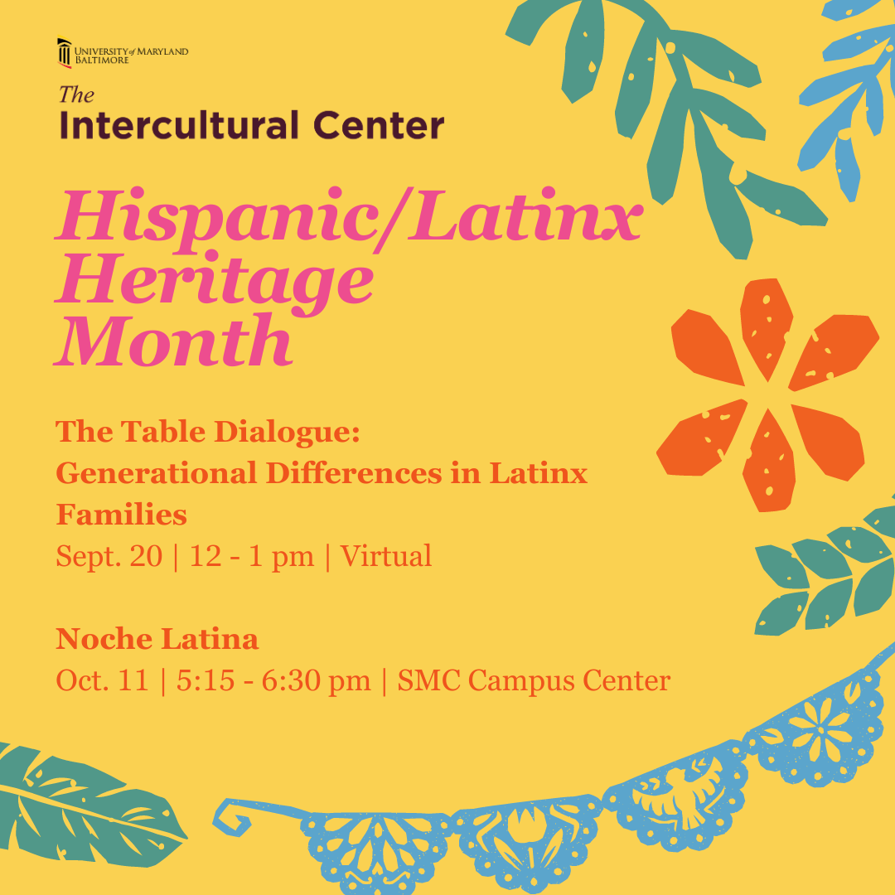
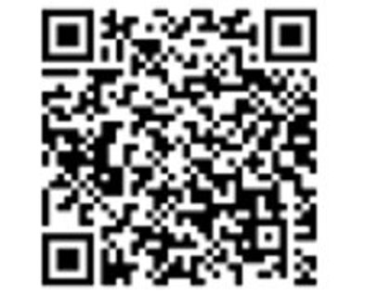
Food Justice & Urban Farming Initiatives in Baltimore City​
April 24| 12 – 1 PM | Zoom

Slide 8
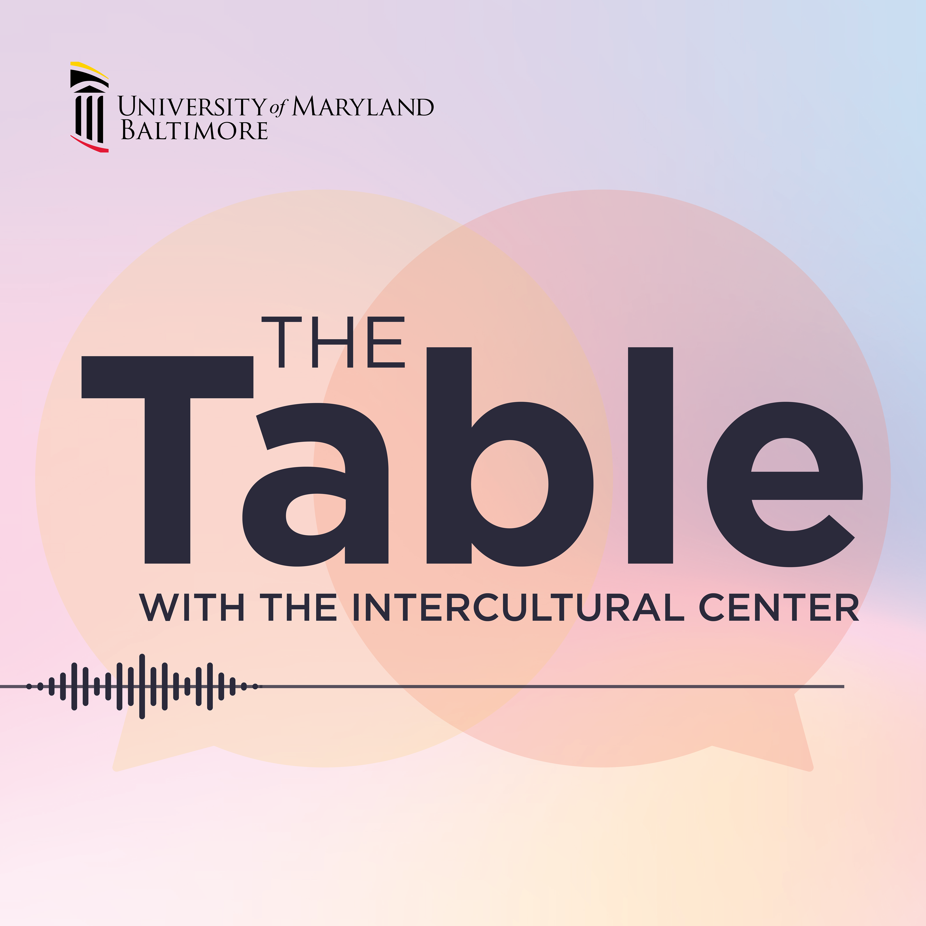
Listen in on our website and subscribe wherever you get your podcasts!
UMB The Table Podcast
The Table with the Intercultural Center at UMB is a podcast that unpacks questions regarding social identities and social issues. New episodes will be released every other month.
Listen in on our website and subscribe wherever you get your podcasts!

Slide 9
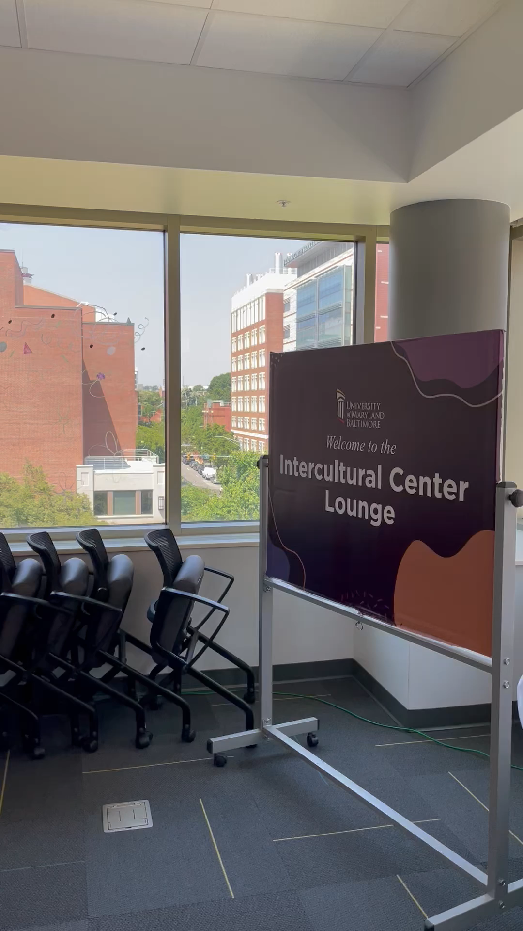
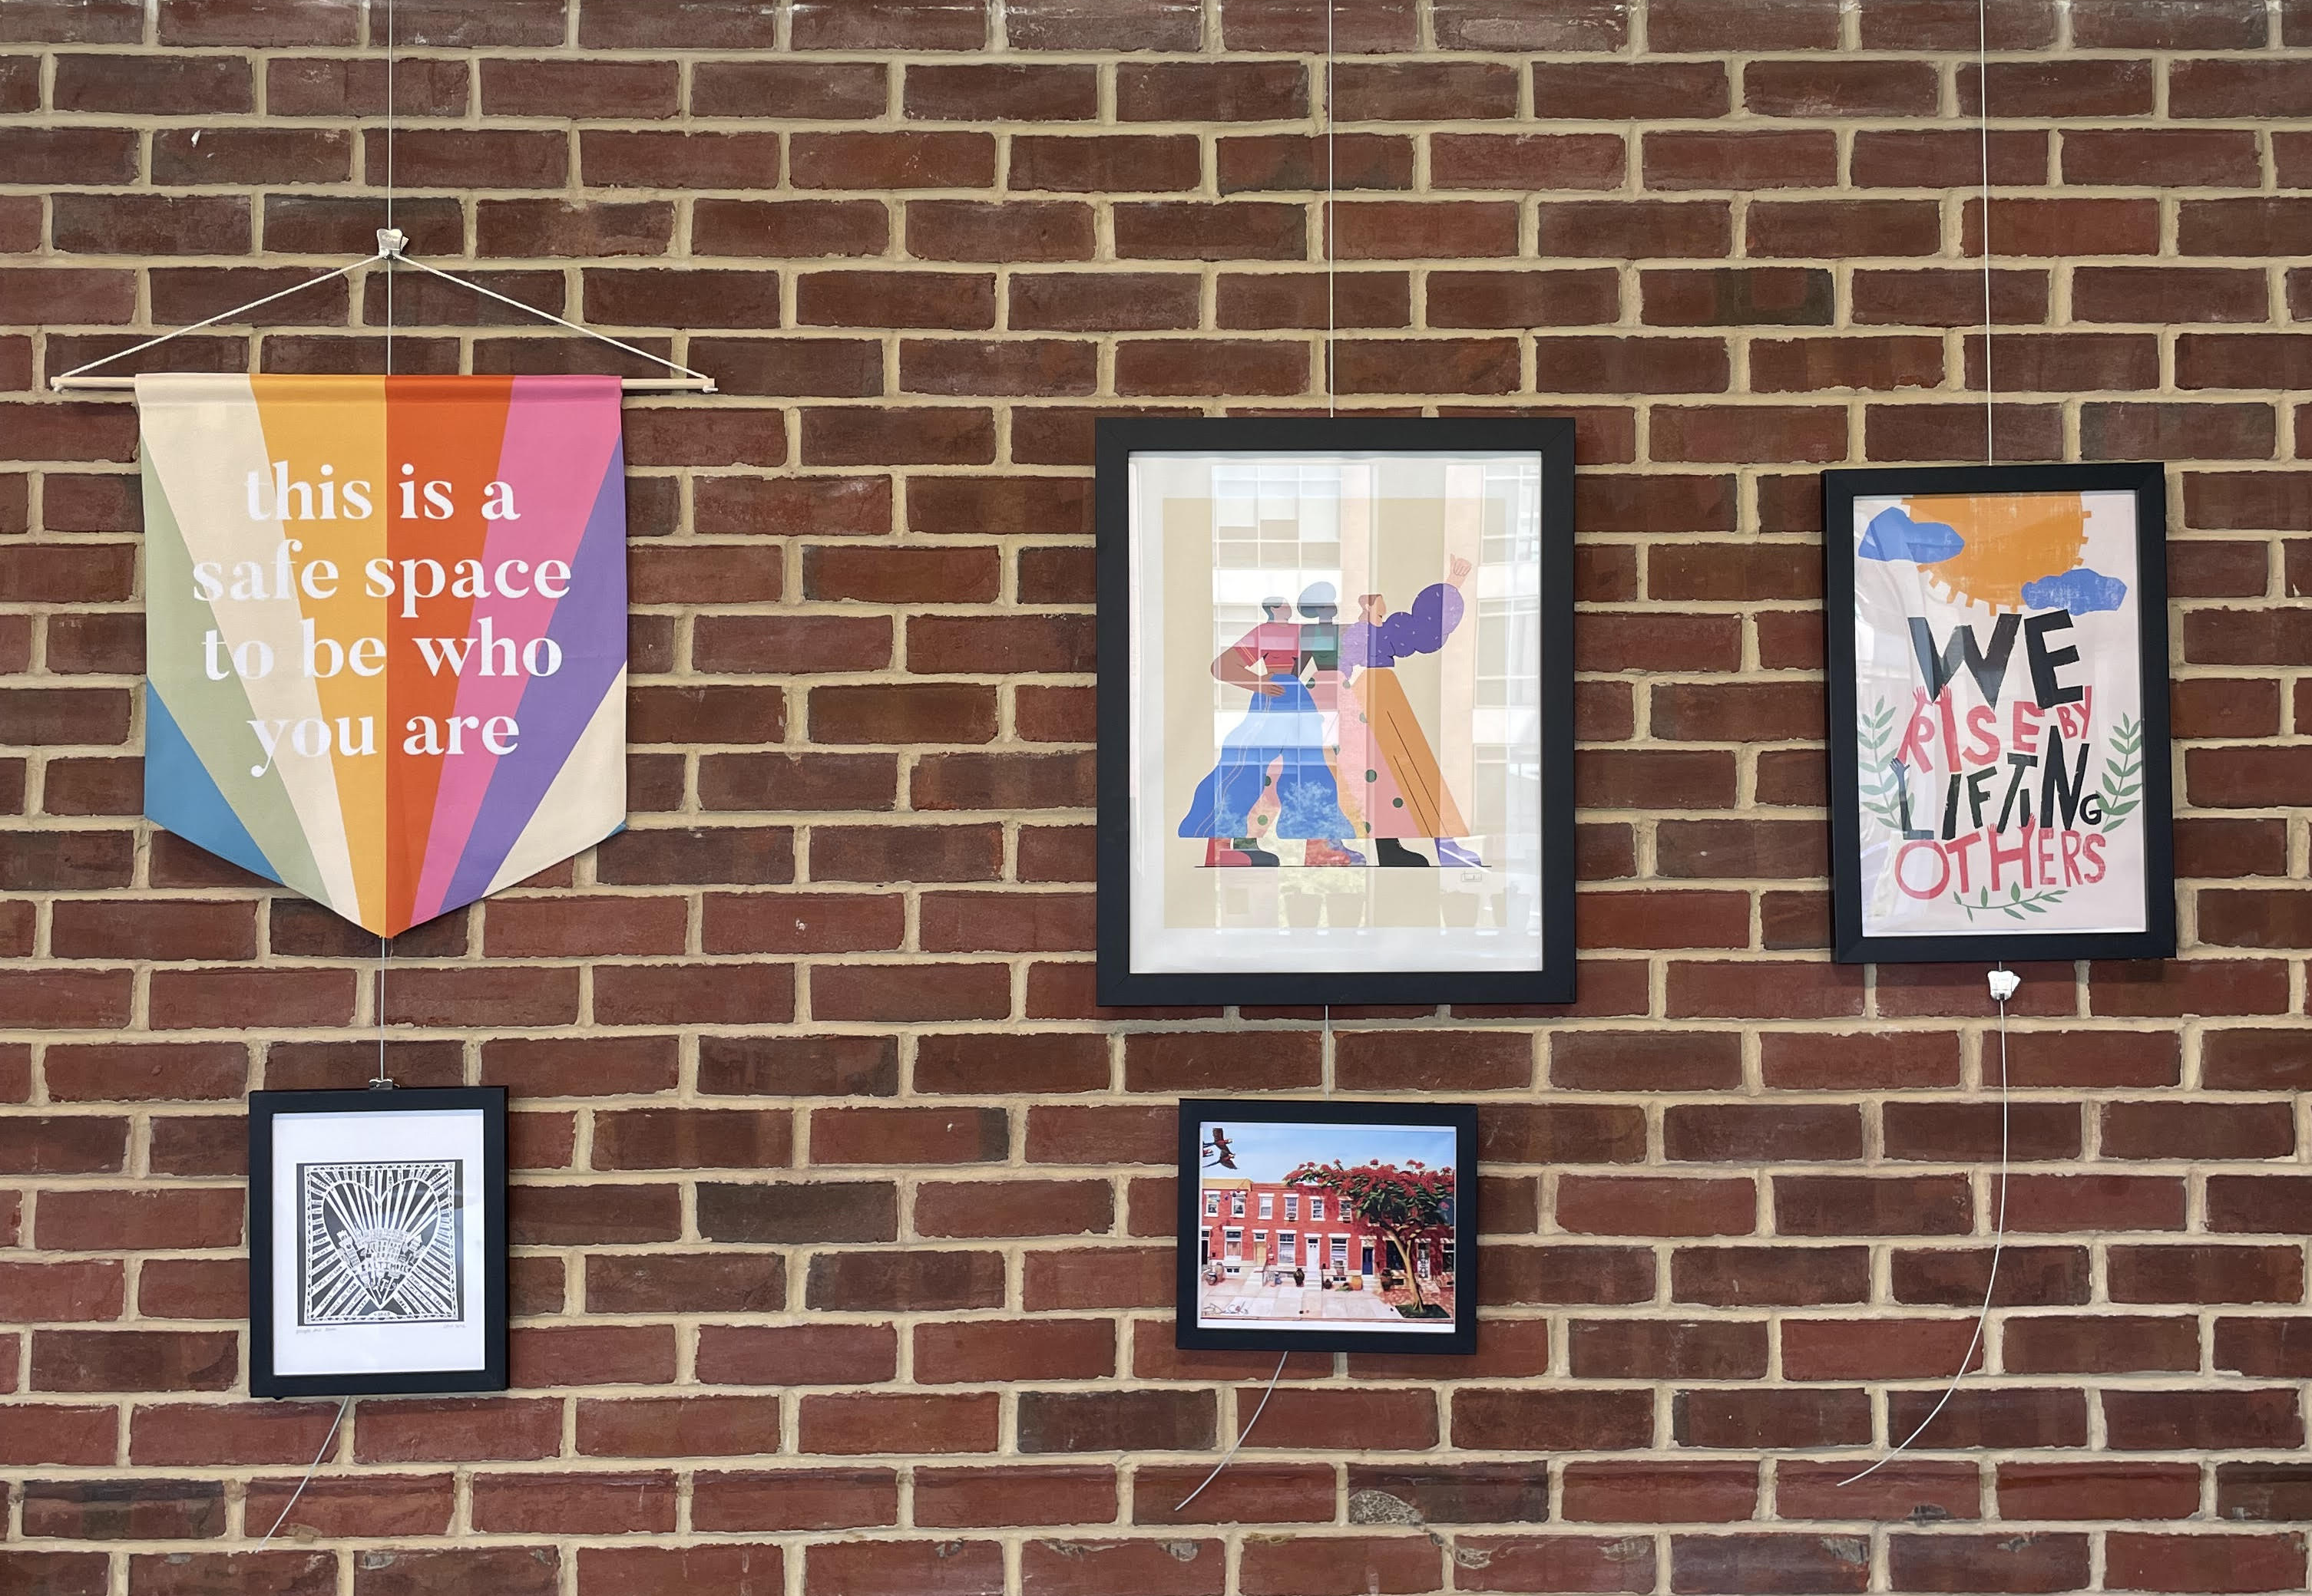
Listen in on our website and subscribe wherever you get your podcasts!
The Intercultural Center Lounge

Slide 10
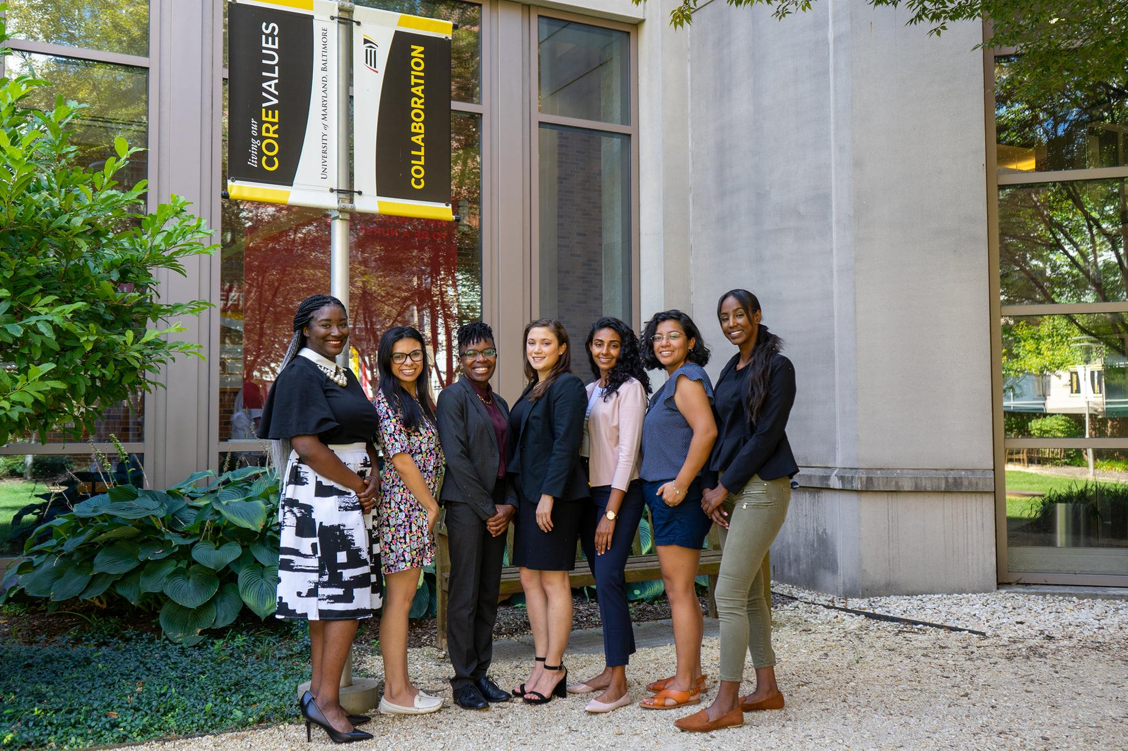
Student Leadership and Involvement
President's Student Leadership Institute (PSLI)
The President’s Student Leadership Institute (PSLI) is an interprofessional co-curricular certificate program designed to expose students to contemporary issues in leadership and professional development.
PSLI-Live: Hosted through live webinars, strengthen your leadership skills by attending events in the areas of Career Development, Effective Leadership, Integrative Health and Wellbeing, Scholarly Research and Writing, Inclusive Leadership, Entrepreneurship and Innovation, and Student Organizational Leadership.
PSLI-On Demand: Completed asynchronously and on your own time, PSLI-On Demand provides you with pre-recorded seminars to engage and strengthen your leadership and career development capabilities centered around the topic of diversity and inclusion.
President's Symposium and White Paper Project
An interprofessional initiative that engages faculty, staff, and students from all UMB schools and academic programs in a yearlong conversation on a topic that is of interest and importance to the University and its community.

Slide 11

2021 – 2022 University Student Government Association (USGA) E-Board​
​
Student Organizations and Governance
University Wide Student Organizations
University Student Government Association (USGA)
Chinese Student and Scholar Association (CSSA)
Indian Association
International Student Organization (ISO)
Jewish Student Association (JSA)
Muslim Student and Scholars Association (MSSA)
United Students of African Descent (USAD)
Queer Student Alliance

Slide 12
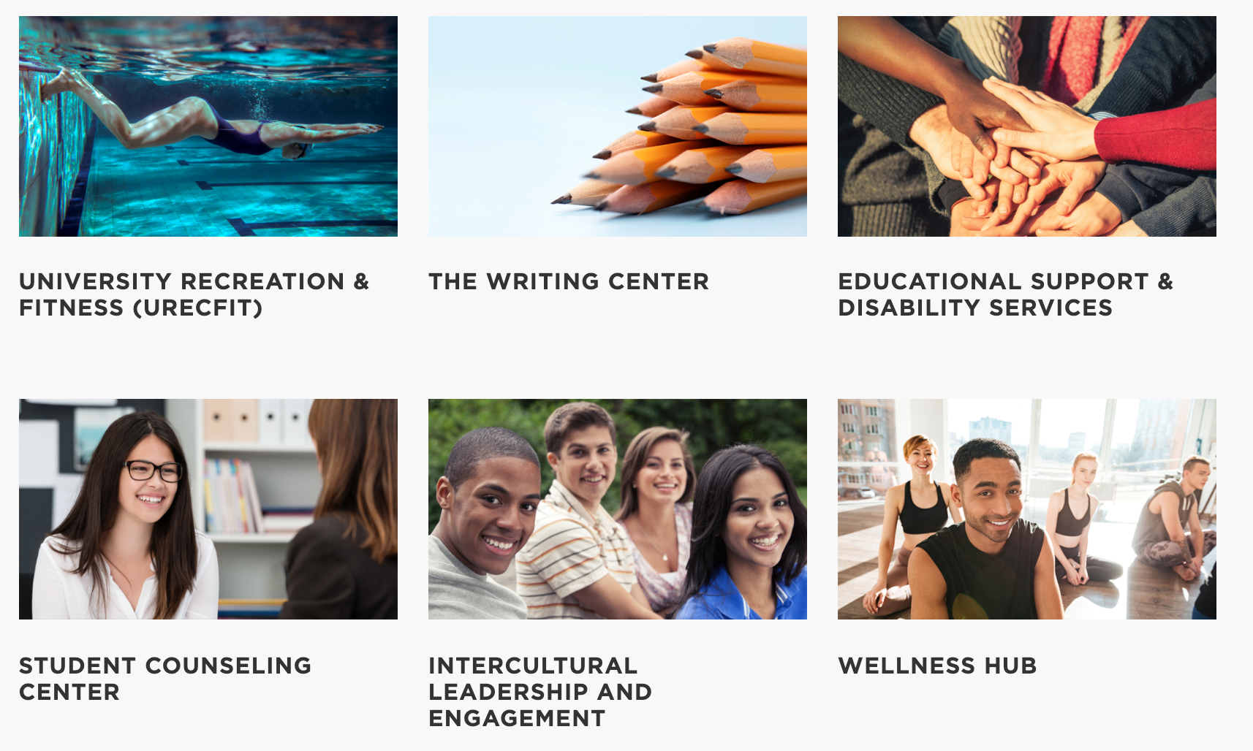
UMB Student Affairs Resources

Slide 13
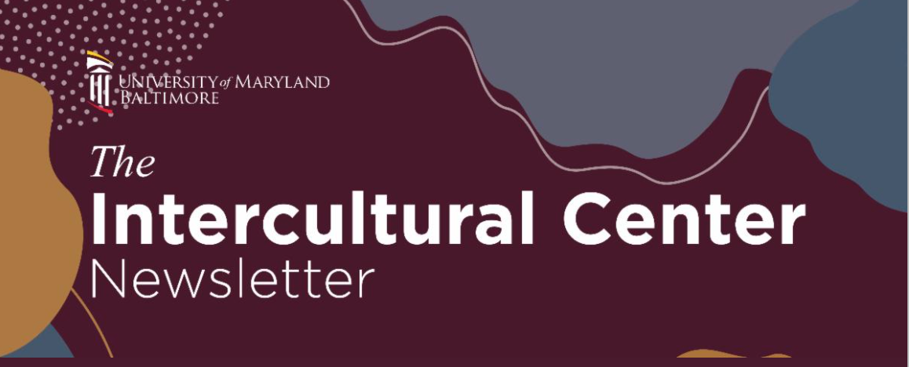
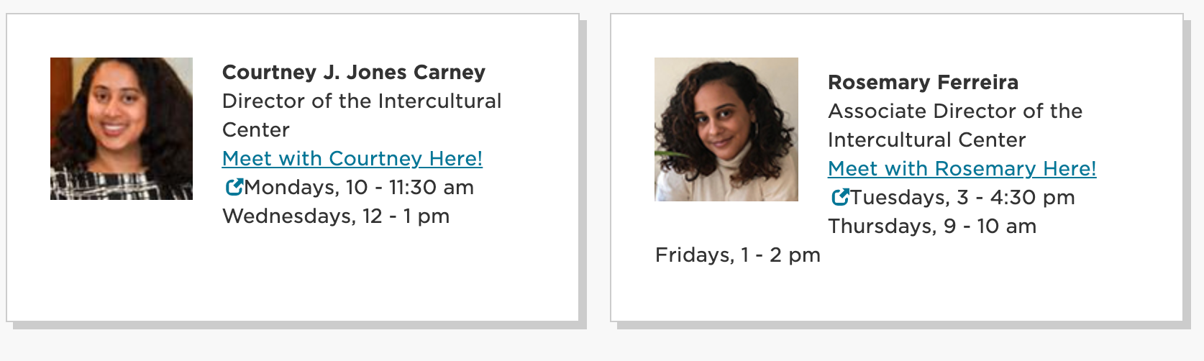
Attend Our Virtual Office Hours
Upcoming Events with the Intercultural Center
Stay Connected with the Intercultural Center & ILE
Sign Up for Our Newsletter
Use the QR code to learn more about the Center and our upcoming events!

Slide 14
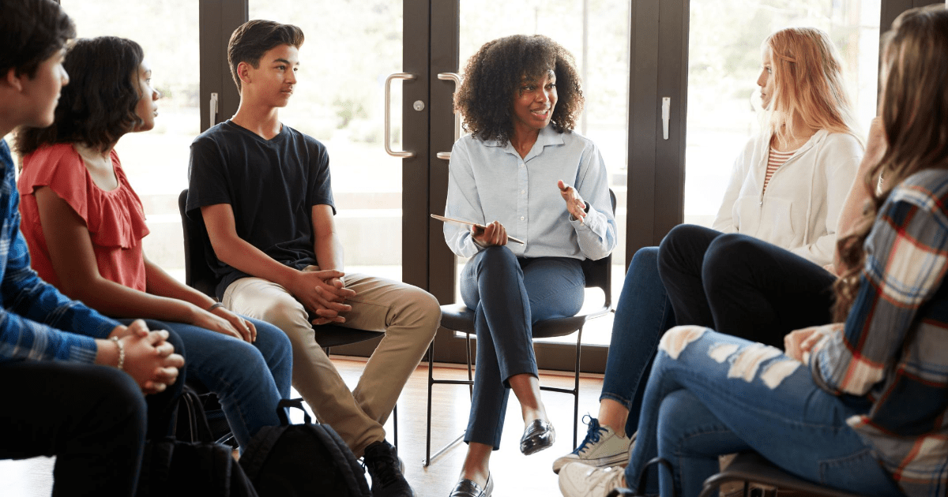
Critical Conversations Dialogue Program
The Critical Conversations Dialogue Program (CCDP) is a 4-week cohort-based program facilitated by 2 trained facilitators.
This fall we will have a dialogue on the topic of race and racism and in the spring, there will be a dialogue on gender and sexuality. Each dialogue is 2 hours long for 4 weeks. There is a student dialogue and a staff/faculty dialogue. Both are capped at 15 participants.
Learn more about CCDP on our website!

Slide 15

What have you heard about Baltimore?

Slide 16

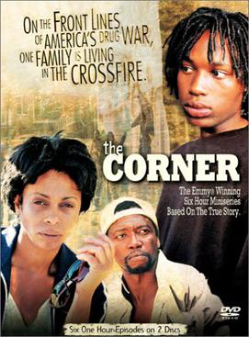

Whose Narrative?

Slide 17

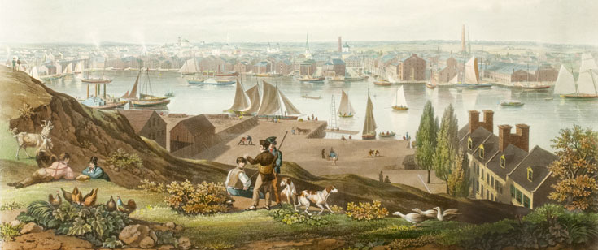


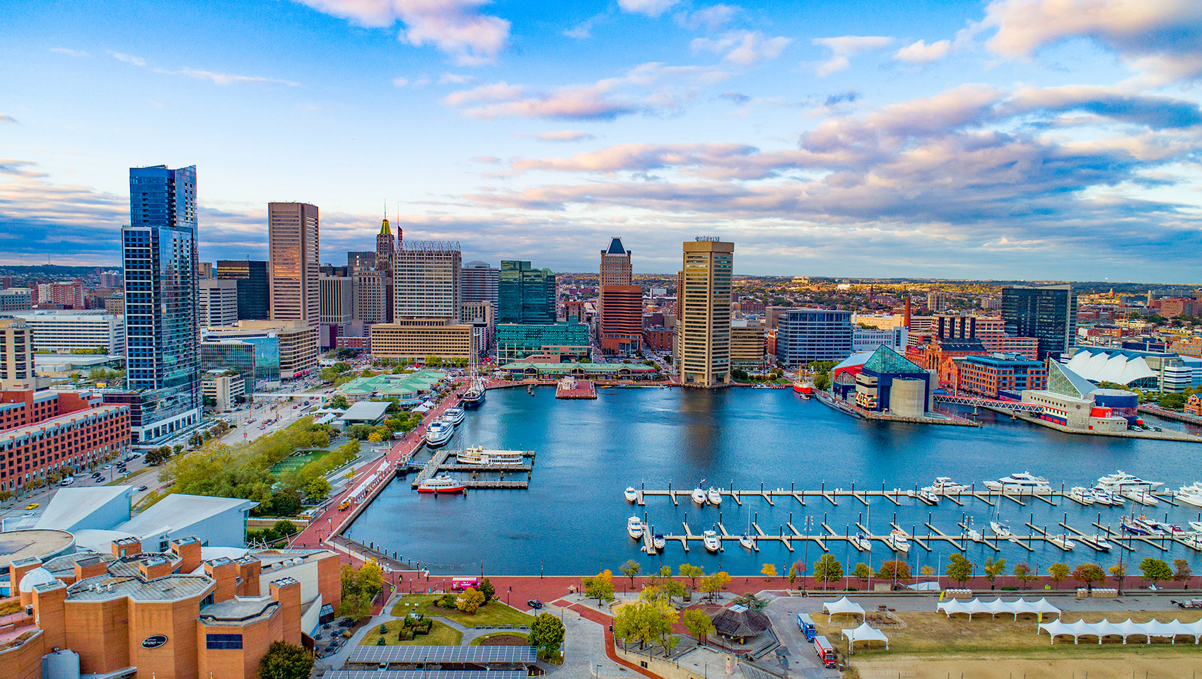

Historical Overview
Whose Land Are We On? Colonialism and Enslavement
Building While Black: The Civil War and Black Reconstruction
Black "Invasion" and White Flight
From a Rust Belt City to Charm City

Slide 18
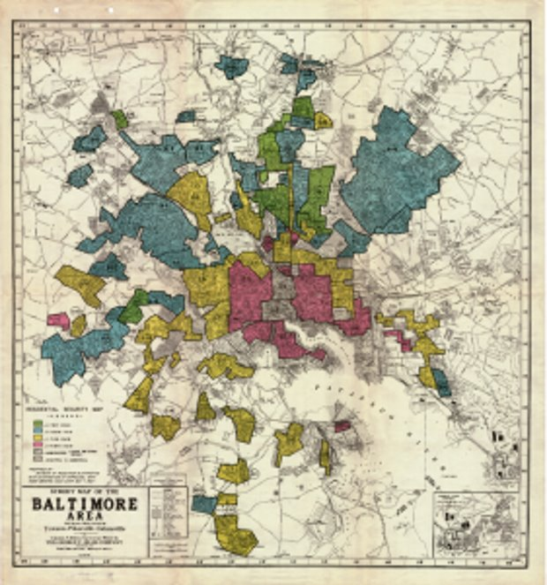
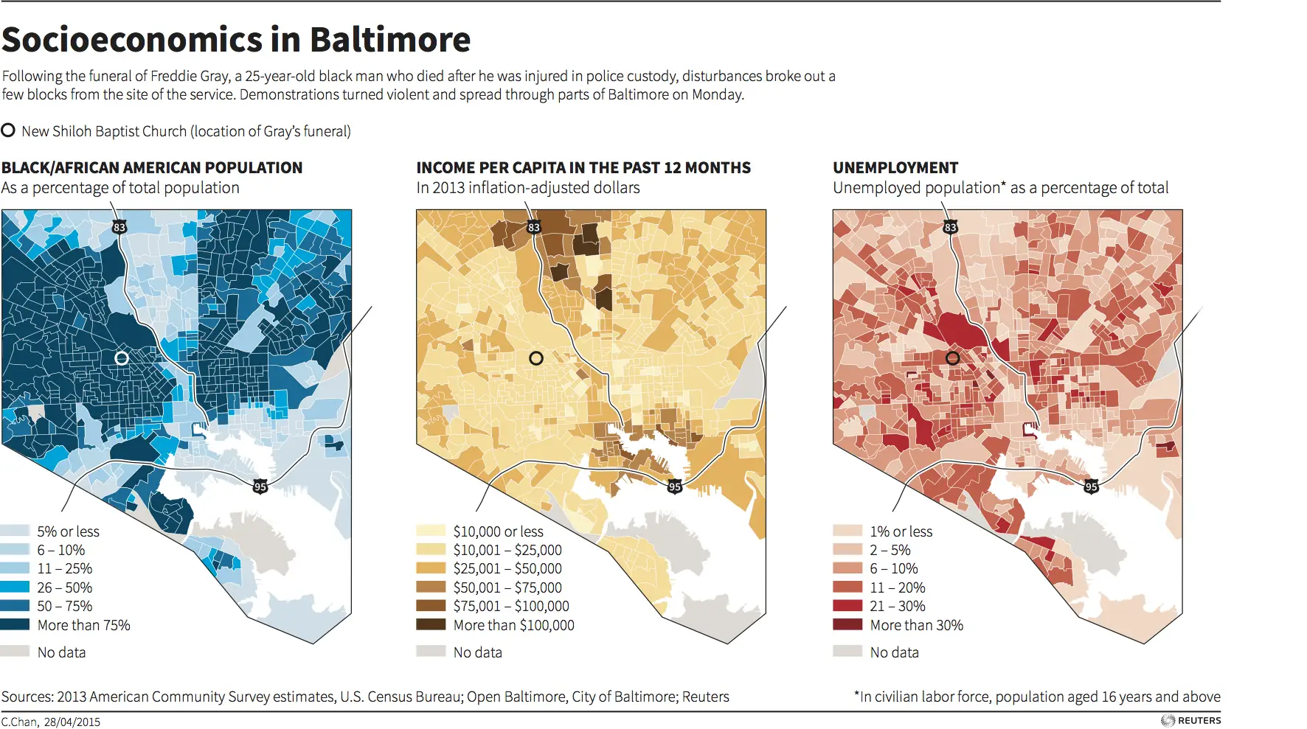
THE LEGACY OF REDLINING

Slide 19
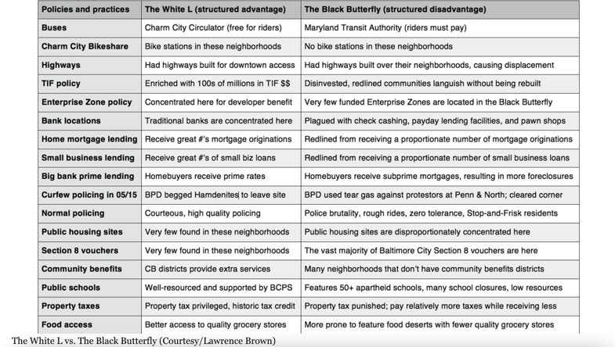
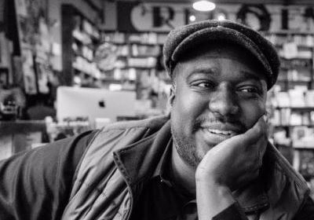
THE WHITE L & THE BLACK BUTTERFLY
Dr. Lawrence Brown

Slide 20
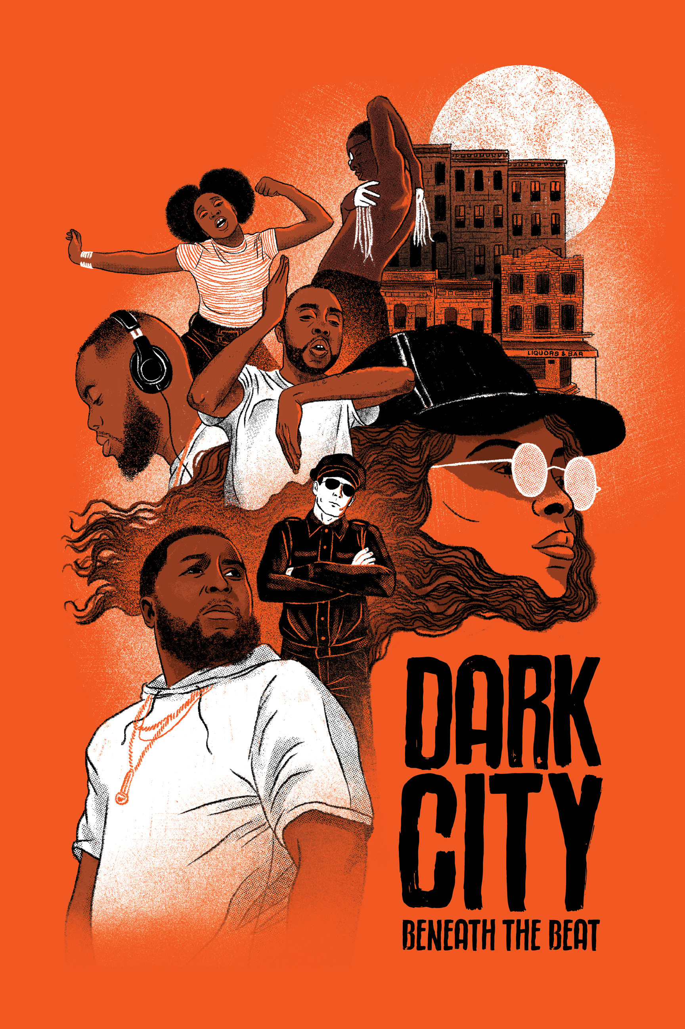
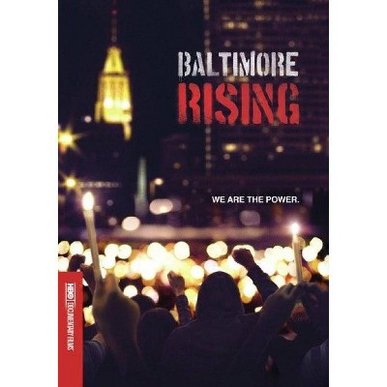



Continued Learning
Documentaries
Books
Podcast

