Slide 1
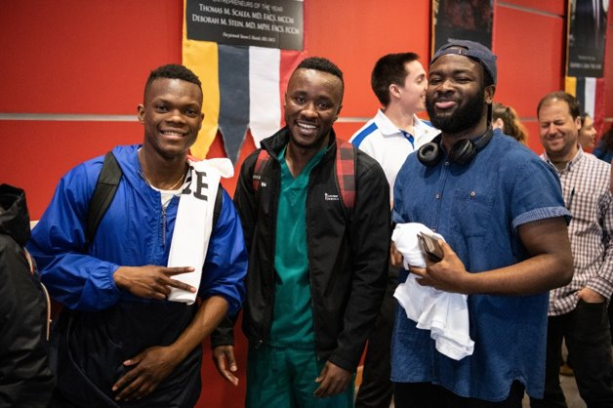





UMB STUDENT AFFAIRS
Notes:
We are so excited to welcome you to the University of Maryland, Baltimore. In this short presentation, we would like to tell you a bit about who we are and what we do. We’d also like to share with you University resources, as well as opportunities available through UMB Student Affairs.

Slide 2

UMB Student Affairs
Office of Student Affairs
Notes:
Main difference between us and your school's Office of Student Affairs: University-wide, work with and for all students, regardless of school and program.

Slide 3
DEPARTMENTS AND UNITS
Office of the Chief Student Affairs Officer
Student Communications
Health and Wellbeing
Student Counseling Center
URecFit and Wellness
Belonging and Inclusion
Educational Support & Disability Services
International Services
Intercultural Center
UMB Housing
SMC Campus Center
Event Services
Facility Operations
One Card Office
Food Service
Student Leadership and Development
Intercultural Leadership & Engagement
Student Organizations
Writing Center
UMB Student Affairs: umaryland.edu/umb-student-affairs/
Notes:
We are committed to providing interprofessional support, services, leadership development, programming, and recreational opportunities to all UMB students. We do this through To stay up to date, you can visit our website at umaryland.edu/umb-student-affairs/.

Slide 4
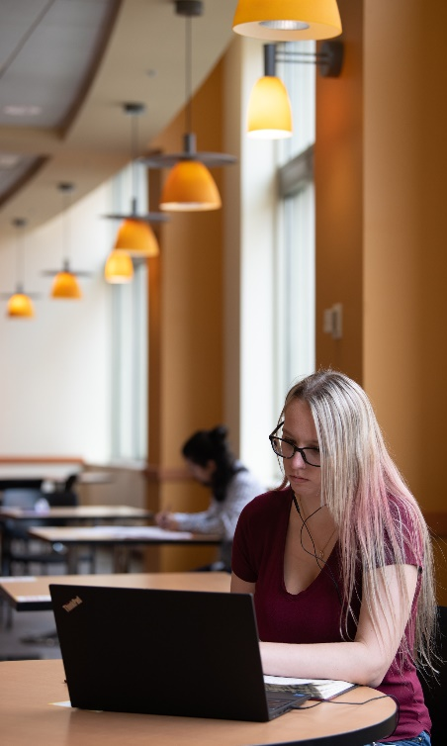
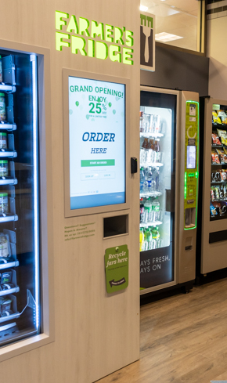
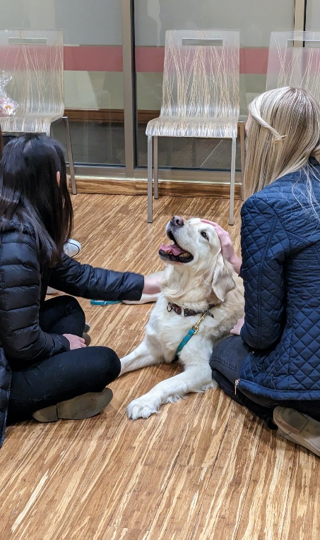
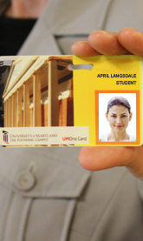
SMC CAMPUS CENTER
621 W. Lombard St. | Between HS/HSL and School of Nursing
Meet Up & Study
Dining ​
Meetings & Events
Get Your One Card
Campus Center: umaryland.edu/campuscenter/
Notes:
The SMC Campus Center. It’s that building on the slide, and is located at 621 West Lombard Street, between the Health Sciences and Human Services Library (HS/HSL) and the School of Nursing. Outside of your school, this is where EVERYTHING else happens on campus. And where all of the departments in UMB Student Affairs are housed, including the OneCard office, which provides the official ID card for students, faculty, and staff. If you don’t have one, check with your school for more information on how to obtain your ID.
The SMC Campus center also houses the Market at UMB, which offers Starbucks coffee, grab and go and other food options.

Slide 5
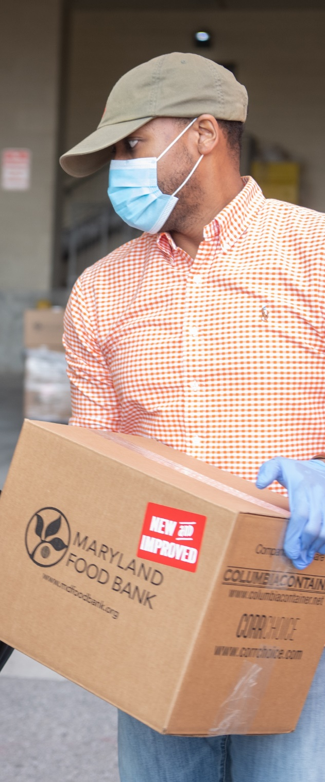
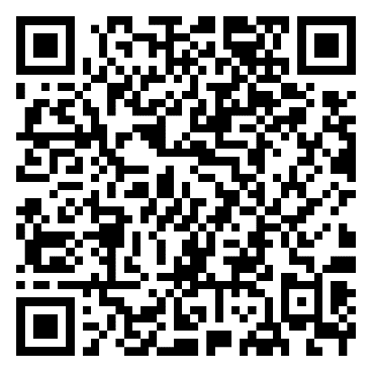
UMB STUDENT PANTRY
Available to all UMB students
Non-perishable food items, kosher items, and hygiene items
Online request form (no request limit)
Pick-up lockers in the SMC Campus Center
Pop-up pantry events
UMB Student Pantry:
umaryland.edu/pantry
Notes:
UMB Student Pantry helps support students by providing access to free non-perishable food and hygiene items. The pantry is locked in the UMB Student Affairs suite, which is located on the third floor of the SMC Campus Center. We do ask that if you have access to internet, to please use their online form to request items. You can find that form on their website. Requested items will be available for pick-up either within the Student Affairs suite, or if you prefer no contact, you can pick them up on the first floor of the SMC Campus Center.

Slide 6
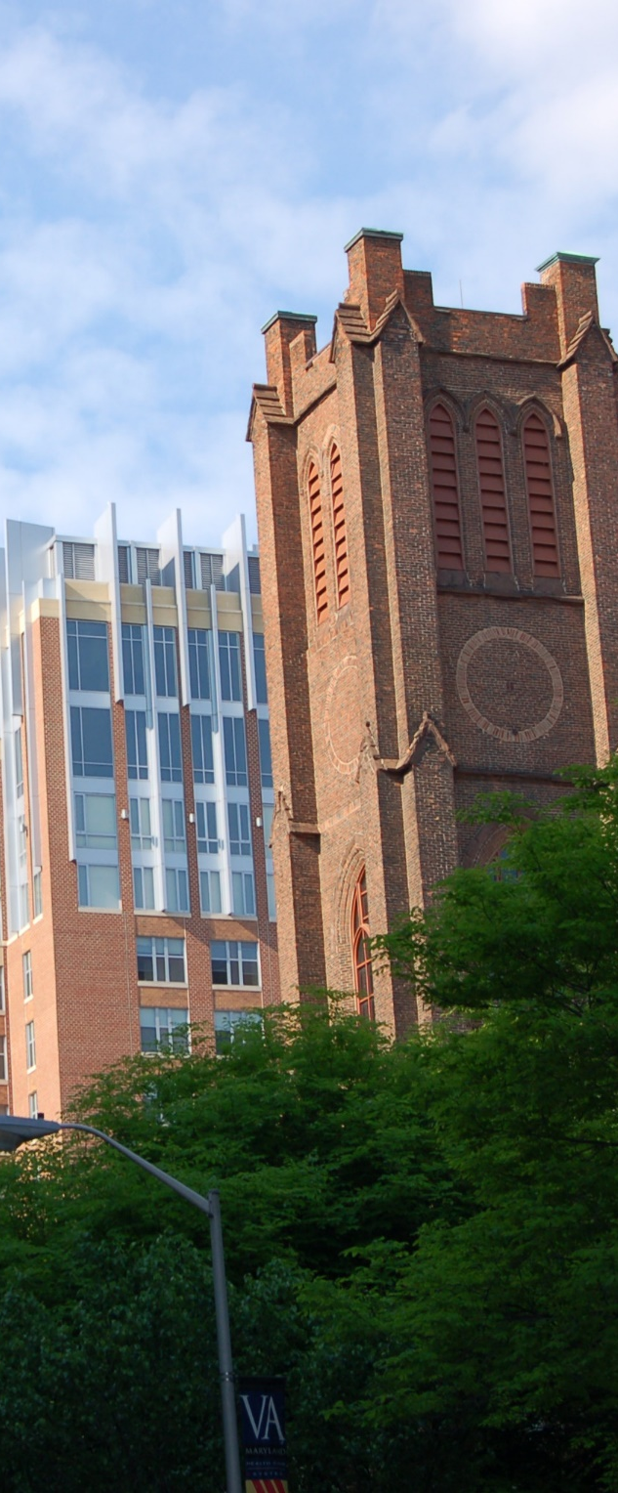
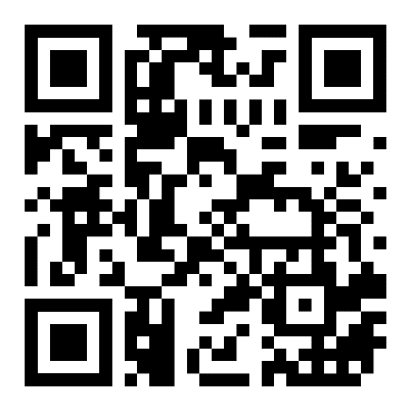
UMB HOUSING
Scholarships & Incentives Available
No Deposit/Application Fee
24/7 Staff/Security Office
Fully Furnished
Utilities Included
In UMB Safe Ride Safe Walk Radius
Priority Parking
Pets Welcome
UMB Housing: umaryland.edu/housing/
Notes:
If you need a place to live UMB provides on-campus housing through UMB Housing. This is not like undergraduate housing. The rooms are all apartment-style and there are no RA’s, curfews, or anything like that. Contact them to learn about any incentives currently available! Visit their website for more information at umaryland.edu/housing/.

Slide 7




ADVISORY BOARDS
Collaboration to Improve the Student Experience
Student Advisory
Board
Student Affairs Deans
Student Fee Advisory Board
SHIP Advisory Committee
Notes:
As mentioned before, we collaborate with students, faculty, and staff across the University to continually improve the student experience. One of those ways is through advisory boards.

Slide 8

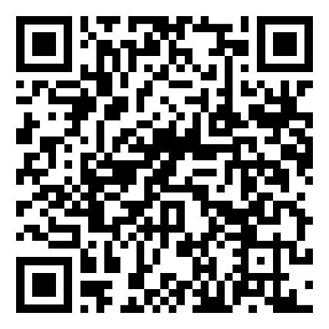
HEALTH & ACCIDENT INSURANCE
UMB Student Health Insurance Plan (SHIP)
  Mandatory for full-time students
  Fall Coverage: August 1 - January 31
  Supplemental June & July Coverage
  Enroll or waive by September 15 for 2023-2024 (must enroll or waive annually)
Student Accident Insurance
Student Health Insurance:
umaryland.edu/studentinsurance
Notes:
New UMB students who are enrolled in a program that has a start date in June or July can enroll in supplemental SHIP coverage, since Fall coverage is effective August 1st.

Slide 9

OFFICE OF ACCOUNTABILITY & COMPLIANCE (OAC): EDUCATION & EQUAL ACCESS TEAM
Receive & investigate complaints
Provide recommendations
Implement mandatory Title IX training
Conduct other training & educational experience
UMB Hotline: umaryland.edu/umbhotline
OAC: umaryland.edu/oac/

Slide 10

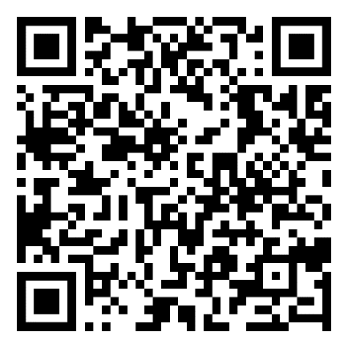
REQUIRED TRAININGS
Title IX Training
  All students, including visitors
  Completed annually
Prescription Drug Prevention Training
  All first-time full-time students
  Complete once
Required Trainings:
umaryland.edu/umb-student-affairs/required-trainings

Slide 11
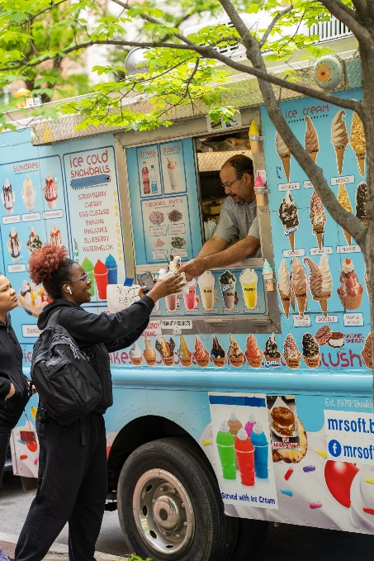
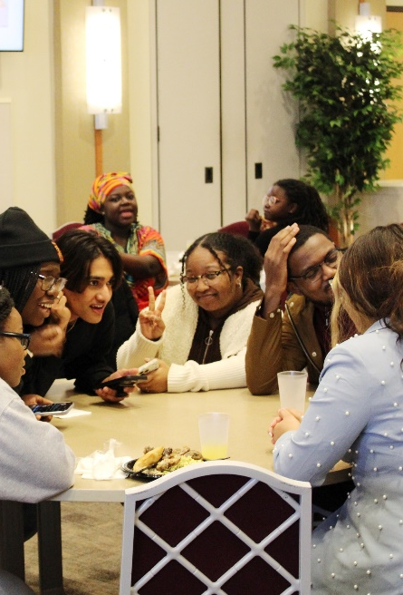
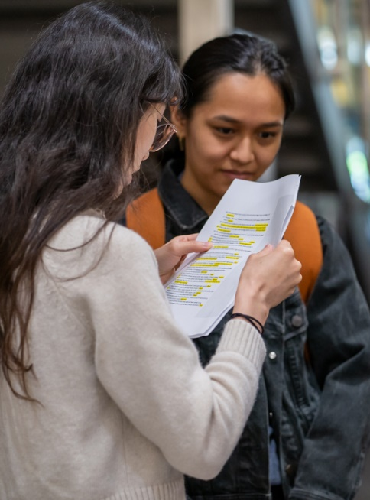

GET INVOLVED
Get the Most from Your University Experience
University Student Government Association
United Students of
African Descent
International
Student
Organization
Scholars for Recovery
Student Groups: umaryland.edu/university-life/student-organizations/

Slide 12




WORK WITH US
FWS and Non-FWS Jobs Available
Social Media Assistants
URecFit & Wellness
Mental Health Ambassador/
Research Assistant
Peer Writing Consultants
Student Employment Opportunities:
umaryland.edu/umb-student-affairs/campus-life-employment-opportunities/
Notes:
We’ve mentioned this place a few times during the presentation, and some of you may wondering what is the SMC Campus Center. It’s that building on the slide, and is located at 621 West Lombard Street, between the Health Sciences and Human Services Library (HS/HSL) and the School of Nursing. Outside of your school, this is where EVERYTHING else happens on campus. And where all of the departments in UMB Student Affairs are housed, including the OneCard office, which provides the official ID card for students, faculty, and staff. If you don’t have one, check with your school for more information on how to obtain your ID.
The SMC Campus center also houses the Market at UMB, which offers Starbucks coffee, grab and go and other food options.

Slide 13
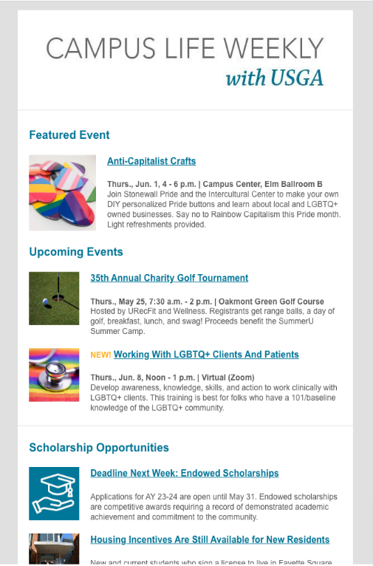
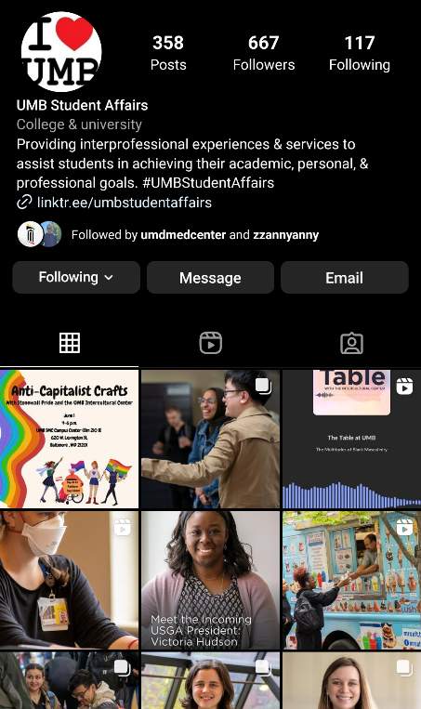
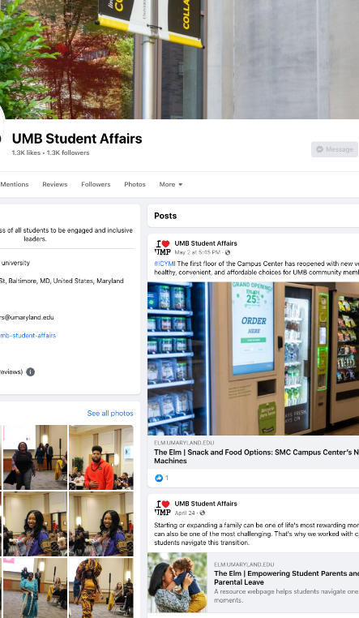
STAY IN THE KNOW
E-mail Updates & Social Media
Campus Life Weekly
Instagram:
@umbcampuslife
Facebook
@campuslifeum

Slide 14
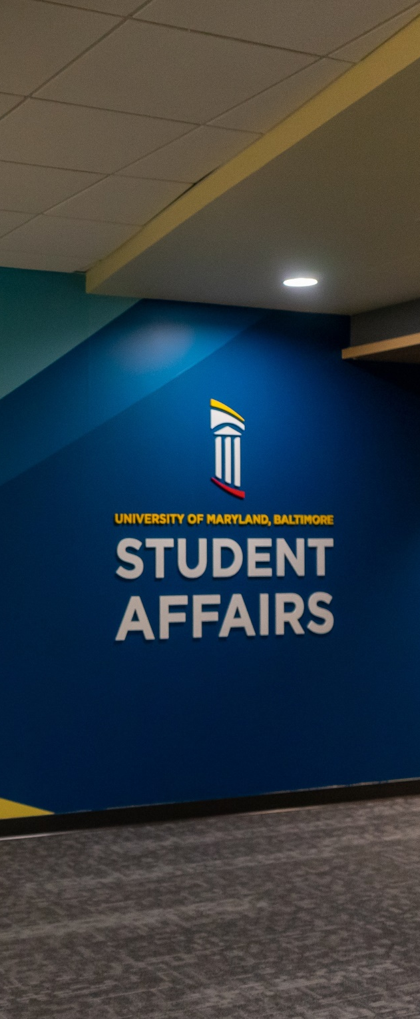
CONTACT US
UMB Student Affairs: umaryland.edu/umb-student-affairs/
umbstudentaffairs@umaryland.edu
410-706-5433

