Slide 1
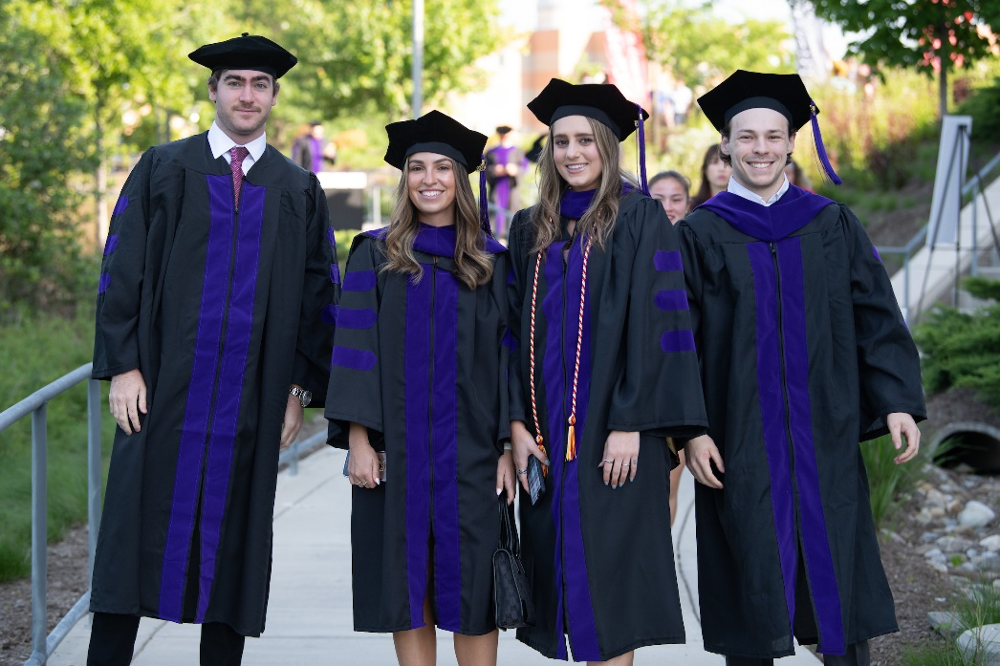
Preparing for Graduation
Notes:
Erin’s Introduction:

Slide 2
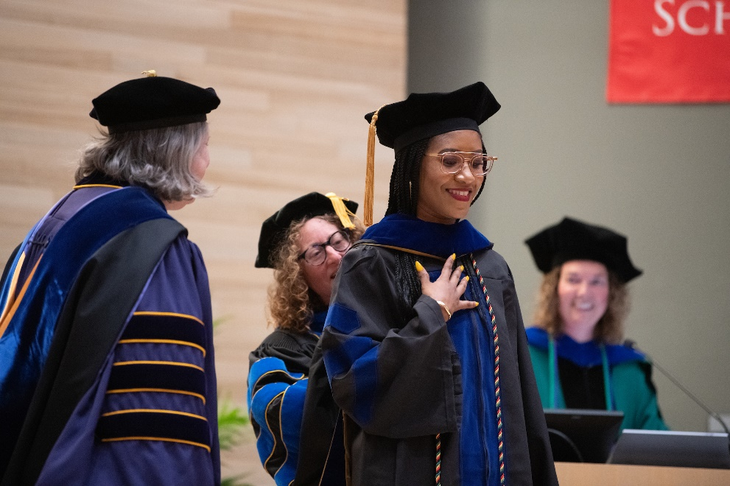

Preparing for Graduation
Notes:
Erin’s Introduction:

Slide 3
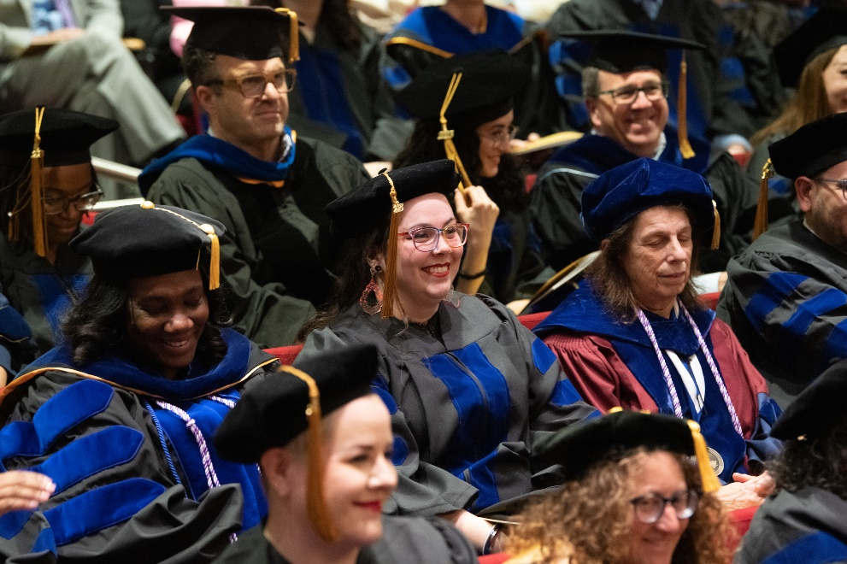

Preparing for Graduation
Notes:
Erin’s Introduction:

Slide 4
Preparing for Graduation
Erin Golembewski, PhD
Vice Dean, Graduate School
Colleen Knapp
Associate Director, Records and Registration
Davonte Johnson and Jennifer Cantrell
Records and Registration
Notes:
Erin’s Introduction:

Slide 5


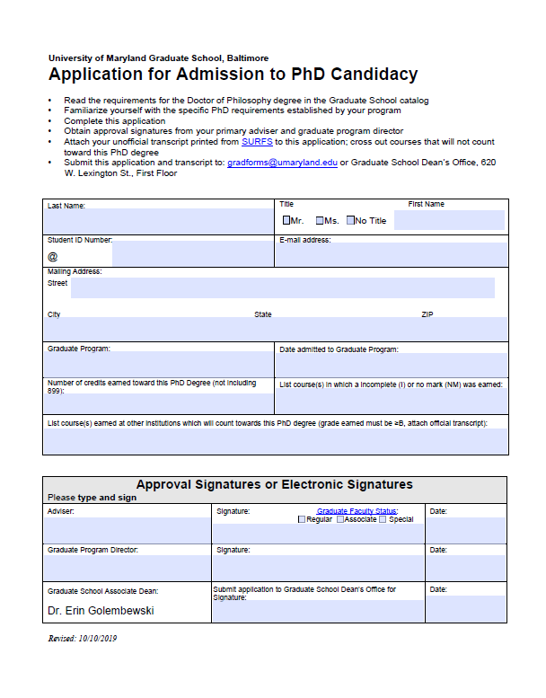
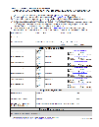
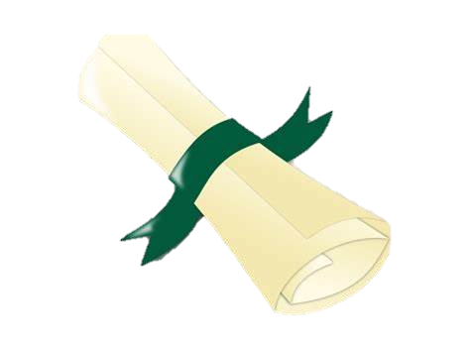

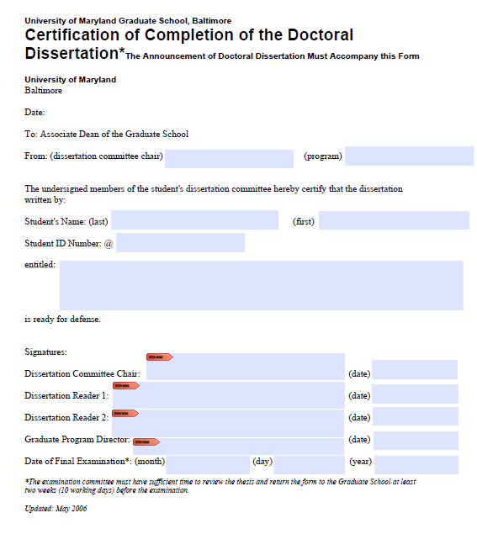


Timeline to Defense
1Y Prior
2 / 6MO Prior
6MO Prior
February
2WK Prior
Admission to Candidacy
Nomination of Committee
Register for Courses
Fulfillment of Course Requirements (Feb 3), SURFS diploma application (Feb 13)
Announcement of Defense
Certification of completion of the Dissertation/Thesis
Notes:
Colleen:
Let’s start with an overview of the timeline to defense.
First, Admission to Candidacy must be achieved at least two semesters before you defend your dissertation.
Next, Nomination of committee form. Committee members must be approved by the Graduate School at least 6 months before you defend your doctoral dissertation or 2 months before you are defending your master’s thesis. For the PHD students planning to graduate in Spring 2026, at this point, these two steps should already be complete.
Next, Registration for classes for Spring is in progress. If you haven’t registered, please do so asap. This step should hopefully also already be complete.
February-The Fulfillment of Course Requirements form is due February 3rd to gradforms@umaryland.edu.
You must submit a diploma application through SURFS once you are registered for courses the semester you will be graduating. The deadline is February 13, 2026 for SURFS.
Finally, 2 weeks prior to your defense-The Announcement of Defense (electronic form) and Certification of Completion are submitted to the Graduate School at least two weeks before your defense.
It is your responsibility to complete all of these steps before graduation.

Slide 6
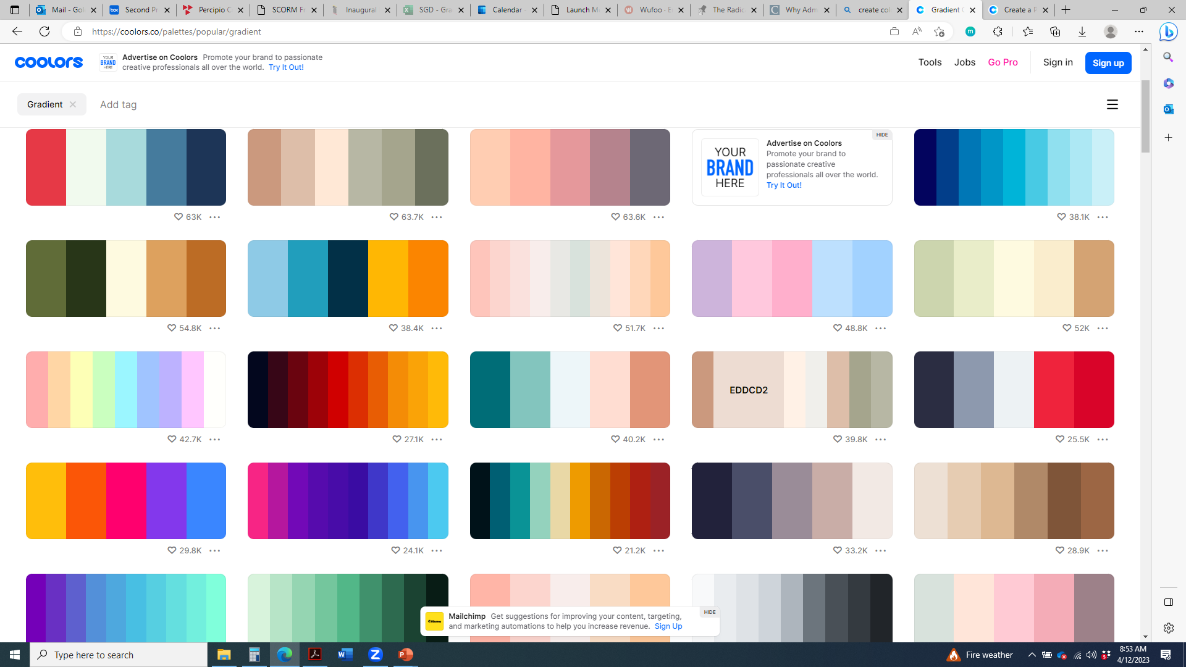
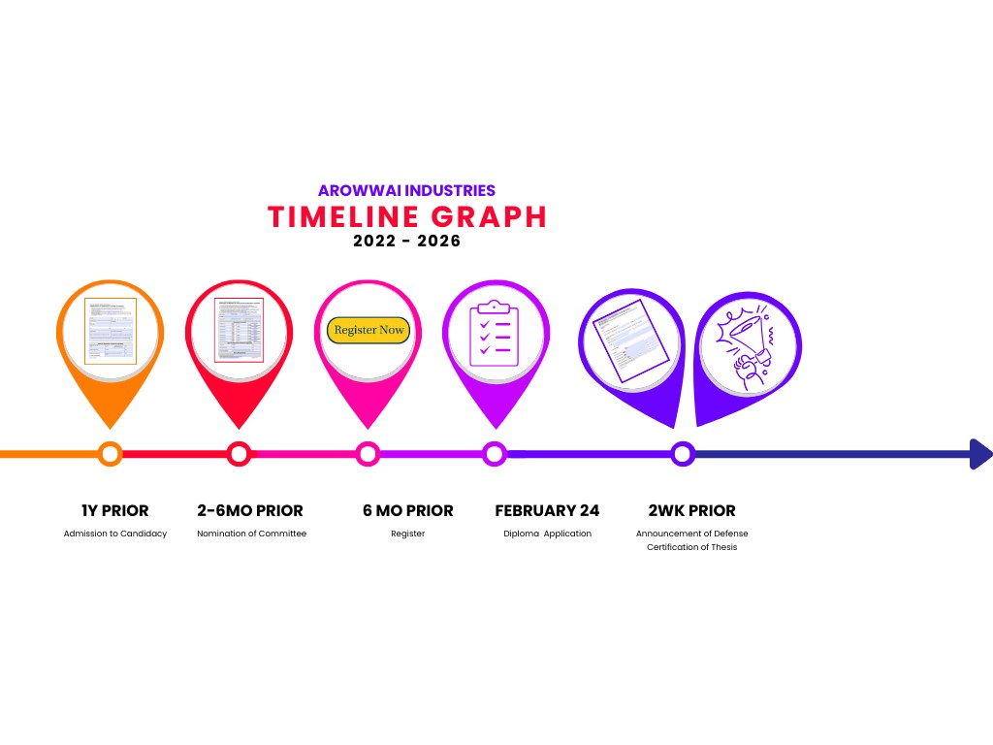
Admission to Candidacy
Graduation Timeline
2-6 Mo Prior
6 Mo Prior
February 24
2WK Prior
Nomination of Committee
Register for Courses
Diploma Application
Announcement of Defense
Certification of Thesis
1Y Prior
Admission to Candidacy
Notes:
- Now we will look at each section of the timeline in detail, beginning with the Admission to Candidacy form. As I mentioned, Admission to Candidacy must be achieved at least two semesters before you defend your dissertation.

Slide 7
Timeline to Defense
1Y Prior
2 / 6MO Prior
6MO Prior
February
2WK Prior
Admission to Candidacy
Nomination of Committee
Register for Courses
Fulfillment of Course Requirements (Feb 3), SURFS diploma application (Feb 13)
Announcement of Defense
Certification of completion of the Dissertation/Thesis
Notes:
Nomination of Committee

Slide 8
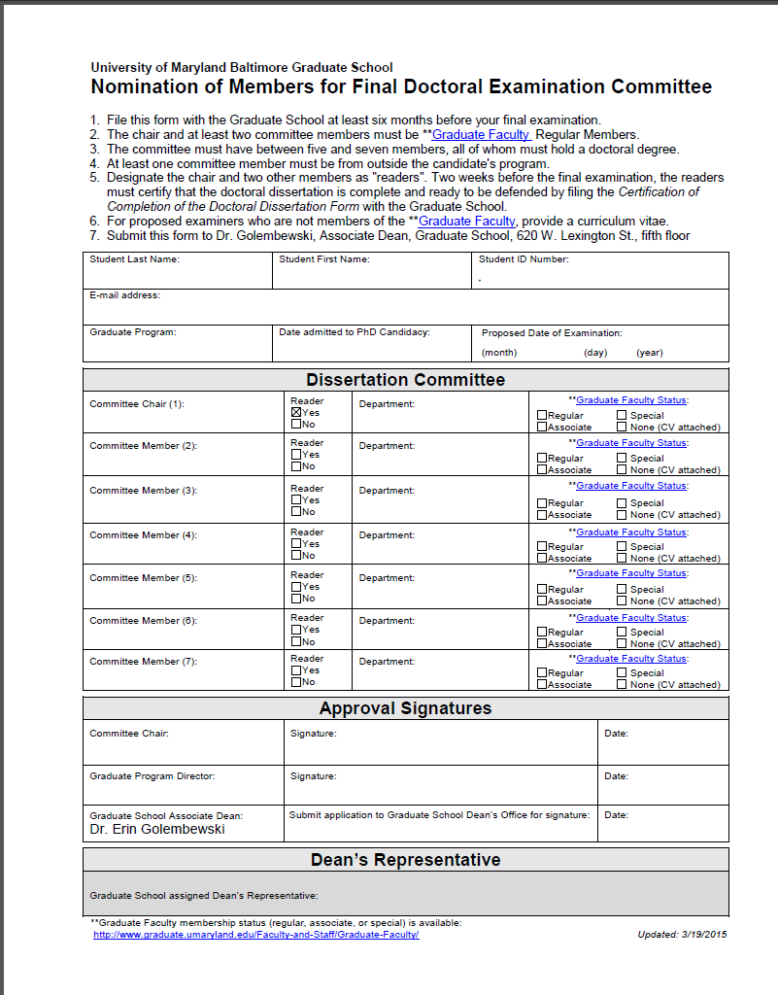
Nomination of Committee
Graduation Timeline
6MO Prior
February 24
2WK Prior
1Y Prior
February 24
2WK Prior
Admission to Candidacy
Register for Courses
Diploma Application
Announcement of Defense
Certification of Thesis
2 (MS) / 6MO (Phd) Prior
Nomination of Committee
Notes:
This form is used to identify faculty members who will serve on your committee.
Doctoral candidates must file the form at least 6 months before the defense date, MS students, 2 months.
- A dissertation committee must have between five and seven members, with 3 being Regular members of the Graduate Faculty, and one member who is external to the student’s program.
Your mentor should be able to recommend committee members.
How do you decide on the number of members? There are a number of academic and logistical considerations:
- If you have many committee members and one cannot attend, you may be able to defend as scheduled without replacing that member.
-On the other hand, the more members you have, the harder it is to schedule meetings and a defense.
In addition to an appointment in the School of Medicine, Social Work, Nursing, Pharmacy, or Dentistry, faculty must have a separate appointment in the Graduate School. We also recognize Graduate faculty from UMBC, and in most cases, College Park.
There are two faculty statuses: “Regular” and “Associate.” The biggest difference is that Regular members can mentor PhD students and serve on committees and Associate members can only serve on committees.
If your outside committee member is not a UMB/UMBC Graduate Faculty member, you must submit his/her CV with the Nomination form. Most outside committee members should be faculty members at other institutions or senior level scientists and scholars in academia and industry. Postdocs may not serve on committees.
On this form, you will also designate your chair and two other committee members to read your thesis. The ‘readers’ are the members who will certify that your thesis is ready to defend at least two weeks before your defense date. You should choose members who will be able to read the entire thesis beforehand, (probably those who may recommend the most changes) and who will be available to sign the form.
The School of Graduate Studies will review the form and appoint one of your members to be the “Dean’s Representative” to oversee your defense. That member will be notified by Records & Registration.
Lastly, the defense date you propose on this form is an approximation. If it changes, there is no need to inform us at this time. Just be sure to submit remaining forms on time.
Again, this step should already be complete for PhD students graduating in the Spring semester.

Slide 9
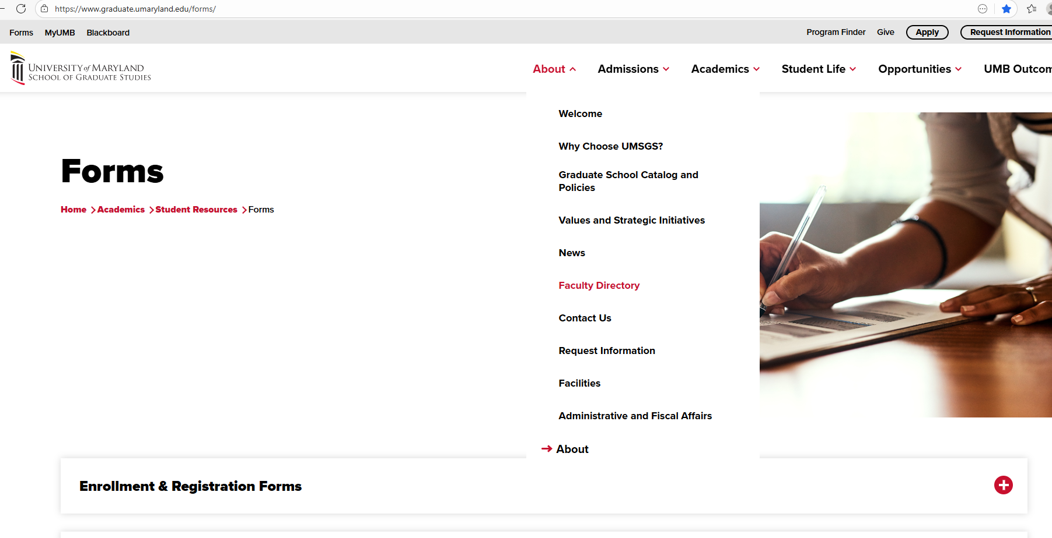
Graduate School Forms Page
Notes:
There is a list Graduate Faculty members on our website in order to be able to determine who is regular and who is associate level for the nomination of committee form.

Slide 10
Timeline to Defense
1Y Prior
2 / 6MO Prior
6MO Prior
February
2WK Prior
Admission to Candidacy
Nomination of Committee
Register for Courses
Fulfillment of Course Requirements (Feb 3), SURFS diploma application (Feb 13)
Announcement of Defense
Certification of completion of the Dissertation/Thesis
Notes:
Register for Courses

Slide 11
Registration and SURFS graduation preparations
-Review Transcript for No Marks and Incompletes
-Inter-Institutional Credit
-Transfer Credit
-Student billing
-Confidentiality Settings
Register for Courses
ABGA 7 credits
799 2-6 credits or
899 2-12 credits
1Y Prior
2-6 Mo Prior
February 24
2WK Prior
Admission to Candidacy
Nomination of Committee
Diploma Application
Announcement of Defense
Certification of Thesis
6 MO Prior
Notes:
Course registration is already open for Spring 2026. If you haven’t registered yet, please do so now.
While you are in SURFS you have additional responsibilities.
Review your unofficial transcript. Make a note of any No Marks, “NM” and Incompletes “I”. Ask your Program Coordinator to obtain your final grades and submit them to Records & Registration. You cannot graduate with No Marks or Incompletes on your record.
Review your transcript for Inter-Institutional credit. Inter-Institutional credit must be “shared” back with your UMB transcript so if you took an inter-institutional class and it does not appear on your UMB transcript, please reach out to gradforms ASAP.
All transfer credit was to be documented in your first semester. If you are expecting transfer credit to show on your transcript and it has not been articulated, please reach out to gradforms.
Count the number of research credits (799 or 899) you have, including your last semester. You need at least twelve credits of 899 (doctoral) or six credits of 799 (masters) to graduate.
The School of Graduate Studies requires that students be registered the term they graduate. Tuition remission will not cover the cost of summer tuition. It only covers Fall/Spring. Talk to your advisor/program to see if they are will to cover the bill. There could be other funding opportunities.
Review your student billing account. You will not receive your diploma if you have an outstanding debt.
Confidentiality Settings Log in to SURFS, click the Personal Information tab, and then click on Update Directory Options. If you want your name to appear in the commencement program or other graduation programs, ensure that Your Name, Attendance, and Degrees are marked ‘Y’ for Opt In

Slide 12
Timeline to Defense
1Y Prior
2 / 6MO Prior
6MO Prior
February
2WK Prior
Admission to Candidacy
Nomination of Committee
Register for Courses
Fulfillment of Course Requirements (Feb 3), SURFS diploma application (Feb 13)
Announcement of Defense
Certification of completion of the Dissertation/Thesis
Notes:
Next up is the Fulfillment of Course Requirements and SURFS diploma application

Slide 13
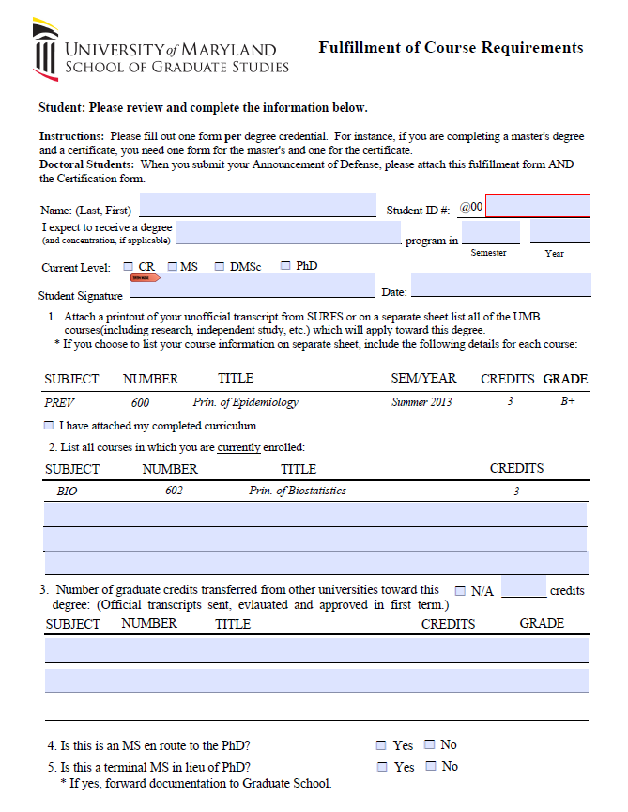
Fulfillment of Course Requirements
Graduation Timeline
2-6 Mo Prior
6 Mo Prior
February 24
2WK Prior
Nomination of Committee
Register for Courses
Diploma Application
Announcement of Defense
Certification of Thesis
Send to gradforms@umaryland.edu by Feb 3rd and/or attach to announcement of defense
Admission to Candidacy
Notes:
This form tells Records and Registration that you have completed and are registered for all required course work for your program. Student will fill out the first page, be sure to sign it and send to your faculty advisor.

Slide 14
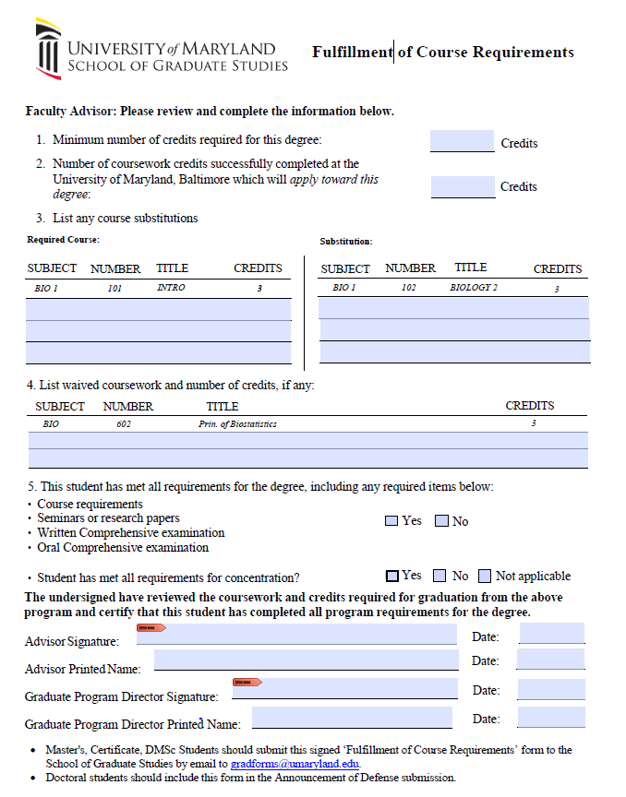
Fulfillment of Course Requirements
Graduation Timeline
2-6 Mo Prior
6 Mo Prior
February 24
2WK Prior
Nomination of Committee
Register for Courses
Diploma Application
Announcement of Defense
Certification of Thesis
Send to gradforms@umaryland.edu by Feb 3rd and/or attach to announcement of defense
Admission to Candidacy
Notes:
Faculty advisor will fill out the 2nd page and sign off stating that you have met your course requirements. This paperwork is due Februrary 3rd, 2026.
If submitting Announcement of Defense by Feb 3rd, you can just submit this form with the announcement. If not submitting by Feb 3rd, please send to gradforms by the deadline. and also attach to your Announcement of defense.

Slide 15
Application for Diploma
1Y Prior
2-6 MO Prior
6 MO Prior
2WK Prior
Admission to Candidacy
Nomination of Committee
Register for Courses
Announcement of Defense
Certification of Thesis
Complete Diploma Application in SURFs
February 13, 2026
Notes:
All students are required to notify the University that they are ready to graduate. The application for diploma in SURFs is the official method for students to notify the university that they are ready to graduate.
Log in to SURFS to submit by February 13, 2026
The application for diploma is a very simple but important process
To apply, log in to your SURFS account, and click the Student Records section.
Complete all fields, including your name, degree, program, and mailing address. If you do NOT have a middle name, enter “none” in the middle name field.
- The name on your diploma must match your official records.
Sometimes there are multiple records, select the top option. If you are graduating with more than one credential (example MS and certificate) and one of those credentials is missing, please contact gradforms. We can make the correction so you can apply for both.
As we all know, research and writing do not always go as planned. If you later realize that you will NOT graduate as scheduled, inform the Graduate School and your program coordinator ASAP. You will need to submit another diploma application for the correct semester.
If you are a DDS Dual Degree/PhD student- you apply for your diploma once you have completed the DDS program.
The University Registrar handles diploma printing and mailing. If you have problems with receipt of diploma or need to change a mailing address for your diploma, please reach out to them.

Slide 16
Thesis/Dissertation Reviewed by Committee
Provide dissertation/thesis document to committee chair and two readers at least one month before defense
They will decide if it is defensible.
1 month prior to defense date
Notes:
At least one month before your defense date, provide your thesis or dissertation to your committee chair and two readers.
After reviewing your thesis or dissertation, your committee will determine if it is defensible.

Slide 17
Timeline to Defense
1Y Prior
2 / 6MO Prior
6MO Prior
February
2WK Prior
Admission to Candidacy
Nomination of Committee
Register for Courses
Fulfillment of Course Requirements (Feb 3), SURFS diploma application (Feb 13)
Announcement of Defense
Certification of completion of the Dissertation/Thesis
Notes:
Back to the timeline, the last bullet is due 2 weeks prior to your defense. Announcement of Defense and Certification of completion of the dissertation or thesis

Slide 18
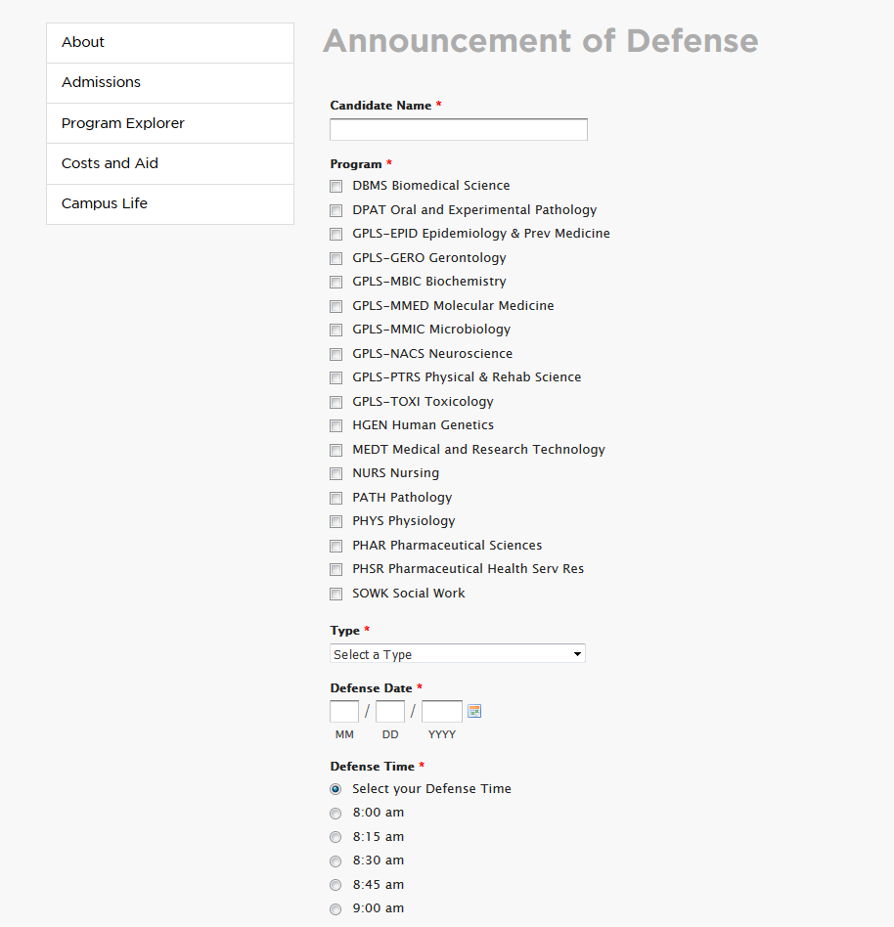
Announcement of Defense
Defense Announcements Posted the Elm
Graduate Studies - The Elm
1Y Prior
2-6 MO Prior
6 MO Prior
February 24
Admission to Candidacy
Nomination of Committee
Register for Courses
Diploma Application
2WK Prior
Announcement of Defense
Notes:
The Announcement of Defense is also due at least two weeks before your defense date to gradforms. Defense Announcement Graduate Studies - The Elm
This online form is the official notification of your defense, including your abstract, and defense date, time, and place.
The same online form is used for MS and PhD students.
If anything changes (date, time, location), e-mail gradforms ASAP.
Records and Registration will post your announcement on the Graduate School website and send the Report of the Examining Committee to the Dean’s Rep. All of your committee members will sign this form at the end of your defense and send it back to gradforms.

Slide 19
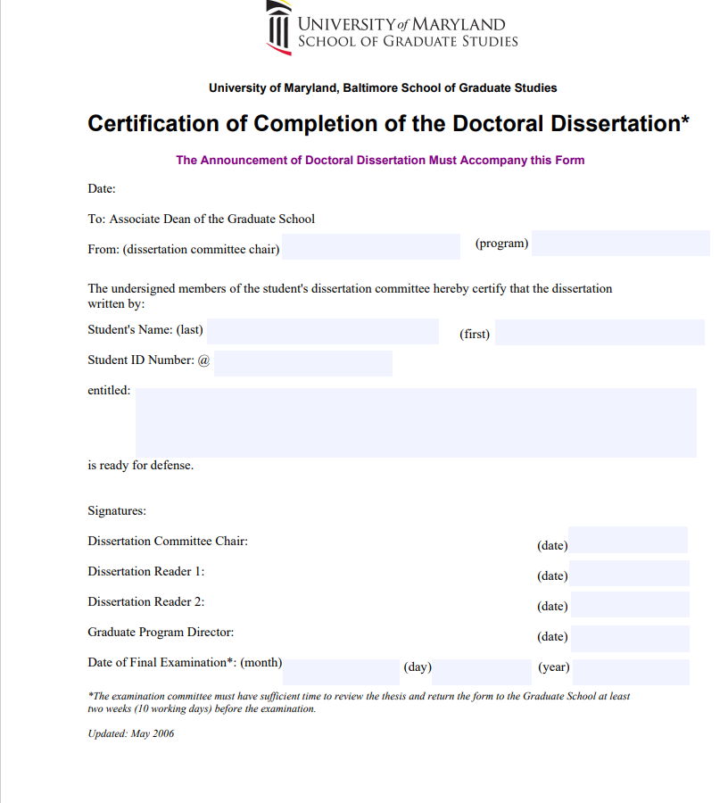
Certification of Completion
1Y Prior
2-6 MO Prior
6 MO Prior
February 24
Admission to Candidacy
Nomination of Committee
Register for Courses
Diploma Application
2WK Prior
Certification of Dissertation
Certification of Thesis
Notes:
The Certification of Completion form is the official notice to the Graduate School that your thesis or dissertation is ready to be defended.
The Certification of Completion form is due to the Graduate School at least two weeks before your dissertation or thesis defense date and is attached to your announcement of defense.
Start obtaining the necessary signatures for the Certification Form early—don’t wait until the day the form is due. Your committee chair, two readers, and your Program Director must sign it.
The defense date and thesis/dissertation title on the Certification form and Announcement must match. At this point in the process, you’ll need to notify the School of Graduate Studies if your defense date changes.

Slide 20
The Defense
Spring graduates must defend on or before, April 13, 2026.
Review the Procedures for Examination
  PhD – https://www.graduate.umaryland.edu/media/Graduate-School/Documents/Procedures-for-Examination-of-the-Doctoral-Dissertation-PDF.pdf
  MS - https://www.graduate.umaryland.edu/media/Graduate-School/Documents/Graduation-and-Degree-Certification/Procedures-for-Examination-of-the-Master's-Thesis.pdf
Role of the Graduate School Dean’s Rep
Notes:
We’ve made it to the defense itself-
The Procedures for the Examination of the Doctoral Dissertation and Master’s Thesis are detailed in the linked documents. Each describes the role of your committee members. You should review the procedure to familiarize yourself with the process.
There are two components to the defense: the public presentation—open to the public—and the private examination by your committee.
For the most part, these take place sequentially on the same day but some programs schedule them separately. Neuroscience in particular.
We highly encourage you to attend other defenses regularly. This will give you a good sense for the event and make you more comfortable at your own. All defense announcements are published on the Graduate School website; the presentations are open to all.
The Dean’s Rep is one of your committee members who is appointed by the Graduate School to ensure that your defense goes according to procedure. This member is also responsible for taking the Report of the Examining Committee to your defense. At the conclusion of your defense, your committee members will decide on an outcome and sign the Report of Exam Committee form. This report is due 2 days post defense.
In the moment--contact us immediately if you encounter a problem (such as an absent committee member) and we will work on a solution.

Slide 21
Overview-Post Defense Document Submission
Please submit the following forms:
Post-Defense Forms | Due Within
Report of the Examining Committee | Two days after your defense
Approval Sheet signed by Committee Chair (PI) | Two weeks after your defense
Electronic Publication Form (Archive Authorization) *make Orchid ID first | Two weeks after your defense
Survey of Earned Doctorates Certificate of Completion | Two weeks after your defense
Dissertation Submission to Proquest | Two weeks after your defense
Notes:
After you defend—the work is not done! Records and registration requests your continued attention to the post defense document submission.
The Report of the Examining Committee - This is due back 2 days after your defense.
All other items due back two weeks post defense
The Approval Sheet
The Electronic Publication Form
The Survey of Earned Doctorates certificate
All forms should be emailed to gradforms@umaryland.edu.
Last the dissertation itself must be submitted to Proquest 2 weeks after your defense.
As a reminder, it is your responsibility to submit these forms. Records and Registration will not process your graduation if all paperwork is not submitted.

Slide 22
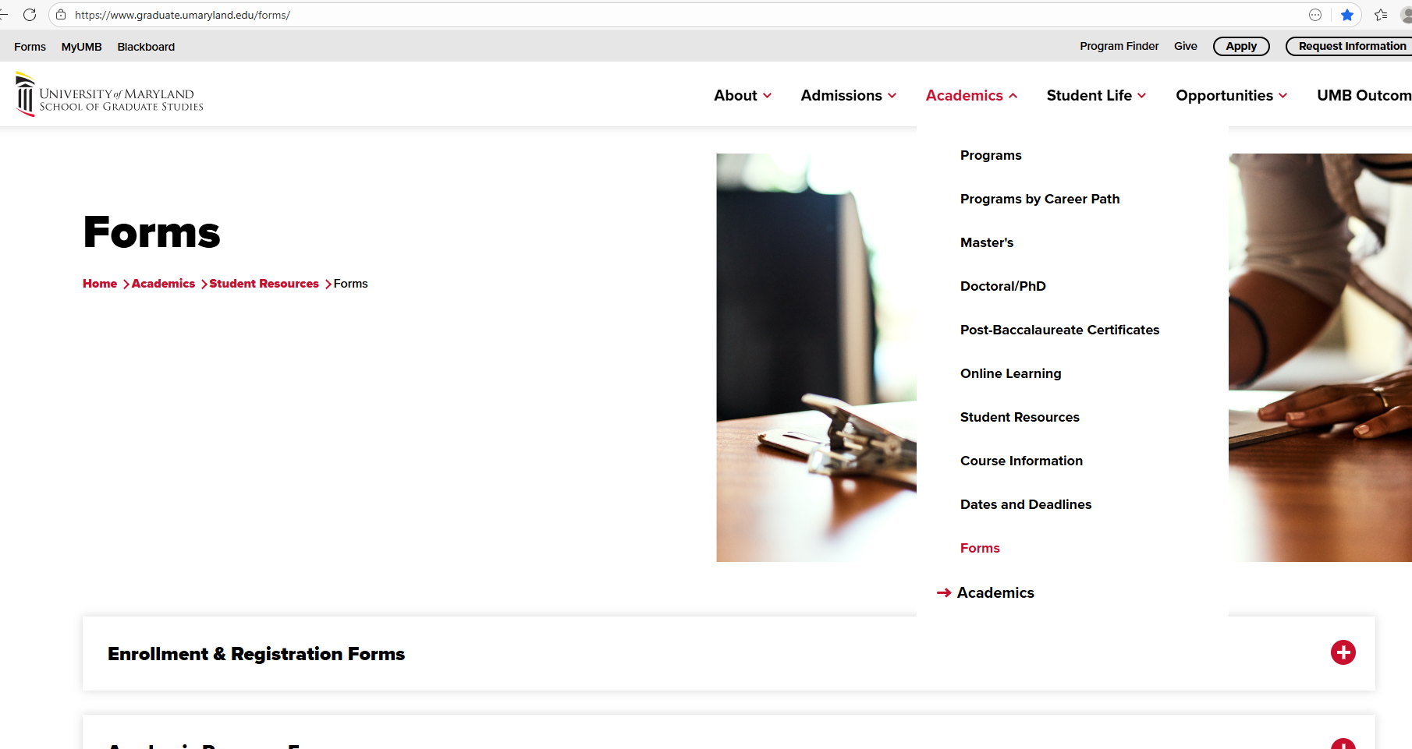
Graduate School Forms
Notes:
Where are the forms?

Slide 23
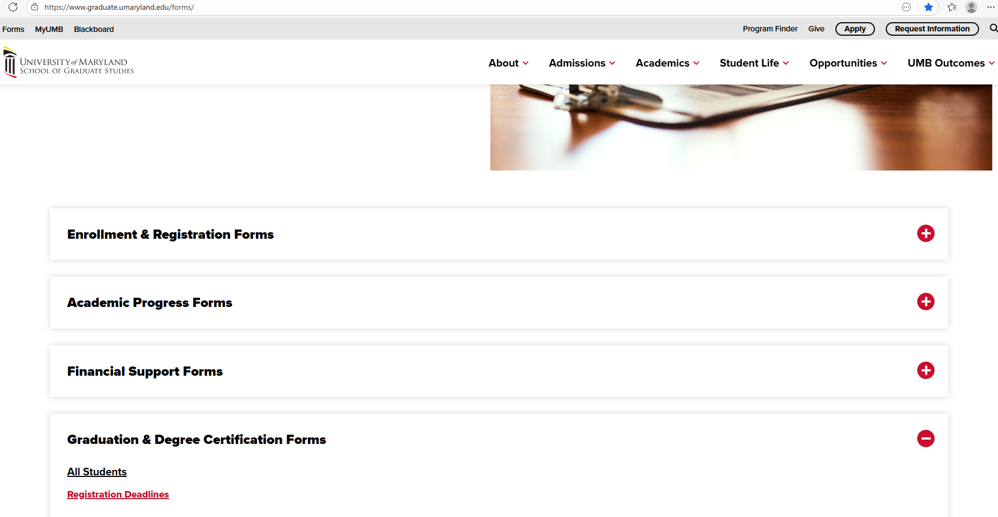
Graduate School Forms Page
Notes:
Scroll down to Graduation & Degree Certification Forms

Slide 24
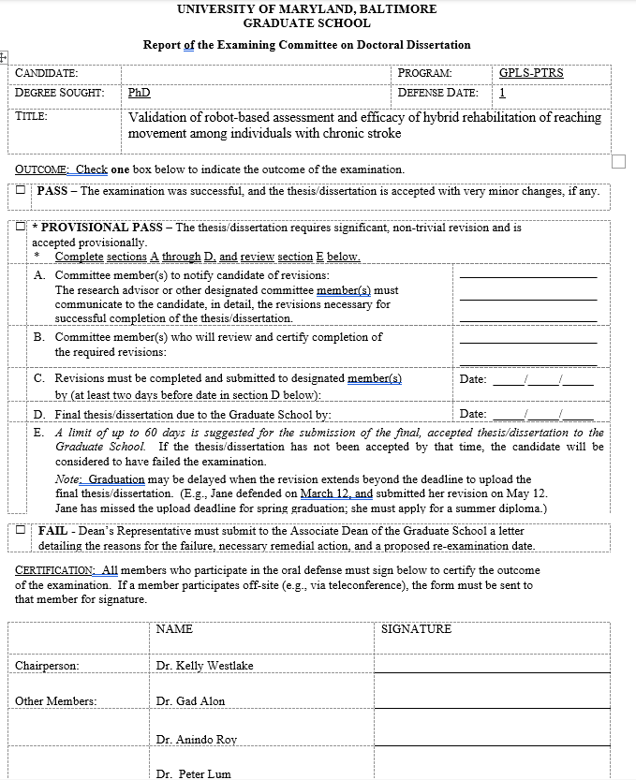
Report of Exam Committee
Notes:
We have talked about a lot of forms. This is an example of what the Report of Exam Committee form looks like. It is emailed directly from gradforms to your Dean’s rep.
Again, The Report of the Examining Committee - to inform the Graduate School of the outcome of your defense. This is due back 2 days after your defense.

Slide 25
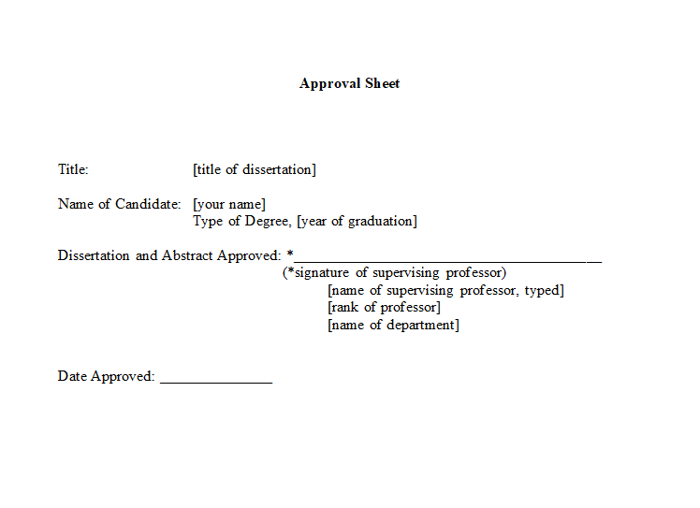
Approval Sheet
Notes:
This is an example of what the approval sheet looks like.
The Approval Sheet states that your mentor approves your dissertation or thesis. Due two weeks post defense.

Slide 26
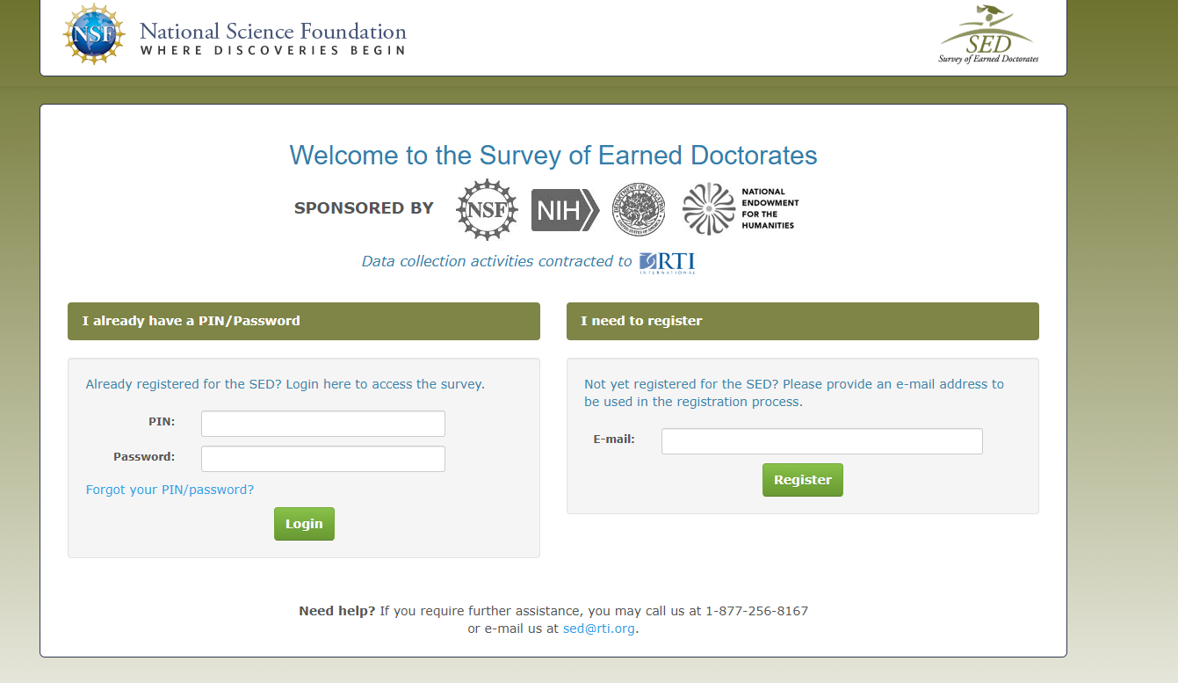
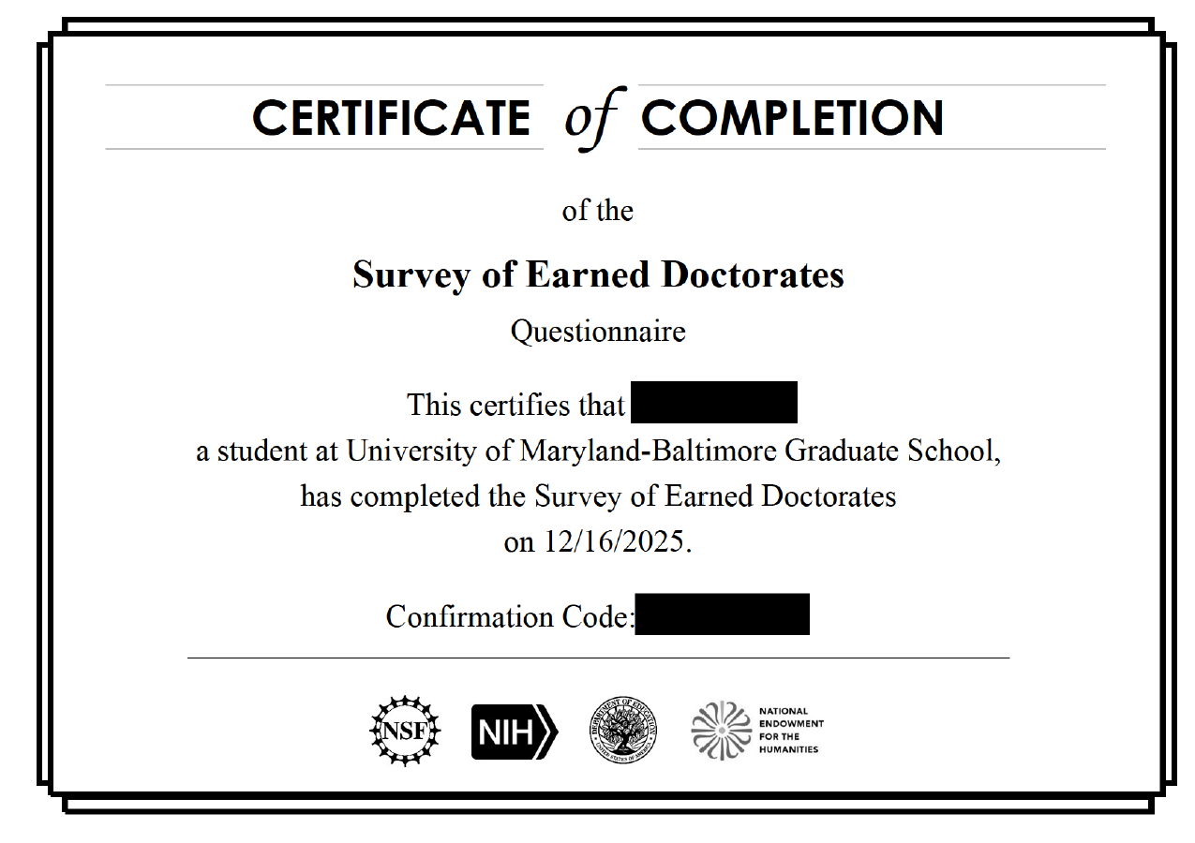
Survey of Earned Doctorate
Notes:
This is the Survey of Earned Doctorate.
The Survey of Earned Doctorates – requests demographic, educational, and career information from recipients of all earned doctorates. Due two weeks after your defense.
When you complete the survey, you will receive an email with a fancy looking “certificate of completion”. This certificate is what we are looking for to be emailed to gradforms.

Slide 27
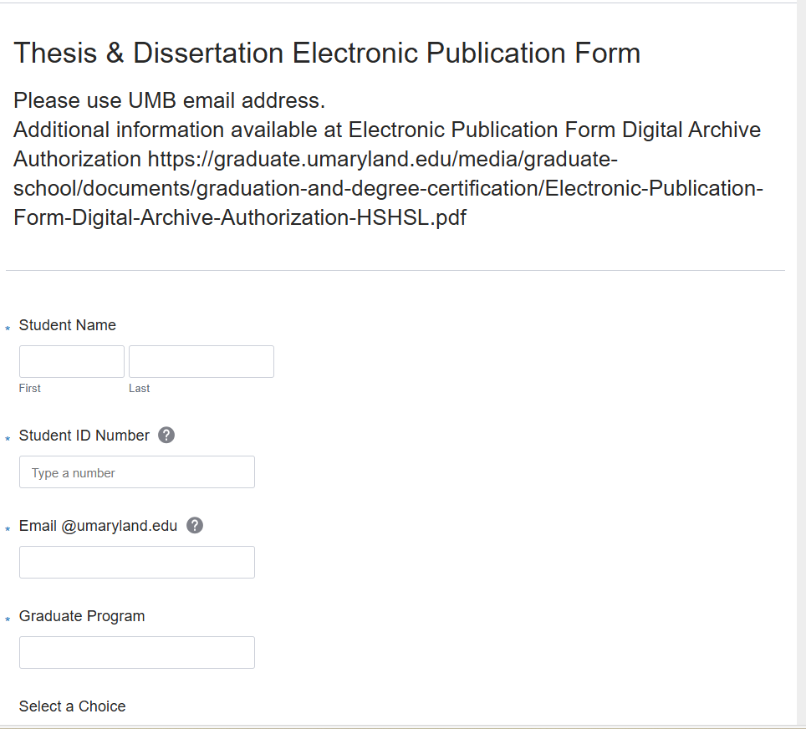
Thesis & Dissertation E-Pub Form
Notes:
This is the Thesis and Dissertation E-Pub Form
The Electronic Publication Form (UM Archive Authorization) gives permission to HS/HSL to keep your thesis/dissertation in the UM Archive. Include your ORCID Identifier, if any. Due two weeks after your defense

Slide 28

Register for an ORCID Identifier
Visit http://orcid.org/ to learn more and register for an ORCID Identifier.
Notes:
ORCID, which stands for Open Researcher and Contributor ID, is a global, not-for-profit.
ORCID strives to enable transparent and trustworthy connections between researchers, their contributions, and their affiliations by providing a unique, persistent identifier for individuals to use as they engage in research, scholarship, and innovation activities.
ORCID registration creates a unique digital identifier to link your dissertation, manuscripts, and other research activities.
Registering for ORCID is optional, but recommended.
Visit orcid.org to learn more and complete the free registration.
If you choose to register, please do so before submission of the Electronic Publication Form.
Now, Dr. Golembewski will review document formatting, submission, and review.

Slide 29
Prepare Your Thesis/Dissertation
Use the style of your discipline
Obtain necessary permissions
Create ProQuest Profile
Notes:
Dr. Golembewski’s Section:
Okay, so you’ve successfully defended, turned in your report and celebrated with friends and family. You still need to turn in your dissertation. We have made some minor revision to the style guide but mostly we updated it with better explanations and more illustrations in hopes that we have fewer revisions at the end of the semester.
Your dissertation should be formatted in the style of your discipline first, then adjust to comply with Graduate School standards.
Before you write, you need to obtain all the appropriate permissions, copyrighted materials, human and animal research, patent information
ProQuest is the vendor we use for dissertation and thesis submission. You will need to create a profile with them. There is NO charge to create a profile or upload your submission. You should use your professional name, that used on all other publications. If you have no other publications, this is the name you will use going forward.

Slide 30
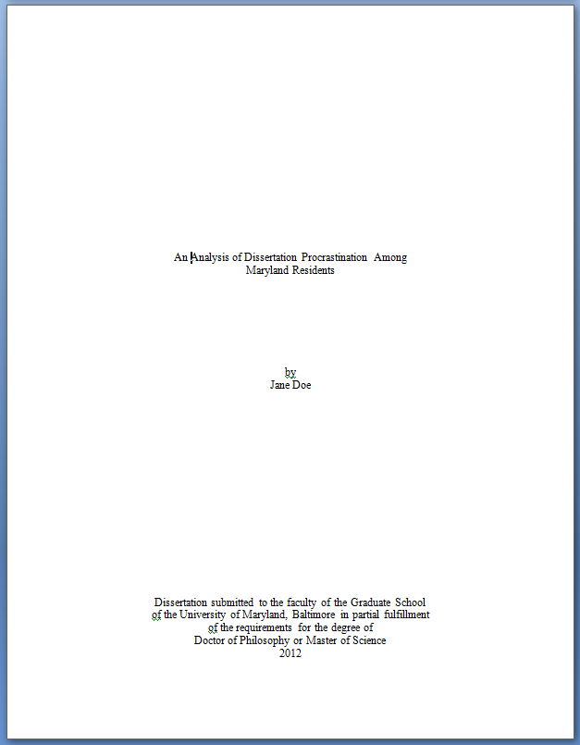

Formal Elements
Curriculum Vitae CV
Abstract
3.5”
1”
5”
8”
Title Page Copyright Page
Notes:
The Curriculum Vitae is the first page of your documents. While it must adhere to the margins, font size and other rules, much of the formatting can be determined by you. Keeping in mind it will be published, do not include any personal information such as a home address. You should include a method to contact you by e-mail other than your university account. Include your graduation date (2020 or May 2020).
The abstract is next, dissertation abstract will be published in Dissertation Abstract International/Digital Dissertations, so please craft it with care. It does not need to match your Announcement abstract verbatim.
Next up the title page, note the margins are different here than on any other page in the document. Use title case for your title, include the professional version of your name, choose the appropriate degree statement for your MS of PhD.
We recommend that you register the copyright for your dissertation. ProQuest makes this a very simple process if you choose to do so. ProQuest will charge a fee for this service. You need to make this decision as your create your profile, it can not be changed afterwards.

Slide 31
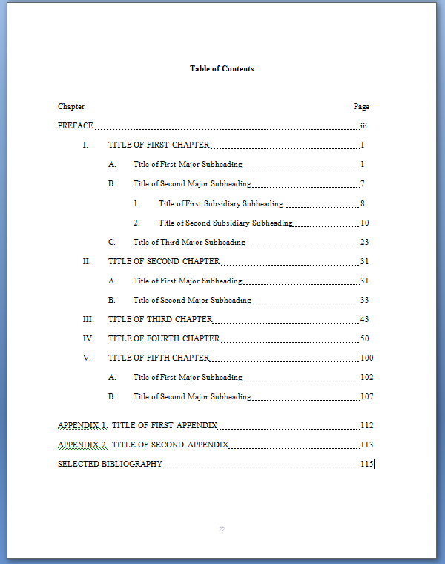
Formal Elements
Preface, Dedication, Acknowledgement
Table of Contents
Notes:
The next three elements are optional, you can read more about the distinction between them in the style guide. If you choose to include them, page numbering starts here with lower case Roman numerals in the bottom center of the page.
The Table of Contents is required, although you have some choice in the amount of detail you want to include. If you are working in Microsoft Word, there is a very helpful tool to identify your section headings and create the Table of Contents so it automatically updates as you make changes to the document. I highly recommend you learn how to use this for the document and the future. You can use it for the next List of Tables, List of Figure and List of Abbreviations which are the next three pages. If you document contains any, you will need to include a list for each relevant item.

Slide 32
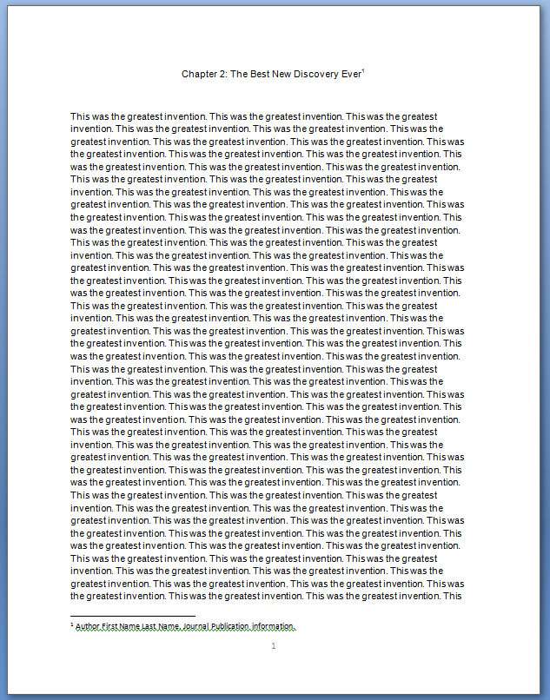
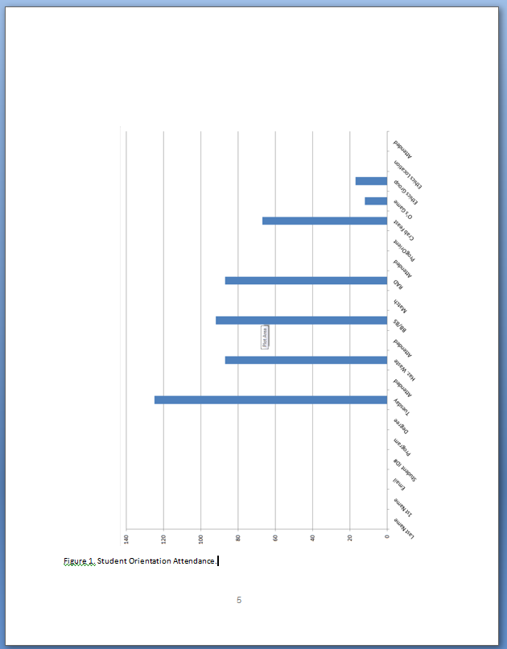
Formal Elements
1”
Chapters Figures
Notes:
Finally, we can start talking about the bulk of your dissertation. Chapters begin immediately after the Table of Contents or Lists. If you are using a Manuscript format, you can include a journal citation as a footnote with all the author, journal and affiliation information in the footnote.
Most if not all of you will include figures, tables or illustrations of some kind in your document. Many student have trouble formatting them properly. Please note the second figure here. The chart is in landscape orientation while the page number and margins are in landscape. How did I perform this miracle you ask? I will tell you my secret. Save the chart, in this case, as a picture (jpg, gif, bmp), insert it as a picture into your Word document, then rotate it 90*. That is it.
If you have additional materials such as video or large data sets, you can include these are supplemental files. They are uploaded separately to ProQuest.

Slide 33
Formal Elements
Appendices
References
Index
Notes:
Appendices follow all the text and figures in your document. If you have more than one, they should be labeled like Chapters, typically alphabetically: Appendix A, Appendix B, etc.
You must include a comprehensive list of references at the end of the document. If you included a list for each chapter, there are instructions in the style guide for how to easily compile it.
An index is optional, there is a tool in Word to help you create one.

Slide 34
Submitting
Login
Upload
Complete revisions
Upload again
Notes:
You are now ready to submit to ProQuest. Your thesis or dissertation is due at least two weeks after your defense date.
Once you upload your document to ProQuest, we receive an e-mail. We review your document and send you a list of corrections by e-mail. Please make sure you register an active e-mail account with ProQuest. Keeping in mind that we receive quite a few dissertations every day and they are long documents, it may take a few days to a week to receive your corrections. Depending on how close we are to the end of the semester, you need to revise and resubmit your dissertation. We will review your corrections and send you another e-mail to let you know the document has been accepted.
A few days after the end of the semester, all the dissertations are sent to ProQuest. You will review an e-mail from them. They are now irretrievable. If you purchased copies, your copies will be sent to you directly from them about six weeks after this date. All questions about orders must be directed to ProQuest.

Slide 35
Degree Verification
A prospective employer may require a letter from the School of Graduate Studies to verify that you have completed your degree requirements.
Information on requesting a verification letter.
Notes:
Allow 3-5 days processing time after receipt of last requirement/ acceptance of your dissertation.
Degree Verification letter includes name, addressee institution, program, dissertation chairs name, dissertation submission date, day diploma is awarded.

Slide 36

Writing
Spring Writing Workshops
In person: February TBD
Virtual: February TBD
Writing Accountability Group
  TBD

Slide 37
Student Counseling Center
short-term
professional counseling
psychiatric services
Our mission is to help promote and maintain the emotional well-being of UMB students and serve as a resource to the entire university community.
410-328-8404

Slide 38
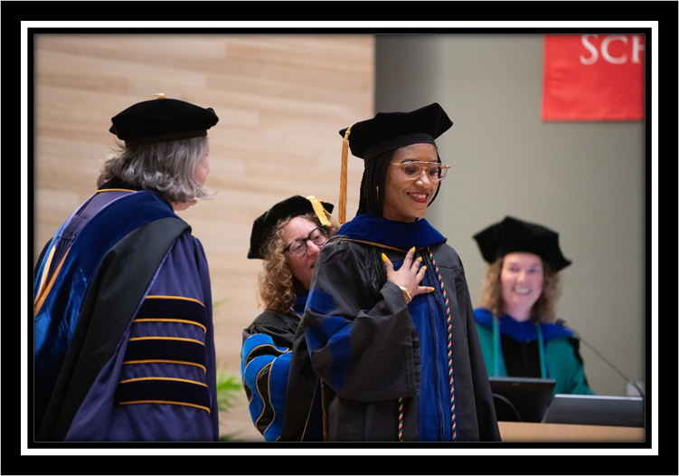
Graduation Ceremonies
MS and Certificate Ceremony
PhD Hooding Ceremony
May 20th, 2026
Masters, Certificate, DMSc at 11:30am
PhD at 4pm

Slide 39
Resources, Links & Contacts
Graduate School - 620 W Lexington St 1st Floor
http://graduate.umaryland.edu/
Records & Registration Forms
Graduation Deadlines
Records & Registration office hour appointments
gradforms@umaryland.edu - Document Submission
egolembewski@umaryland.edu
cknapp@umaryland.edu
Notes:
Add QR code to templates and

Slide 40
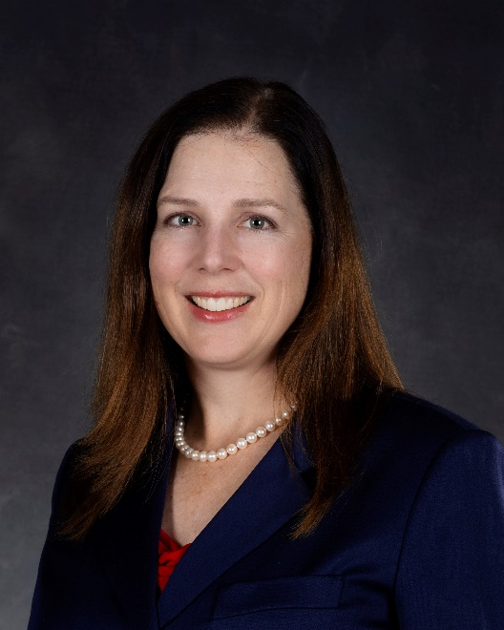
Preparing for Graduation
Erin Golembewski, PhD
Senior Associate Dean, Graduate School
egole001@umaryland.edu
Notes:
Erin’s Introduction:

