Slide 1
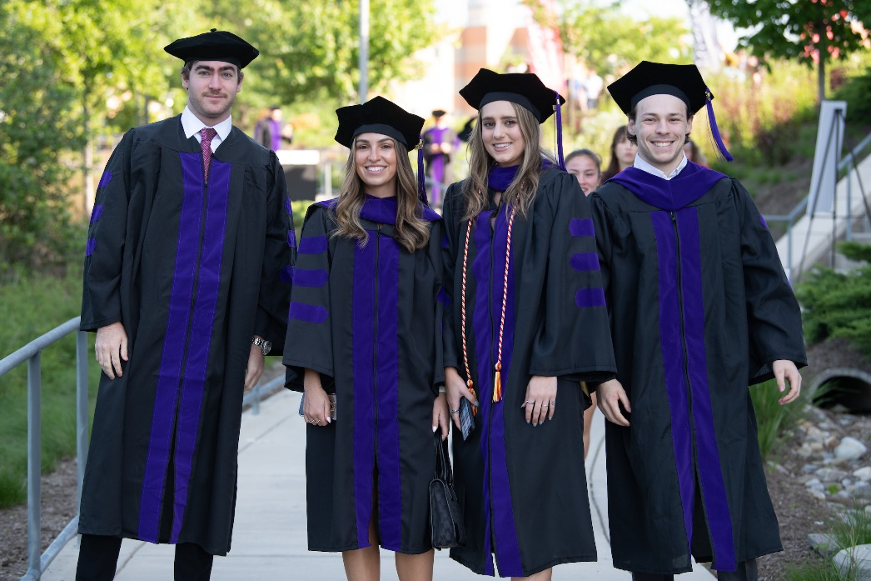
Preparing for Graduation
Notes:
Erin’s Introduction:

Slide 2
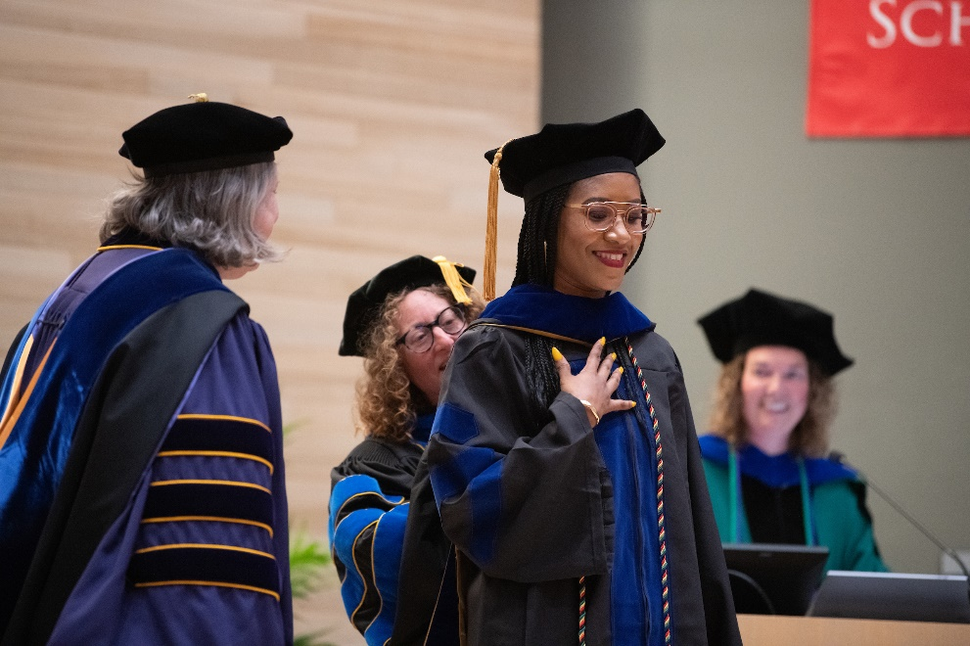

Preparing for Graduation
Notes:
Erin’s Introduction:

Slide 3
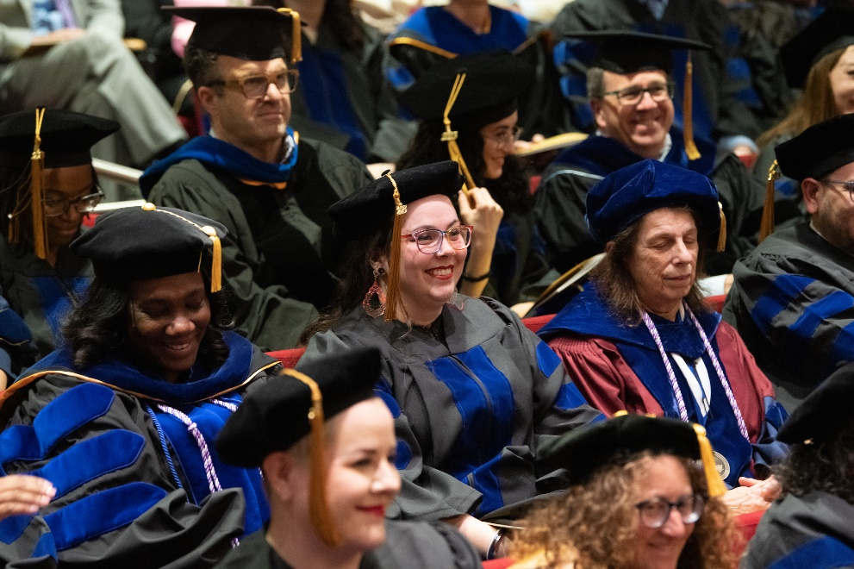

Preparing for Graduation
Notes:
Erin’s Introduction:

Slide 4
Preparing for Graduation
Erin Golembewski, PhD
Vice Dean, Graduate School
Colleen Knapp
Associate Director, Records and Registration
Davonte Johnson and Jennifer Cantrell
Records and Registration
Notes:
Erin’s Introduction:

Slide 5


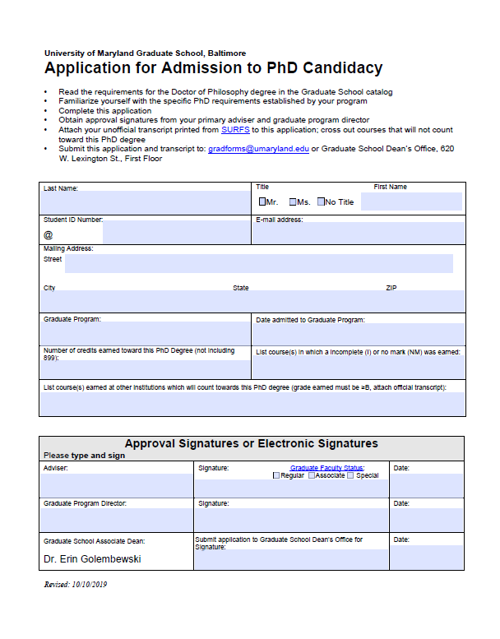
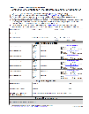
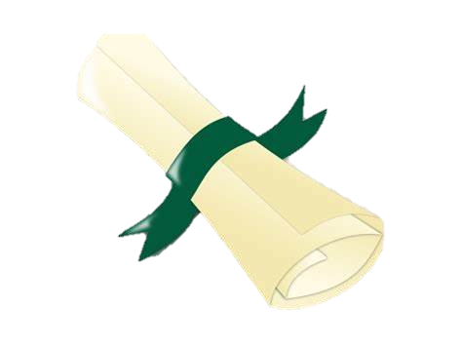

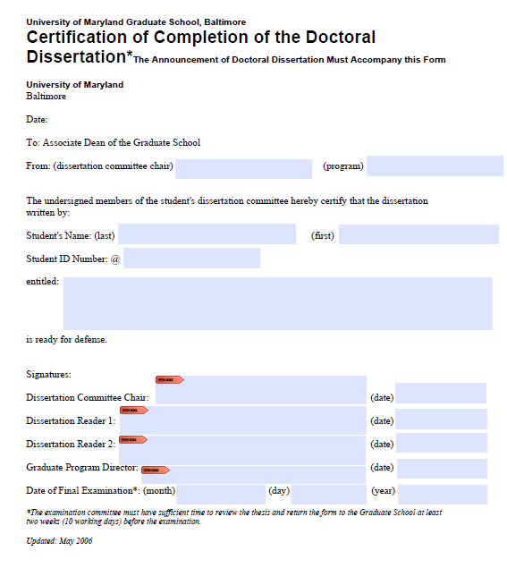


Timeline to Defense
1Y Prior
2-6MO Prior
6MO Prior
Sept 19
2WK Prior
Admission to Candidacy
Nomination of Committee
Register for Courses
Diploma Application
Announcement of Defense
Certification of Thesis

Slide 6
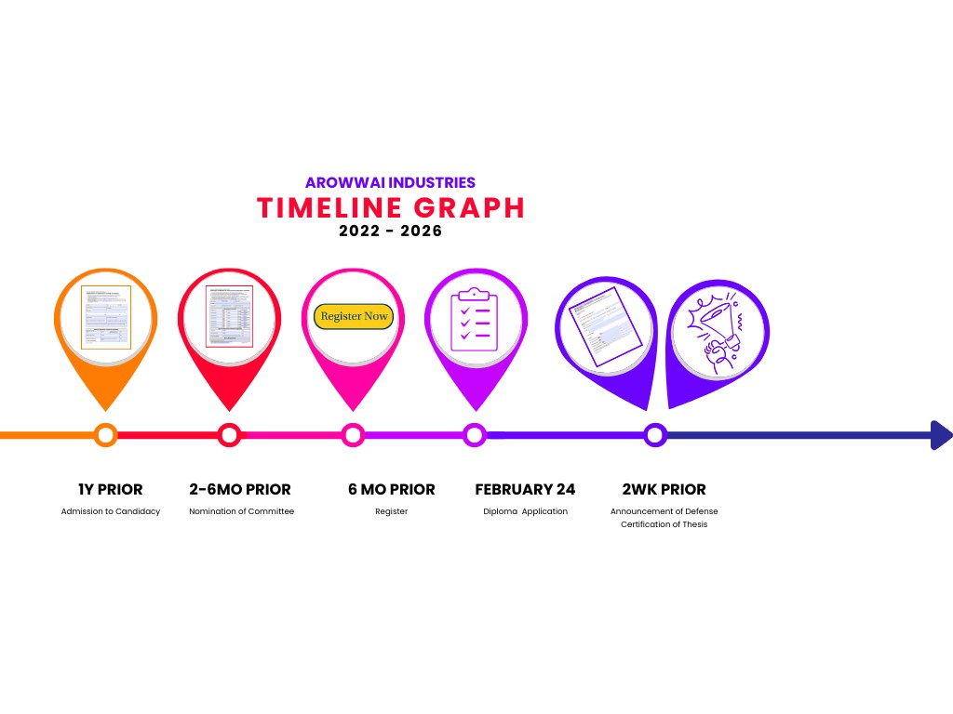
Admission to Candidacy
1Y Prior
Admission to Candidacy
Notes:
- Admission to Candidacy must be achieved at least two semesters before you defend your dissertation.

Slide 7
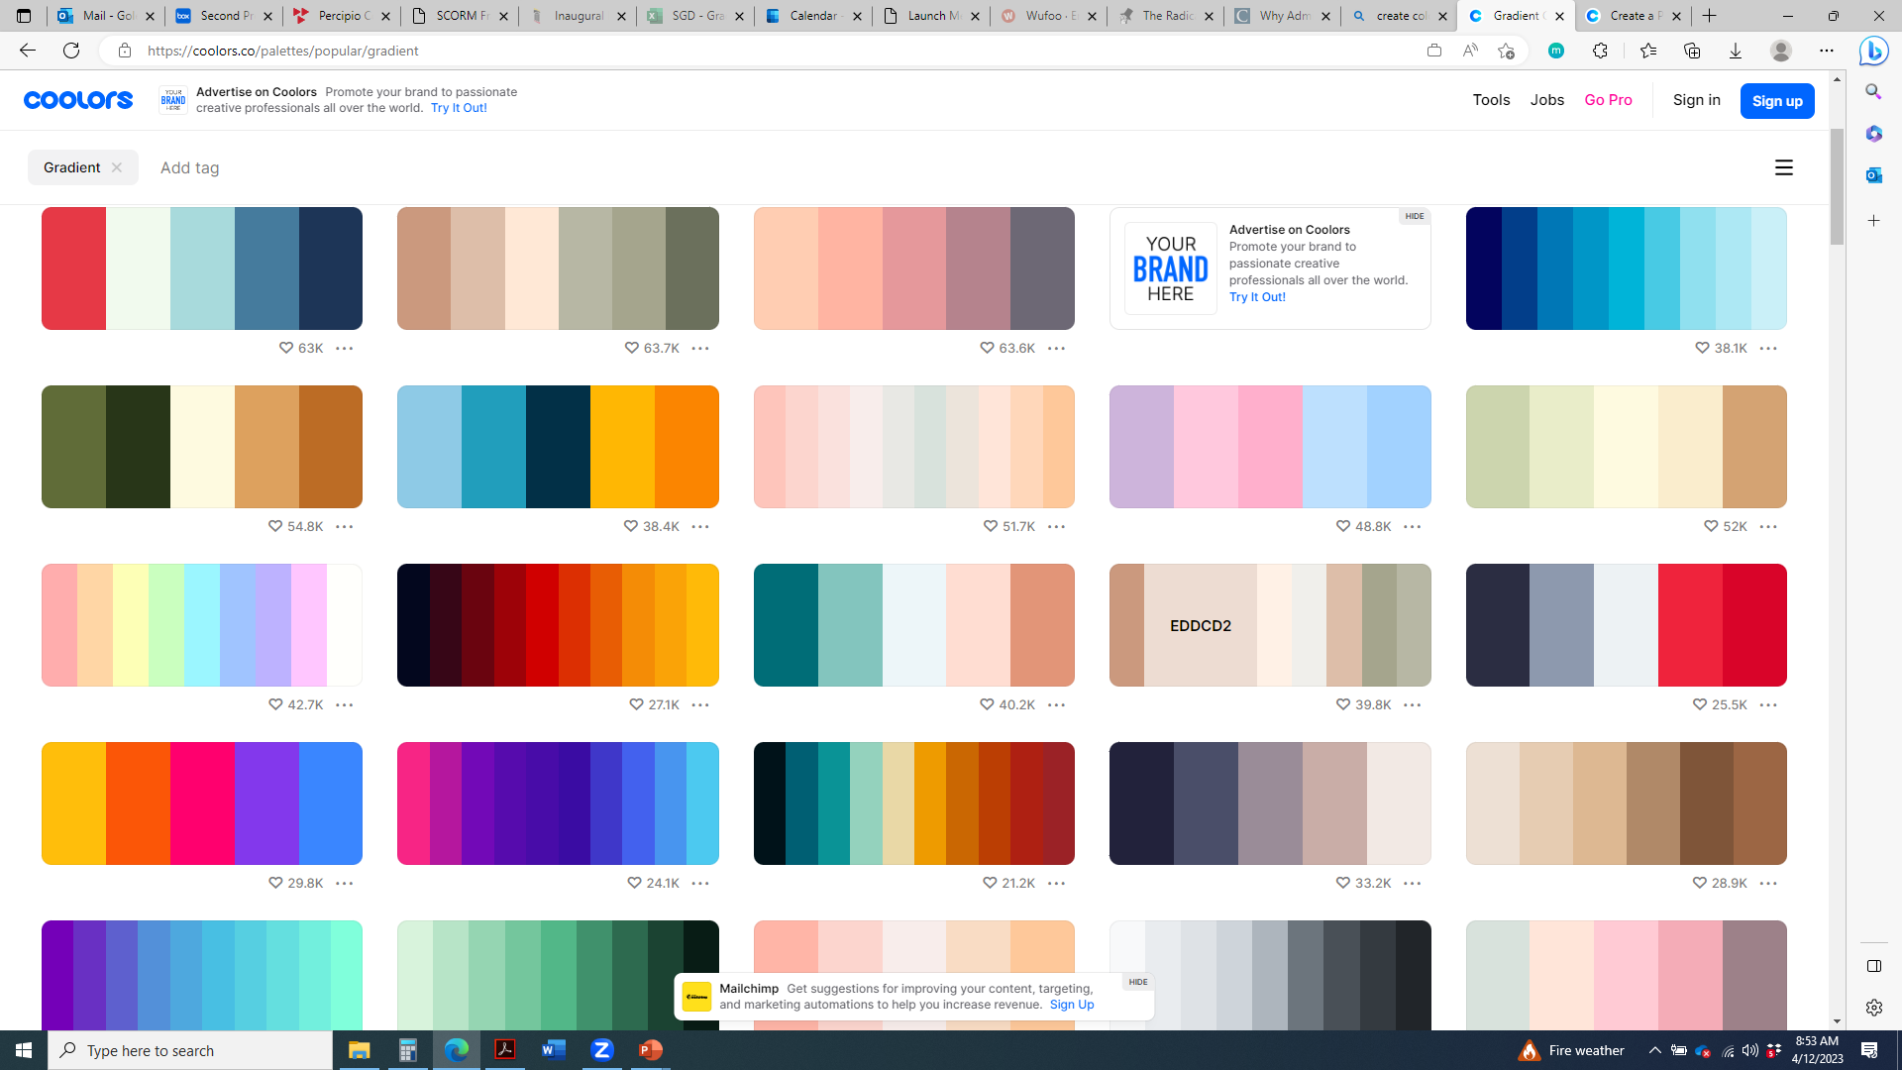
Timeline to Defense
1Y Prior
2-6MO Prior
6MO Prior
Sept 19
2WK Prior
Admission to Candidacy
Nomination of Committee
Register for Courses
Diploma Application
Announcement of Defense
Certification of Thesis

Slide 8
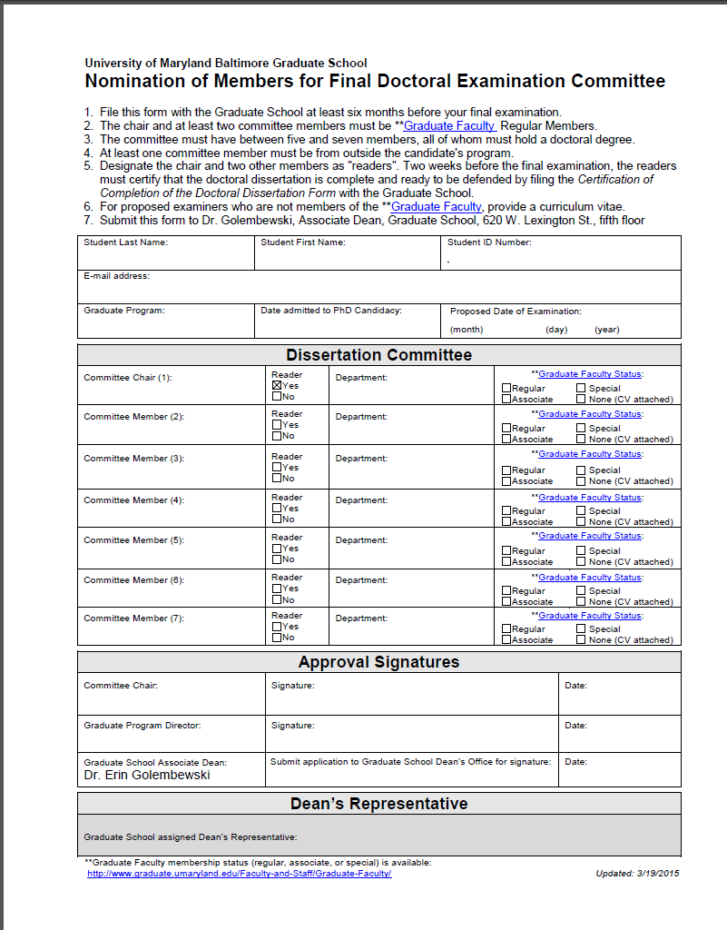
Nomination of Committee
Graduation Timeline
6MO Prior
February 24
2WK Prior
1Y Prior
February 24
2WK Prior
Admission to Candidacy
Register for Courses
Diploma Application
Announcement of Defense
Certification of Thesis
2-6MO Prior
Nomination of Committee

Slide 9
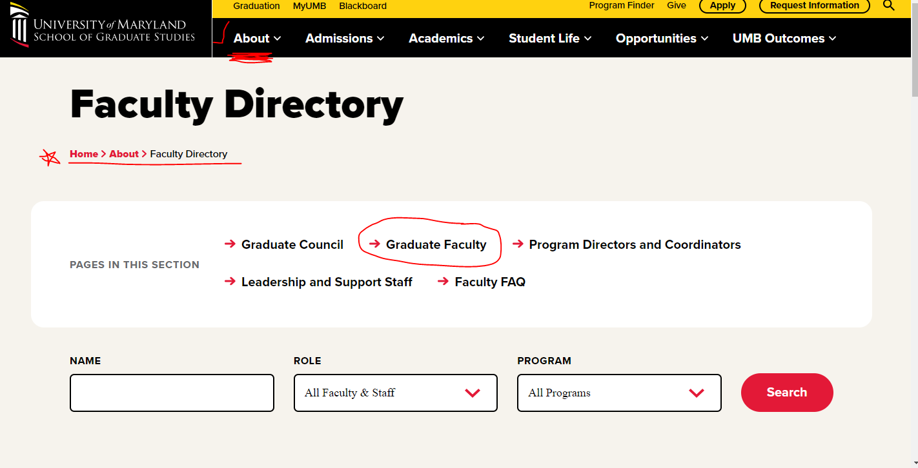
Graduate School Forms Page

Slide 10
Timeline to Defense
1Y Prior
2-6MO Prior
6MO Prior
Sept 19
2WK Prior
Admission to Candidacy
Nomination of Committee
Register for Courses
Diploma Application
Announcement of Defense
Certification of Thesis

Slide 11
Register
Register for Courses
ABGA 7 credits
799 2-6 credits or
899 2-12 credits
1Y Prior
2-6 Mo Prior
February 24
2WK Prior
Admission to Candidacy
Nomination of Committee
Diploma Application
Announcement of Defense
Certification of Thesis
6 MO Prior

Slide 12
Timeline to Defense
1Y Prior
2-6MO Prior
6MO Prior
Sept 19
2WK Prior
Admission to Candidacy
Nomination of Committee
Register for Courses
Diploma Application
Announcement of Defense
Certification of Thesis

Slide 13
Application for Diploma
1Y Prior
2-6 MO Prior
6 MO Prior
2WK Prior
Admission to Candidacy
Nomination of Committee
Register for Courses
Announcement of Defense
Certification of Thesis
Complete Diploma Application in SURFs
February 3

Slide 14
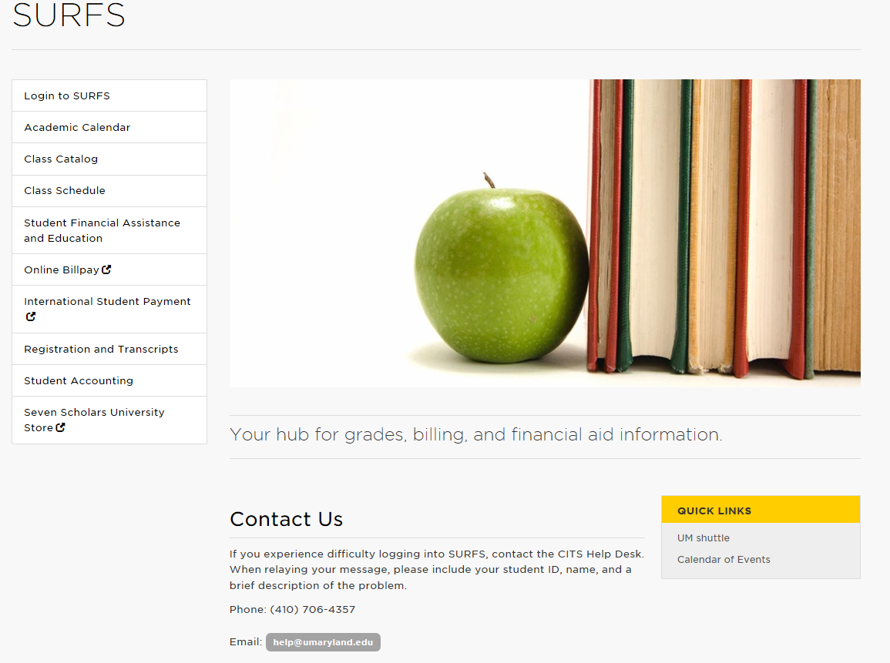
Login to SURFS
http://www.umaryland.edu/surfs/
Notes:
While you are in SURFS there are three additional things to do.
Review your unofficial transcript. Make a note of any No Marks, “NM” and Incompletes “I”. Ask your Program Coordinator to obtain your final grades and submit them to the Registrar. You cannot graduate with No Marks or Incompletes on your record.
- Count the number of research credits (799 or 899) you have, including your last semester. You need at least twelve credits of 899 or six credits of 799 to graduate.
- Review your student account. You will not receive your diploma if you have an outstanding debt.

Slide 15
Timeline to Defense
1Y Prior
2-6MO Prior
6MO Prior
Sept 19
2WK Prior
Admission to Candidacy
Nomination of Committee
Register for Courses
Diploma Application
Announcement of Defense
Certification of Thesis

Slide 16
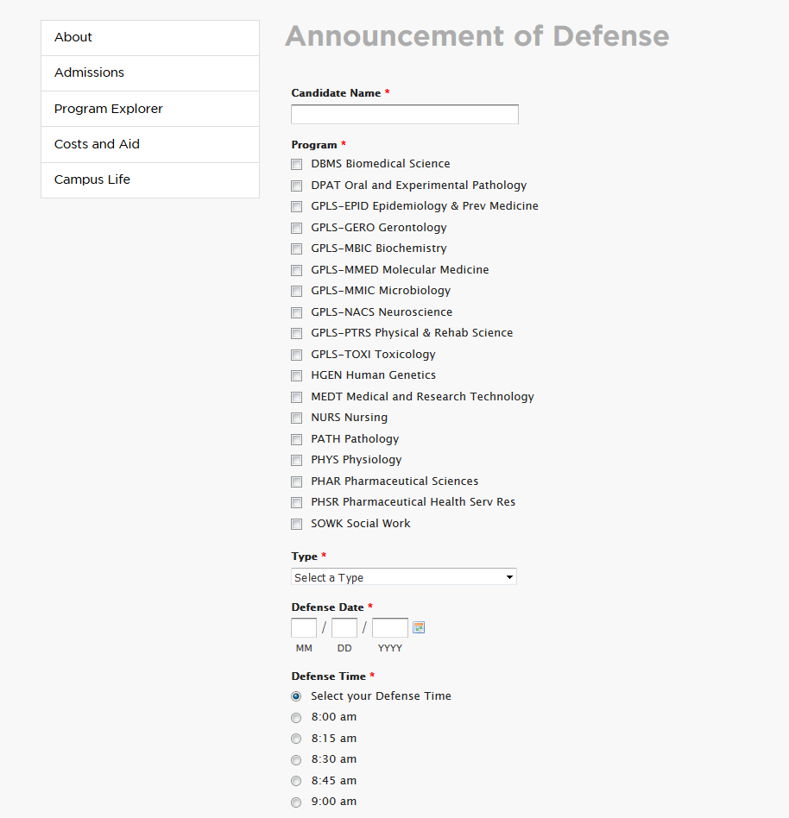
Announcement and Certification
1Y Prior
2-6 MO Prior
6 MO Prior
February 24
Admission to Candidacy
Nomination of Committee
Register for Courses
Diploma Application
Announcement of Defense
Certification of Thesis
2WK Prior
Announcement of Defense
Certification of Thesis

Slide 17
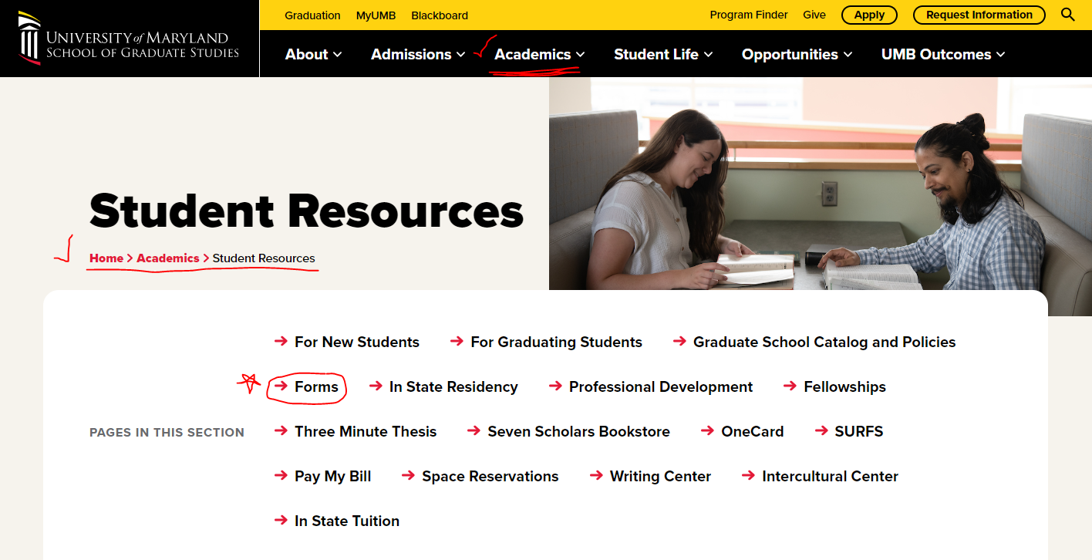
Graduate School Forms Page

Slide 18
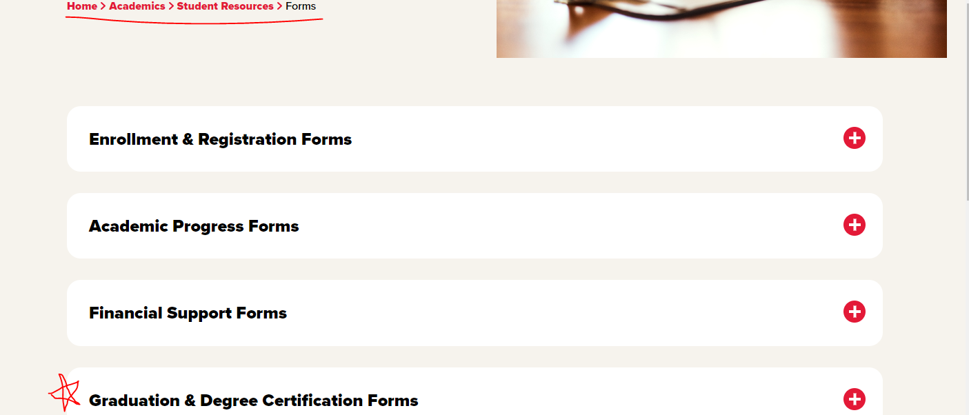
Graduate School Forms Page

Slide 19
Thesis/Dissertation Reviewed by Committee
Provide document to committee chair and two readers at least one month before defense
They will decide if it is defensible.
Notes:
At least one month before your defense date, provide your thesis or dissertation to your committee chair and two readers.
After reviewing your thesis or dissertation, your committee will determine if it is defensible.

Slide 20
Defense
Fall graduates must defend on or before, November 26, 2025.
Review the Procedures for Examination
PhD – https://www.graduate.umaryland.edu/media/Graduate-School/Documents/Procedures-for-Examination-of-the-Doctoral-Dissertation-PDF.pdf
MS - https://www.graduate.umaryland.edu/media/Graduate-School/Documents/Graduation-and-Degree-Certification/Procedures-for-Examination-of-the-Master's-Thesis.pdf
Defense Announcements Posted on our Website
http://graduate.umaryland.edu/ under Upcoming Events
Role of the Graduate School Dean’s Rep
Notes:
The Procedures for the Examination of the Doctoral Dissertation and Master’s Thesis are detailed in the respective documents. Each describes the role of your committee members. You should review the procedure to familiarize yourself with the process.
There are two components to the defense: the public presentation—open to the public—and the private examination by your committee.
For the most part, these take place sequentially on the same day but some programs schedule them separately. Neuroscience in particular.
You should attend other defenses regularly. This will give you a good sense for the event and make you more comfortable at your own. All defense announcements are published on the Graduate School website; the presentations are open to all.
The Dean’s Rep is one of your committee members who is appointed by the Graduate School to ensure that your defense goes according to procedure. This member is also responsible for taking the Report of the Examining Committee to your defense. At the conclusion of your defense, your committee members will decide on an outcome and sign this form.
Contact us immediately if you encounter a problem (such as an absent committee member) and we will work on a solution.
Before you go out and celebrate passing your defense...

Slide 21
Document Submission
Please submit the following forms:
Post-Defense Forms | Due Within
Report of the Examining Committee | Two days after your defense
Approval Sheet signed by Committee Chair (PI) | Two weeks after your defense
Electronic Publication Form (Archive Authorization) | Two weeks after your defense
Survey of Earned Doctorates Certificate of Completion | Two weeks after your defense

Slide 22
Graduate School Forms Page

Slide 23

Register for an ORCID Identifier
Visit http://orcid.org/ to learn more and register for an ORCID Identifier.

Slide 24
Prepare Your Thesis/Dissertation
Use the style of your discipline
Obtain necessary permissions
Create ProQuest Profile

Slide 25
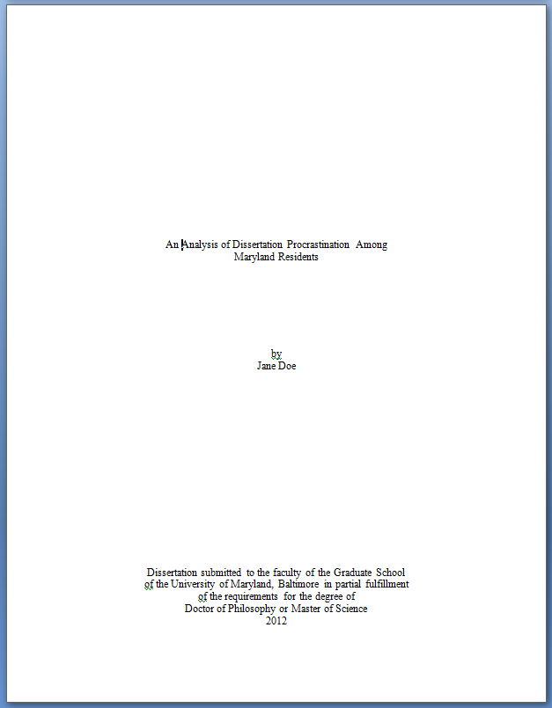

Formal Elements
Curriculum Vitae CV
Abstract
3.5”
1”
5”
8”
Title Page Copyright Page

Slide 26
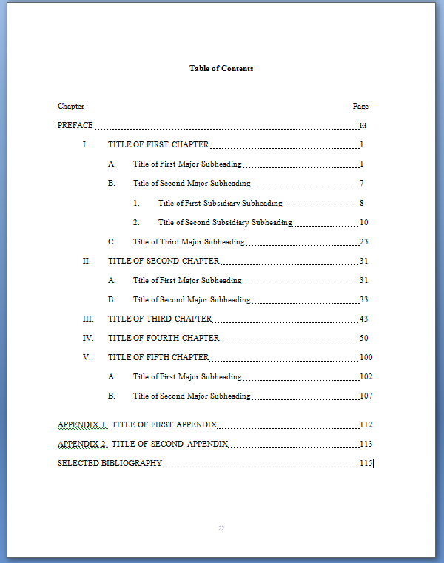
Formal Elements
Preface, Dedication, Acknowledgement
Table of Contents

Slide 27
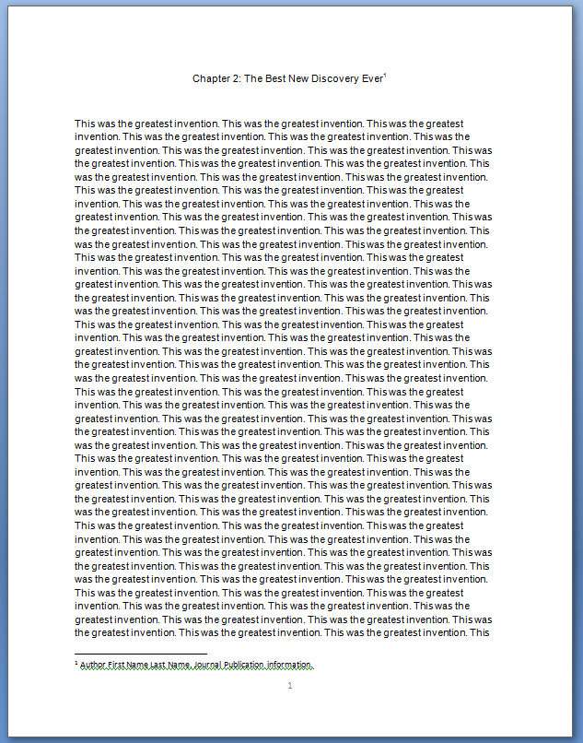
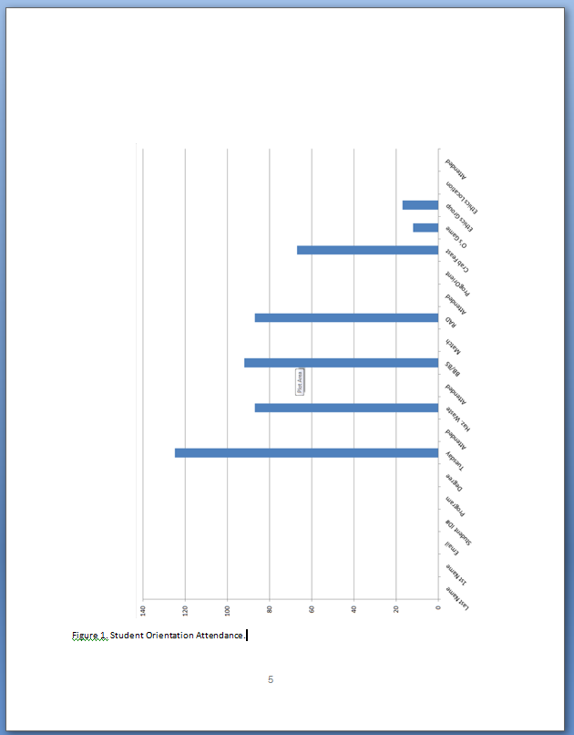
Formal Elements
1”
Chapters Figures

Slide 28
Formal Elements
Appendices
References
Index

Slide 29
Submitting
Login
Upload
Complete revisions
Upload again

Slide 30
Degree Verification
A prospective employer may require a letter from the Graduate School to verify that you have completed your degree requirements.
Information on requesting a verification letter.

Slide 31

Writing
Fall Writing Workshops
In person: September 23-25
Virtual: Week if October 6th
Writing Accountability Group
TBD

Slide 32
Student Counseling Center
short-term
professional counseling
psychiatric services
Our mission is to help promote and maintain the emotional well-being of UMB students and serve as a resource to the entire university community.
410-328-8404

Slide 33
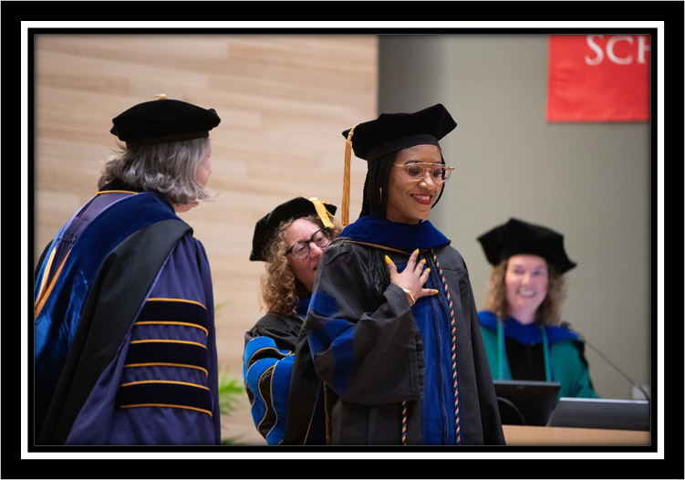
Graduation Ceremonies
MS and Certificate Ceremony
PhD Hooding Ceremony
Hold May 20th

Slide 34
Questions
Resources & Contacts
Graduate School - 620 W Lexington St 1st Floor
http://graduate.umaryland.edu/
gradforms@umaryland.edu - Document Submission
egolembewski@umaryland.edu
cknapp@umaryland.edu

