Slide 1
To ensure proper credit:
1) Sign in. Print name legibly.
2) Complete a ‘Radiation Worker Registration Form’, via:
www.umaryland.edu/ehs
3) Complete online exam via MyEHS > Online Training > Radiation Safety.
Two weeks from today – 70%

Slide 2
Radiation Safety Instruction
Presented by:
Department of Environmental Health & Safety
University of Maryland, Baltimore

Slide 3
Environmental Health and Safety Services and Phone Numbers
Director: 410-706-7055
Occupational Safety: 410-706-7055
Fire Safety: 410-706-3494
Risk Management: 410-706-7055
Environmental Management : 410-706-7055
Radiation Safety: 410-706-7055
Biosafety: 410-706-7845
Web Site: www.ehs.umaryland.edu

Slide 4
Topics to Be Covered
Part I Introduction to Radiation Physics
Part II Detection Instrumentation
Part III Units of Measurements
Part IV Radiation Biology
Part V Radiation Protection
Part VI What to Expect at UMB

Slide 5
Introduction to Radiation Physics
In this section we will discuss
Types of radiation
Where it comes from
Interactions

Slide 6
RADIATION
The emission of energy
in particles or waves.
“Energy in Transit”

Slide 7
Lab Concerns; CONTAMINATION
Unwanted distribution
of radioactive material.

Slide 8
Atom Structure
1e⁻
1p⁺
All matter is composed of elements
Fundamental structure of elements, atoms
The atom is composed of:
Nucleus: • neutrons • protons
Orbital Shell: • electrons
Stable/non-radioactive atoms have a ~ balance of protons and neutrons.
Radioactive atoms have a ~ unbalanced ratio of protons to neutrons
1
H
Hydrogen
1
2e⁻
2p⁺
2n
4
Helium
He
2
92e⁻
92p⁺
146n
238
U
Uranium
92

Slide 9
Isotopes of atoms
e⁻
ELEMENT: Number of protons
NUCLIDE: Element with unique arrangement of protons and neutrons
ISOTOPES: Same element but differing number of neutrons.
p⁺
n
2
H
1
Deuterium
e⁻
e⁻
n
p⁺
p⁺
n
3
1
H
H
1
1
Tritium
Hydrogen
Notes:
Isobars: same mass number (n+p)
Isotones: name number of neutrons (different Z)
Isomers: metastable, half-life > 1ps

Slide 10
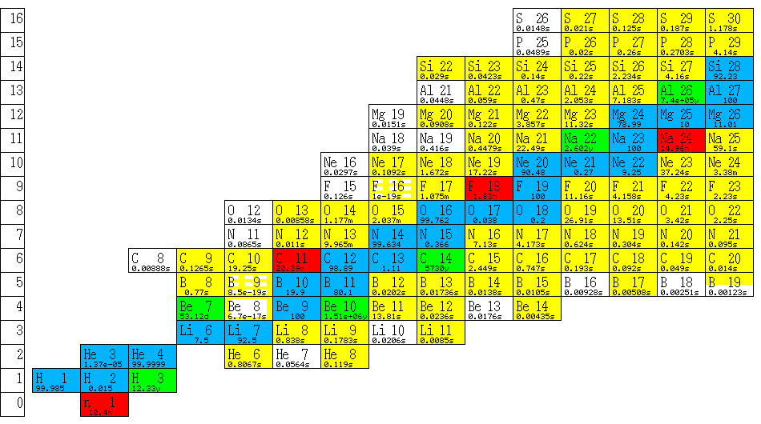
Isotopes, “Line of Stability”
Notes:
Blue line plots stable isotopes.
Stability occurs in light elements when n:p is one (exception H)
Decay occurs to obtain optimal n:p ratio
Below line of stability too many neutrons: beta decay
Above too many protons: positron decay (or EC)
Intermediate elements like rhenium n:p about 1.3, goes up to 1.5 for heavy elements like gold.
Presence of neutrons helps to dilute the long range repulsive force that pushes protons apart, keeping a nucleus together. Allows short-range attractive forces between adjacent nucleons to overcome the repulsive force.
Really heavy elements are just too heavy to be stable – adding too many nucleons means that the individual nucleons are too far apart from one another for the short-range strong force to win out. Decay by alpha decay or fission. Alpha: eject 2n, 2p gives doubly ionized He atom. Fission: split up into equal fragments (more or less. I-131 and Mo-99 created by fission of U-235 – useful.

Slide 11
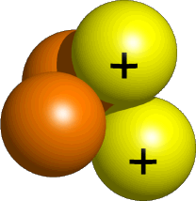
Alpha Particles
Highly charged, heavy particles which are identical to helium nuclei (2n, 2p, +2 charge) emitted from the nucleus
Energy range from 3 to 8 MeV (most are around 5)
Have a very short range in air (a few cm) or tissue
Common example of alpha emmitters are: polonium-210, uranium-238, and plutonium-239
Notes:
Alpha particles are emitted from the nuclei heavy radionuclides such as polonium, uranium and plutonium. The alpha particle is essentially a doubly charged helium nucleus. Due to their relatively large mass and their charge, alphas are very likely to interact with other atoms thus losing all of their kinetic energy a short distance from their source. Consequentially, their range is very short: a few cm in air and a few microns in tissue. 8 MeV alpha 7 cm in air, 42 u in tissue. Their short range means that alphas do not present an external radiation hazard since they cannot penetrate beyond the dead skin layer to the basal cell layer (at 0.07 mm). Therefore shielding is not required when working with alphas. However, they do present a very significant internal radiation hazard if inhaled, injected, ingested since a high radiation dose will be deposited. To prevent inhalation exposure, alphas emitters can be handled in a fume hood. Most of the Earth’s helium stems from alpha decay of underground minerals containing Uranium or Thorium.

Slide 12
Beta Particles
Electrons emitted from the nucleus
Have a spectrum of energies with an average beta energy equal to about one third of the maximum beta energy
May be either negatively charged (negatrons) or positively charged (positrons)

Slide 13
Beta Particles
Range in skin is less than 1 mm to a few mm, depending on the energy
More penetrating than an alpha particle and less penetrating than an X or gamma ray

Slide 14
Bremsstrahlung Radiation
Interaction of β⁻ particles with the nucleus of an atom causing the generation of X-rays
The β⁻ deflected by nucleus
Bremsstrahlung X-ray is emitted
Bremsstrahlung
Neutral Atom
Path of fast electron

Slide 15
Bremsstrahlung Radiation
β⁻
The likelihood of occurrence increases with high Z material and the energy of e⁻
Best shielding is low Z material
Plexiglas
High Z (lead)
β⁻
Low Z (Plexiglas)

Slide 16
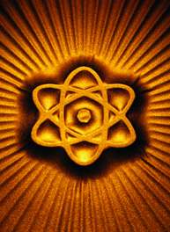
Neutrons
Neutrally charged atomic particles…
Emitted from the nucleus of the atom
Wide spectrum of energies
Can easily penetrate many materials
Generally produced by reactors or accelerators
Can “activate” non-radioactive materials

Slide 17
Photons
Electromagnetic radiation emitted from the nucleus or electron shells
Photons are highly penetrating
Unshielded photon sources can be a severe radiation hazards

Slide 18
Photons: X-Ray vs Gamma Ray
Gamma Ray
X-ray

Slide 19
Gamma Radiation: RAM
Electromagnetic radiation emitted from the nucleus
Only accompanies other emissions
No isotope decays by “pure” gamma emission

Slide 20
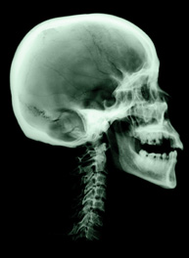
X-Ray Radiation: RPM
Emitted as a broad spectrum of energies
Result of electrons interaction with a tungsten target (Bremsstrahlung)

Slide 21
The Penetrating Powers of Alphas, Betas and Photons
CONCRETE
BOOK
Alpha
Beta
Photon
1 meter
Sheet of Paper

Slide 22
Half Value Layer (HVL)
HVL
100% intensity
50% intensity

Slide 23
Photon Interactions with Matter
Photo-Electric Effect
Compton Scattering
Pair Production

Slide 24
Photo-Electric Effect
e⁻

Slide 25
Compton Scattering
hv’
θ
ϕ
e⁻
hv

Slide 26
Pair Production
511 keV
e⁺
511 keV
e⁻
hv = 2m_{o} c² + T₊ + T₋

Slide 27
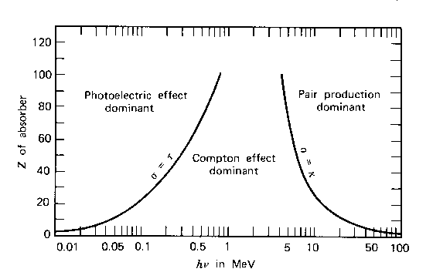
Photon Interactions

Slide 28
Part II -- Instrumentation
In this section we will discuss:
Detection Modes
Detector Types
Detection Limitations

Slide 29
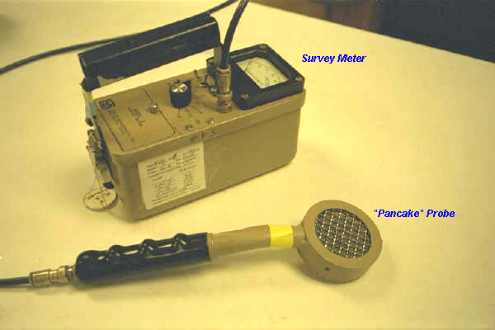
Detector Types
Gas Filled
Ion chamber
GM tubes
Pancake
Thin window
Gas filled proportional Counters
Scintillators
Liquid Scintillation counters (LSC)
NaI(Tl)
Solid State
HPGE
Ge(Li)
CdTe

Slide 30
Gas Filled Detectors
Detector signal from formulation of ion pairs
Ion pairs result from radiation interaction with detector gas
Detector signal is made via applied voltage differential which collects ions at poles
All gas
Thin window
-------------------------
+++++++++++++++
+++++++++++++++
-------------------------
HV

Slide 31
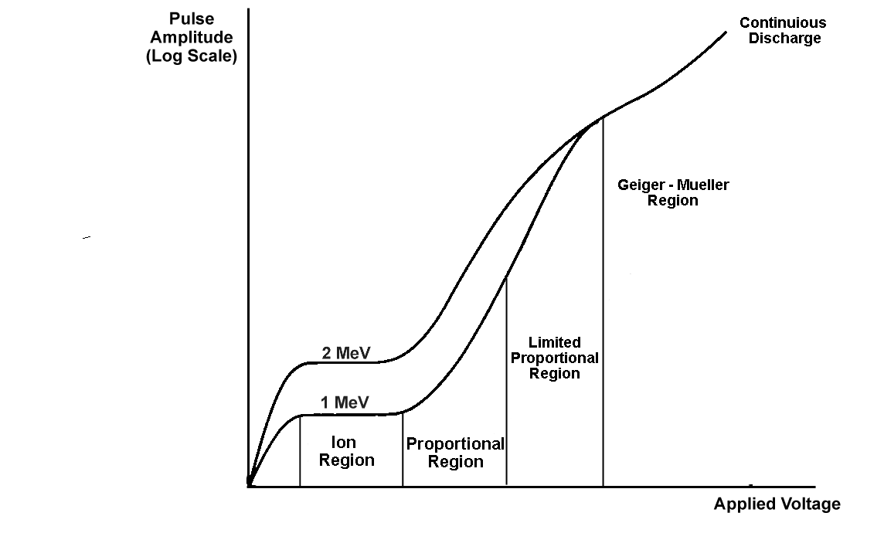
Gas Filled Detectors Applied Voltage
Notes:
Ionization Region As voltage is increased in the ionization region (Region II), there is no appreciable increase in the pulse height. The field strength is more than adequate to ensure collection of all ions produced; however, it is insufficient to cause any increase in ion pairs due to gas amplification. This region is called the ionization chamber region. Proportional Region As voltage increases to the proportional region (Region III), the pulse height increases smoothly. The voltage is sufficient to produce a large potential gradient near the anode, and it imparts a very high velocity to the electrons produced through ionization of the gas by charged radiation particles. The velocity of these electrons is sufficient to cause ionization of other atoms or molecules in the gas. This multiplication of electrons is called gas amplification and is referred to as Townsend avalanche. The gas amplification factor (A) varies from 103 to 104. This region is called the proportional region since the gas amplification factor (A) is proportional to applied voltage.
Limited Proportional Region In the limited proportional region (Region IV), as voltage increases, additional processes occur leading to increased ionization. The strong field causes increased electron velocity, which results in excited states of higher energies capable of releasing more electrons from the cathode. These events cause the Townsend avalanche to spread along the anode. The positive ions remain near where they were originated and reduce the electric field to a point where further avalanches are impossible. For this reason, Region IV is called the limited proportional region, and it is not used for detector operation.
Geiger-Müller Region The pulse height in the Geiger-Müller region (Region V) is independent of the type of radiation causing the initial ionizations. The pulse height obtained is on the order of several volts. The field strength is so great that the discharge, once ignited, continues to spread until amplification cannot occur, due to a dense positive ion sheath surrounding the central wire (anode). V4 is termed the threshold voltage. This is where the number of ion pairs level off and remain relatively independent of the applied voltage. This leveling off is called the Geiger plateau which extends over a region of 200 to 300 volts. The threshold is normally about 1000 volts. In the G-M region, the gas amplification factor (A) depends on the specific ionization of the radiation to be detected.

Slide 32
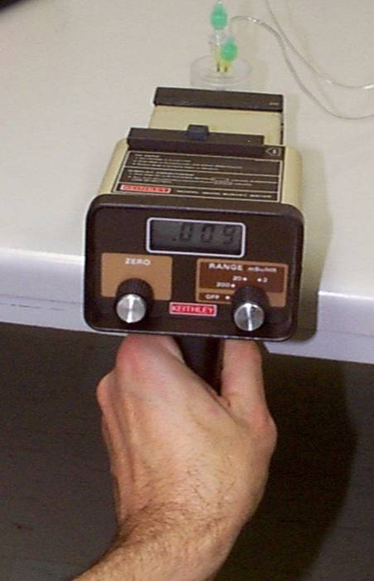
Gas Filled - Ion Chambers
Primary function
Used to quantify exposure in air
Roentgens

Slide 33
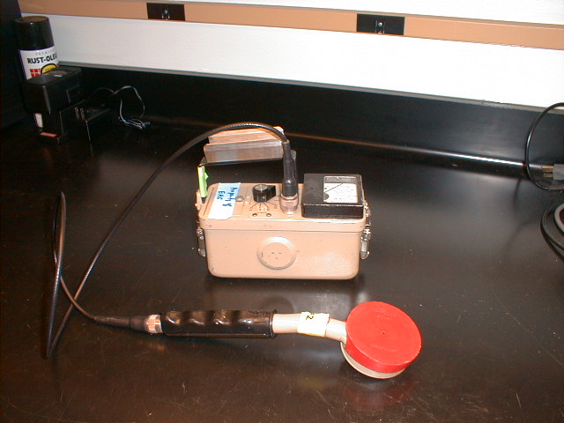
Gas Filled - G-M Detectors
Primary function
Used to detect the presence of radioactive material
cpm

Slide 34
Scintillation Detectors
Detector made of
Scintillator
PMT (Photo Multiplier Tube)

Slide 35
Scintillation Detector Operation
Detection Network
Photo-Multiplier Tube
Radiation is absorbed in the Scintillator
Scintillator Produces Secondary Photons
Number Relates to Primary Energy
Emission are Quasi-Monoenergetic
Able to Measure Dose Rate
Notes:
A PMT is an extremely sensitive detector of light. These detectors multiply the signal produced by incident light by as much as 10^8. Once photons enter a PMT they strike a photocathode which is a thin deposit on the entry window of the PMT which converts the photons to electrons via the PE effect. Focusing electrodes direct these electrons to dynodes which are essentially electrodes held at increasing voltages. So electrons are accelerated towards the first dynode (gaining energy) so when they strike it more electrons are produced and so on as a cascade. An anode collects this accumulation of charge resulting in a sharp current pulse indicating the arrival of a photon at the photocathode.

Slide 36
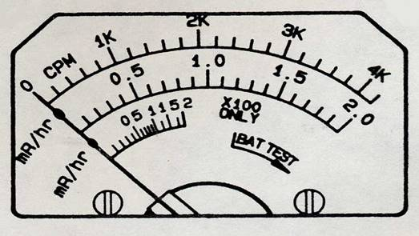
Detection Instrument Use
Ensure Meter within Calibration
Information can be found on calibration sticker
Ensure Proper Function
Battery Check
Use check source
Must be in OK Range to Use
Determine Background
Move to a Low Radiation Area
Start With Highest Scale
Readjust Sensitivity as Needed
GM Counters/Scintillators
Hold Probe Near Area of Interest
Note Reading
Move Slowly

Slide 37
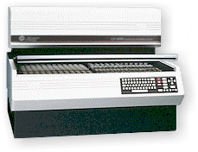
Liquid Scintillation Counter (LSC)
Most common Instrument used for the measurement of low energy beta emitters (H-3, C-14, S-35 etc…)

Slide 38
LSC Detectors
Samples are dissolved and suspended in “cocktail” with scintillator
The photo multiplier tubes are used to detect light from “cocktail”
Coincident circuit used to record true counts.
PMT
PMT
Coincidence Circuits
Electronics

Slide 39
Part III -- Units of Measurement
Our discussion will cover:
SI Prefixes
Quantitative units
Exposure
Dose

Slide 40
Units of Measure
Purpose: Familiarization with some commonly used terms in Radiation measurement and safety

Slide 41
SI Prefixes
Factor
Prefix
Symbol
10⁶
mega
M
10³
kilo
k
10⁻²
centi
c
10⁻³
milli
m
10⁻⁶
micro
μ
10⁻⁹
nano
n

Slide 42
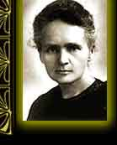
Unit of Activity
Curie (Ci)
radioactivity within of 1 gram of radium

Slide 43
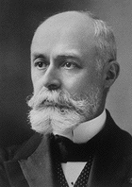
Unit of Activity
Becquerel (Bq)
Quantity of radioactive material decaying at a rate of one transformations per second
1 Ci = 3.7 x 10¹⁰ Bq
37,000,000,000 Bq or
37,000,000,000 dps

Slide 44
Half-Life
The time it takes for a quantity of a radioisotope to decay to one-half its initial amount
% of Radioactivity
HALFLIFE
Number of Half-lives

Slide 45
Activity Decay Calculation
A_{t} = A_{o}e^{-λt}
Where: A_{t} = Activity at time t
A_{o} = Original Activity of sample
λ = The radioactivity decay constant
λ = 0.693/T_{1/2}
T_{1/2} = Half-life of isotope
t = Decay time
This is the equation for computing the activity of a radionuclide remaining in a sample after it has undergone decay for some time interval.

Slide 46
Exposure Units
Roentgen (R)
Radiation Absorbed Dose (Rad)
Roentgen Equivalent Man (Rem)
Dose Equivalent (DE)
Effective Dose Equivalent (EDE)
Committed Dose Equivalent (CDE)
Committed Effective Dose Equivalent (CEDE)
Total Effective Dose Equivalent (TEDE)

Slide 47
Roentgen (R)
A measure of exposure in air
2.58 x 10⁻⁴ coulombs per kg _{air}
5.4 x 10⁷ MeV per g _{air}

Slide 48
Radiation Absorbed Dose (rad)
Amount of energy imparted to matter
1 rad = 100 ergs per gram
Gray (Gy) = 100 rads

Slide 49
Roentgen Equivalent Man (rem) or (r)
Dose equivalency (DE) applied to rad(s) for a specific type of radiation (Photon, Beta, Alpha, Neutron) and/or tissue sensitivity (W)
rad x DE x W = r

Slide 50
Exposure metrics (r)
Effective DE (EDE)
Sum of DE and W for each irradiated organ(s)
Committed DE (CDE)
Sum of DE and W for organ(s) from intake of RAM
Committed Effective DE (CEDE)
Sum of CDE and W for irradiated organs
Total Effective DE (TEDE)
Sum of EDE and CDE

Slide 51
Part IV -- Radiation Biology
Here we will explore:
Sources of Radiation
Biological Effects
Exposure Limits

Slide 52
Sources of Radiation Exposure
Background radiation (non-smoker)= 360 mrem/year

Slide 53
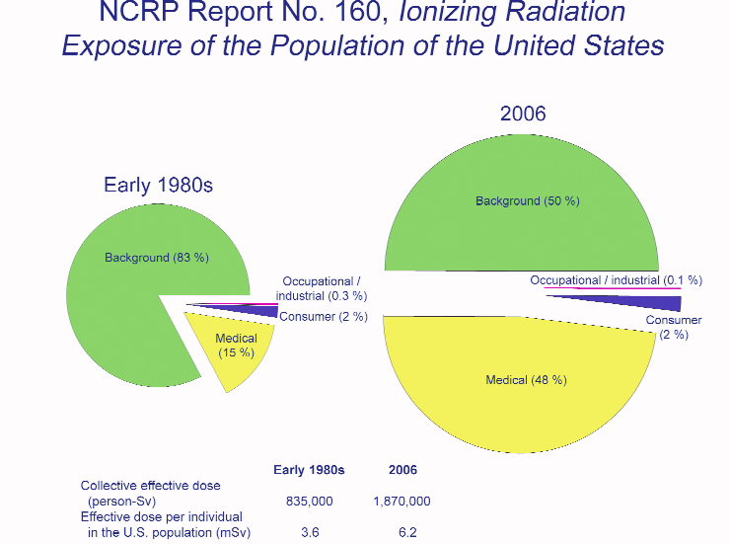

Slide 54
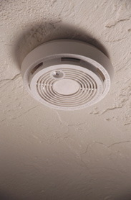
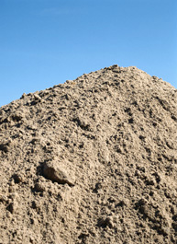
Sources of Ionizing Radiation
Consumer products
Naturally Occurring
Medical exposure

Slide 55
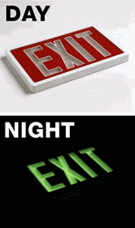
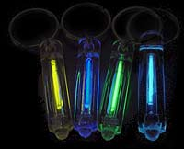
Consumer Products
Radio-luminous Products

Slide 56
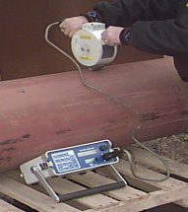
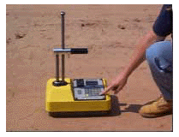
Consumer Products
Industrial

Slide 57
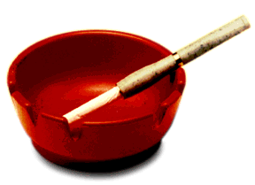
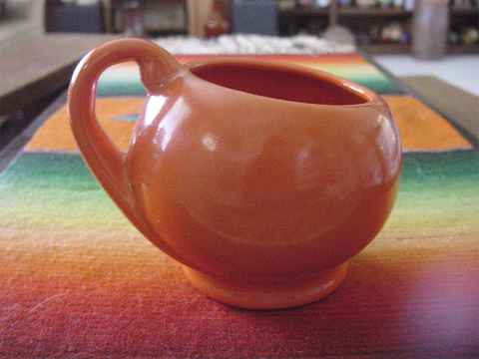
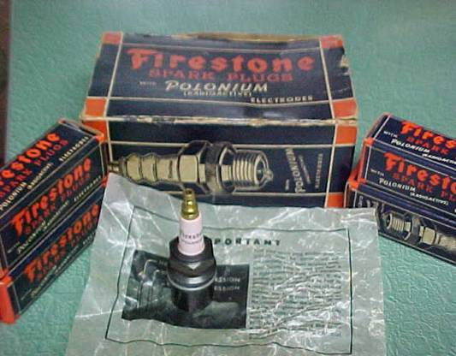
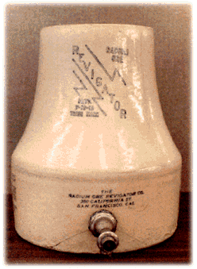
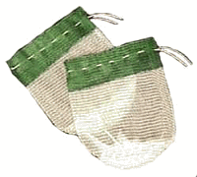
Consumer Products
Miscellaneous

Slide 58
Naturally Occurring Radiation
Cosmic radiation--originating from outside the earth’s atmosphere
Terrestrial radiation--naturally occurring radionuclides in the environment

Slide 59
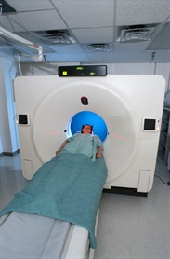
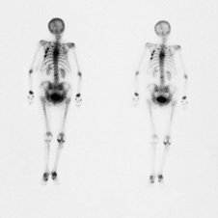
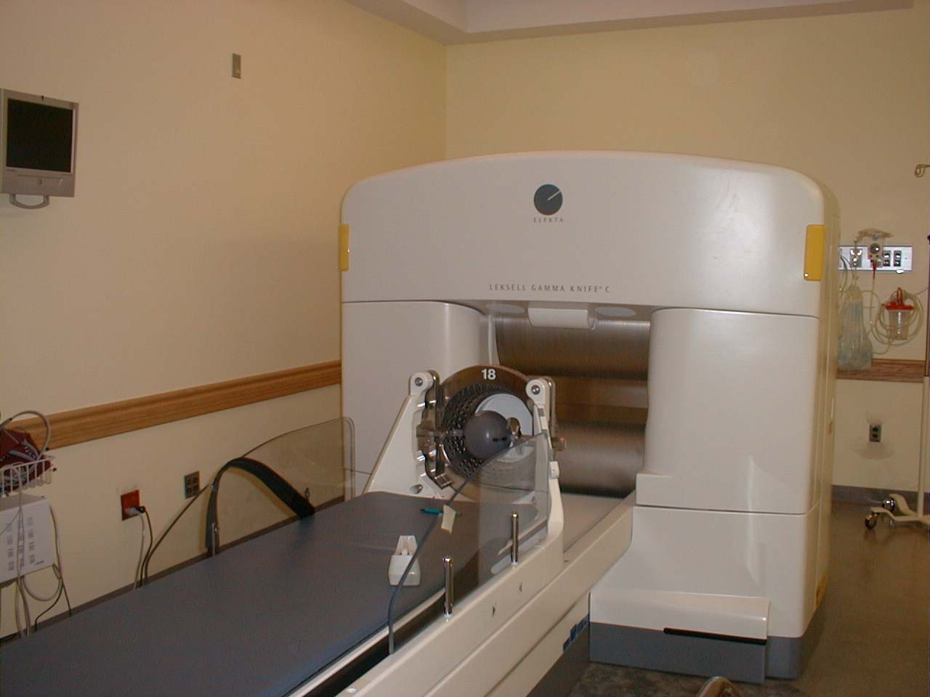
Medical Exposures
X-ray exposure
Nuclear medicine procedure
Radiation oncology procedure

Slide 60
Biological Effects
Whether the source of radiation is natural or man made, whether it is a small dose of radiation or a large dose, there will be some biological effects.
Radiation causes ionization of atoms
which affect molecule
which may affect cells
which may affect tissue
which may affect organs
which may affect the whole body

Slide 61
Direct vs. Indirect Effects
Direct
Produced by the initial action of the radiation
Example is a strand break in the DNA caused by an ionization in the molecule

Slide 62
Direct vs. Indirect Effects
Indirect
Produced by later chemical reaction of free radicals
Example is a DNA strand break caused by (OH.) radical attacking a DNA sugar
H.
OH.
OH.

Slide 63
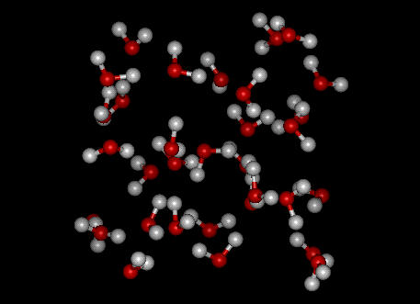
Ionization of Water
H₂O → H. + OH.
Recombines as:
(1) H. + H. → H₂
H. + OH. → H₂O
OH. + OH. → H₂O₂

Slide 64
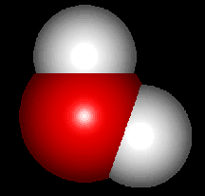
Chemical Protection
Encourage OH. radicals to recombine with H to form water
Saturate cells with H donating compounds

Slide 65
Acute vs. Chronic Dose
Acute
Large dose delivered in a short time
Chronic
Same dose delivered in increments over a long time

Slide 66
Prompt vs. Delayed Effects
Prompt
Acute Radiation Syndrome
Skin Burns
Delayed
Cancer Induction
Leukemia
Degenerative Changes
Life Shortening
Cataracts
Genetic

Slide 67
Prompt Effects
Lethal Dose (LD _{50/60}) for whole body X or gamma radiation is approximately 450 rad

Slide 68
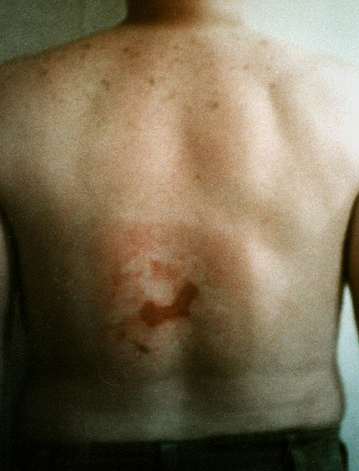
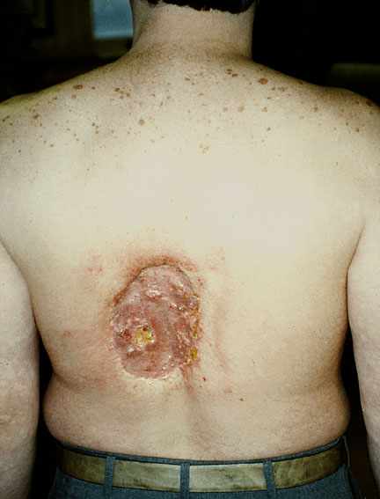
Skin Burn

Slide 69
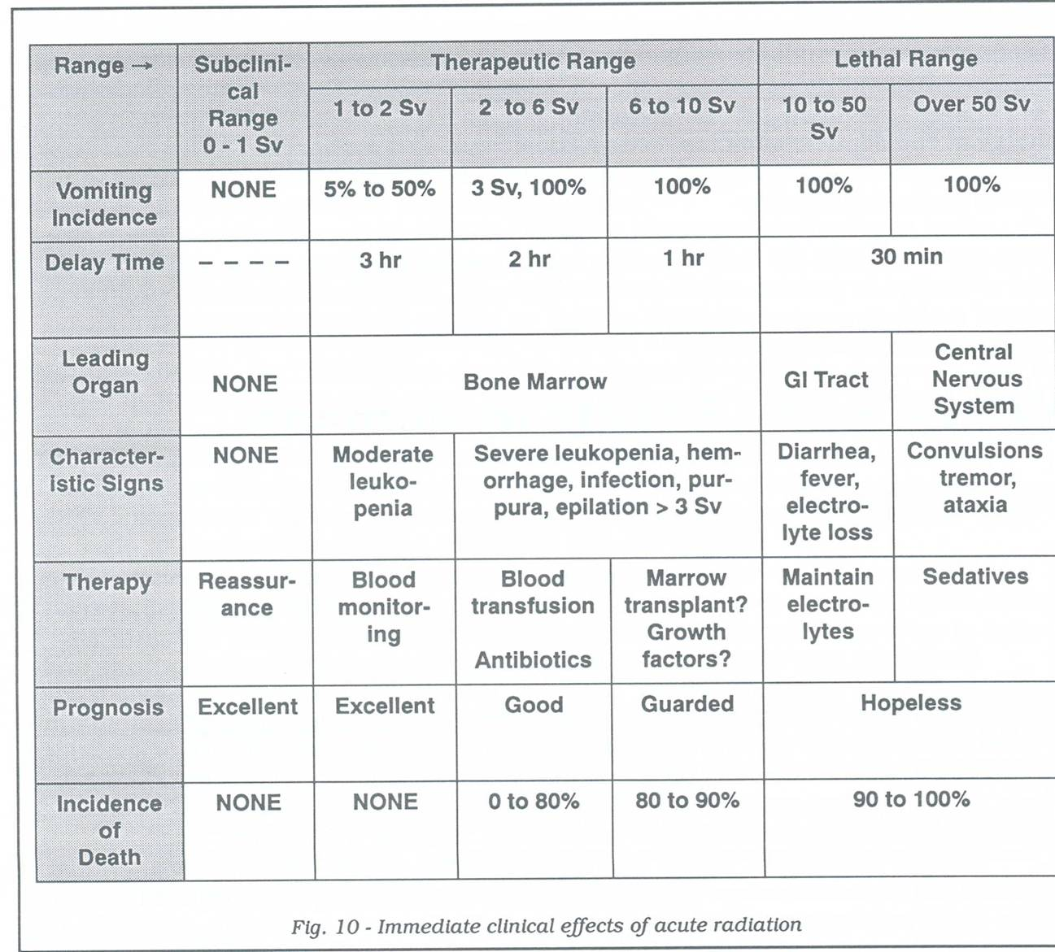
Prompt Effects of Acute Exposure

Slide 70
Delayed Effects
Definition:
Radiation, given either acutely or chronically, increases the incidence of a number of conditions observable from 2-20 years after the exposure was delivered.

Slide 71
Types of Delayed Effects
Carcinogenesis
Leukemia (2-3 years)
Skin (10 years)
Lung (10 years)
Bone (3-4 years)
Thyroid (4-5 years)
Heredity
The effects on humans remains in question
Lifespan Shortening
Chronic exposure results in
7% shortening for every
dose equivalent to the LD50
Surviving an acute LD50
dose has life expectancy
reduction of 50%
Tissue Effects
Cataracts (200 rad/3 years)
Sterility (50 rad/30-60 days)

Slide 72
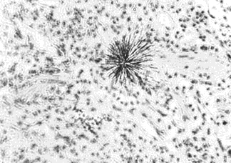
Damage from Alpha Emitter

Slide 73
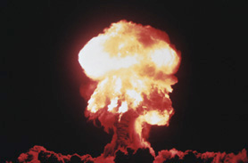
Sources of Data
Nuclear bomb survivors (Japan)
Fallout
Accidents
Criticalities
Radiation Devices
Radioisotopes

Slide 74
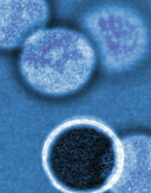
Cell Sensitivity
Law of Bergonie and Tribondeau
Cells will be radiosensitive if they:
Have high division rate
Have long dividing future
Are of unspecialized type

Slide 75
Relative Radiosensitivity of Cells, Tissues, and Organs
Type
Blood-forming
Organs
Reproductive
Organs
Digestive
Organs
Vascular
Organs
Skin
Bone
Teeth
Respiratory System
Muscles and
Connective Tissue
Nervous
System
Extremely
Radio
sensitive
Moderately
Radio
sensitive
Radio
sensitive
Moderately
Radio
resistant
Radio
resistant
Relatively
Radio
resistant
Very
Radio
resistant
Extremely
Radio
resistant
Biological Response

Slide 76
Stochastic vs. Non-stochastic Effects
Stochastic
Occurs in a statistical manner
Risk of occurrence increases with dose
Example: Cancer
Non-stochastic
Clear causal relationship
Threshold
Severity increases with dose
Example: Skin reddening

Slide 77
Effects Depend On...
Rate of absorption
Area exposed
Variation in species
Variation in cell sensitivity

Slide 78
Radiation Hormesis
Theory that small amounts of radiation are necessary for good health
Studies show 3 recognizable effects:
Increased life span
Increased growth and fertility
Reduction of cancer incidence

Slide 79
Dose Effects
Linear No Threshold Risk Model
Known Effects
1
Effects (Cancer Risks)
2
3
4
Dose (Rem)
50 Rem

Slide 80
Exposure Limits
Body Part
Whole-body (Head, trunk including male gonads, arms above elbow and legs above knees)
Lens of the eye
Extremities
Skin of the whole-body
Declared pregnant worker
General public whole-body
Limit
5 rem (0.05 Sv)
15 rem (0.15 Sv)
50 rem (0.50 Sv)
50 rem (0.50 Sv)
0.5 rem (0.005 Sv)
0.1 rem (0.001 Sv)

Slide 81
Exposure Limits for Minors
Body Part
Whole-body (Head, trunk including male gonads, arms above elbow and legs above knees)
Lens of the eye
Extremities
Skin of the whole-body
Limit
0.5 rem (0.005 Sv)
1.5 rem (0.015 Sv)
5.0 rem (0.050 Sv)
5.0 rem (0.050 Sv)

Slide 82
Estimated Loss of Life Expectancy From Health Risks
Health Risks
Unmarried male
Cigarette smoking - male
Unmarried female
Overweight by 20%
Cigarette smoking - female
Auto Accidents
Alcohol consumption (US avg.)
Home accidents
Drowning
Occupational radiation exposure
Safest jobs (e.g. teaching)
Natural background radiation (calculated)
Medical x-rays (Calculated from US aver.)
Natural disasters
Estimated # of Days Lost
3500
2250
1600
900
800
200
130
95
41
40
30
8
6
3.5

Slide 83
Part V -- Radiation Protection
We will discuss the following:
External Hazards and Precautions
Internal Hazards and Precautions
Dosimetry Program
Bioassay Program
Laboratory Safety

Slide 84
Radiation Protection
Common Sense

Slide 85
Radiation Protection
A s
L ow
A s
R easonably
A chievable

Slide 86
ALARA Program
This program is designed to restrict actual occupational exposures to less than 10% of the Maximum Permissible Dose (MPD).
Investigation levels have been established in accordance with the ALARA Program.

Slide 87
ALARA Investigation Levels
 | Level I | Level II
Whole Body | >125 mrem/quarter | >375 mrem/quarter
Eye | >375 mrem/quarter | >1125 mrem/quarter
Skin or Extremity | >1250 mrem/quarter | >3750 mrem/quarter

Slide 88
Procedures for ALARA Level Review
Level I:
Notice will be sent to the individual informing them of the exposure.
Level II:
Notice will be sent to the individual informing them of the exposure;
Investigation of exposure will be conducted by Radiation Safety personnel;
If warranted, action to prevent or reduce ongoing exposures will be taken.

Slide 89
External Exposure
External exposure precautions may be necessary when working with photon emitters or high energy beta emitters like P-32.

Slide 90
External Exposure
Exposure is controlled by three basic principles:
Time
Distance
Shielding

Slide 91
Time
The amount of exposure an individual receives is directly proportional to the time of exposure. Therefore, minimize the amount of time spent with a radioactive source.

Slide 92
Distance
d= 50 cm
12,000 mR/hr
4.8 mR/hr
Exposure from a point source of radiation diminishes according to the inverse square law I=I₀1/r² (doubling the distance from the source will decrease the exposure fourfold)

Slide 93
Shielding
Any object between you and a source of radiation will provide some shielding. In general, the more dense an object or material, the better the shield.

Slide 94
Shielding

Slide 95
External Exposure Personnel Monitoring
External radiation exposure is measured and recorded by personnel monitoring devices.
Three major types are:
Thermoluminescent dosimeters
Film badges
Pocket Dosimeters
Required to monitor at 10% of dose limit.
Personnel monitoring provides a permanent legal record of an individuals occupational exposure to radiation

Slide 96
Dosimeters
Purpose:
Monitor the external radiation exposure of radiation workers

Slide 97
Global Dosimetry Information

Slide 98
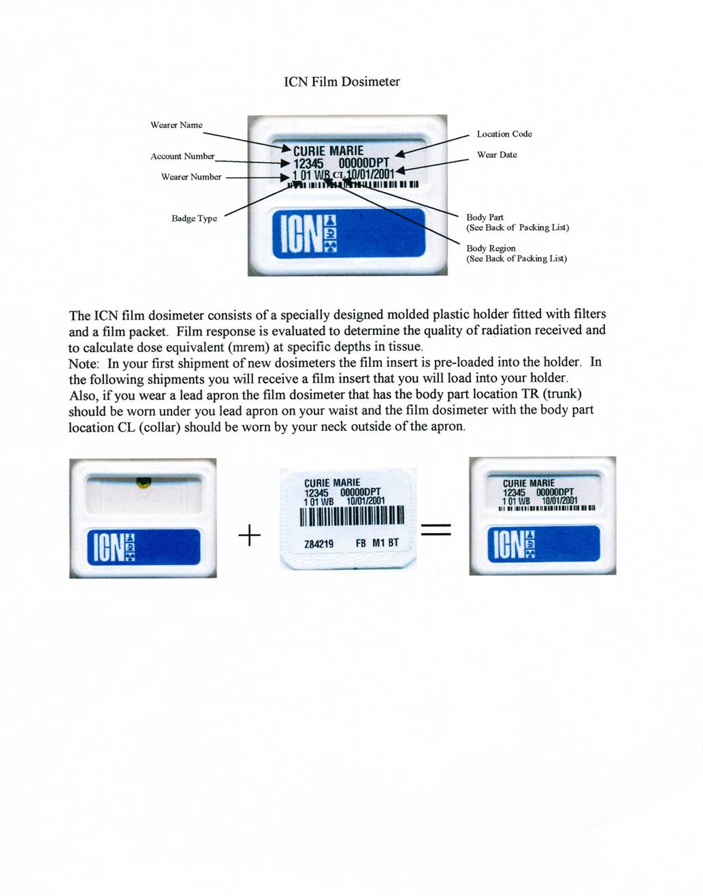
Global Dosimetry Information

Slide 99
When Are Dosimeters Issued and Returned?
Issued:
Quarterly dosimeters are issued on the first day of every quarter (January, April, July, October).
Monthly dosimeters are issued on the first day of the month.
Any individual working with P-32, Cr-51, > 1mCi I-125 will be issued a badge
Dosimeters are specific for each individual, therefore, they are to be worn only by that individual.
Returned:
All dosimeters should be returned to the Radiation Safety Office within fifteen days (15) of receiving new dosimeters.

Slide 100
Proper Handling of Dosimeters
When to Wear the Dosimeter
Dosimeters must be worn when handling isotopes, which includes picking up a package from EHS.
Storage of the Dosimeter
When not being worn, dosimeters should be left in the lab and stored in an area free of radiation, excessive heat and moisture.
Location to Wear the Dosimeter
Dosimeter should be worn as indicated on your badge and on the outside of your lab coat.
Ring badge, if assigned, should be worn on prominent hand, under your gloves, with label facing the radiation source.

Slide 101
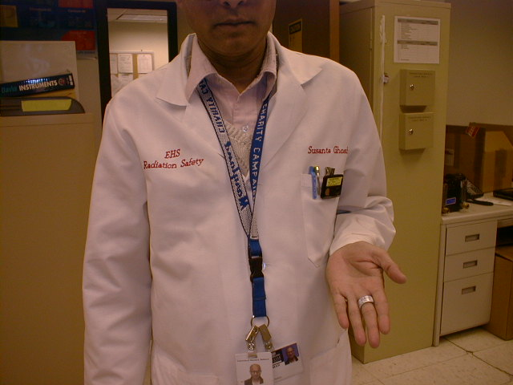
Location to Wear Dosimeters
Wear your body badge between the waist and neck.
Wear your ring badge under your glove, label facing toward radiation source

Slide 102
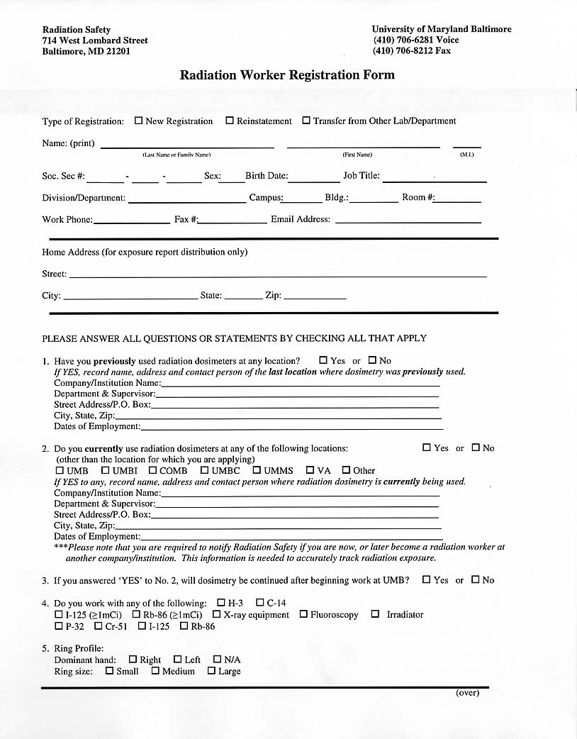
Obtaining A Dosimeter

Slide 103
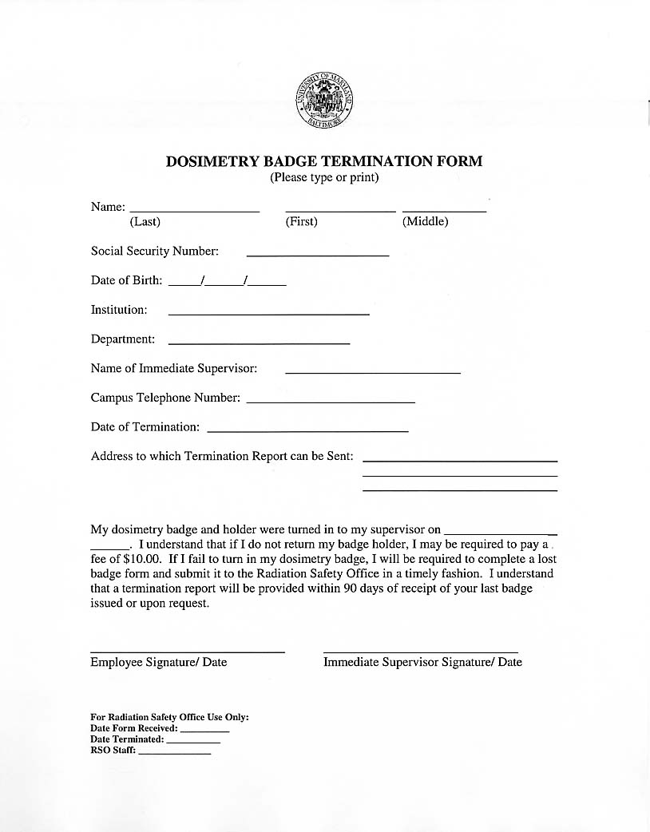
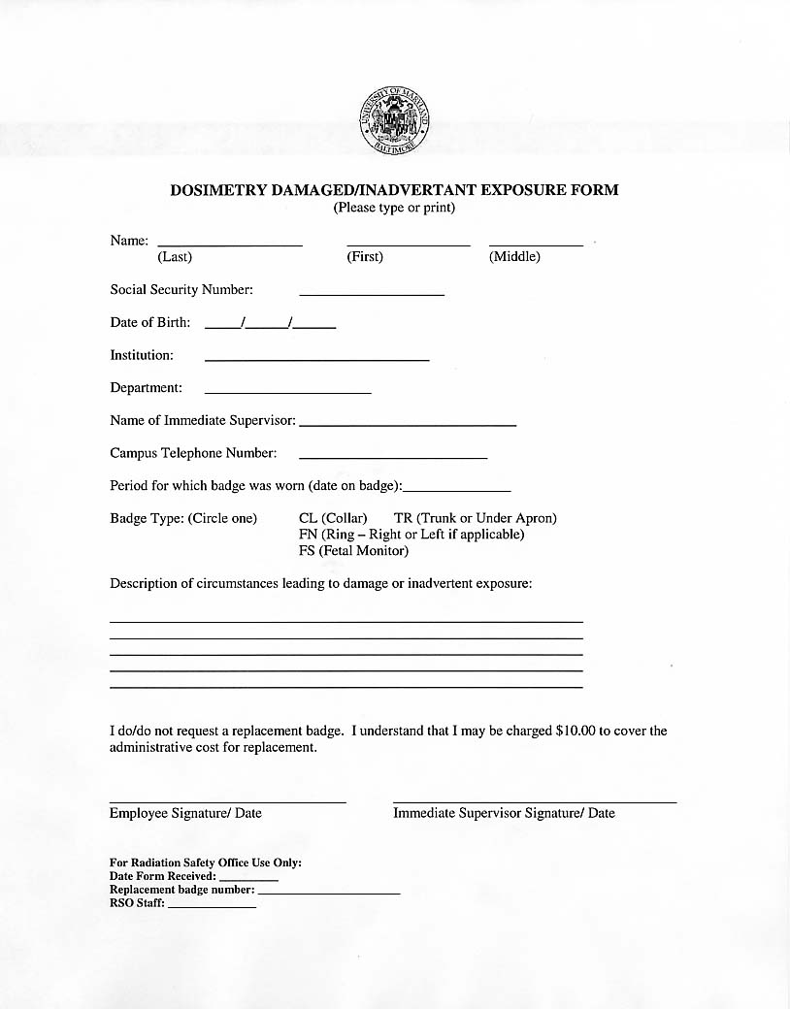
Dosimetry Forms

Slide 104
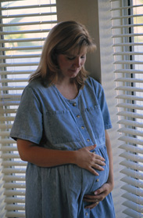
Declared Pregnancy
Pregnant worker may declare pregnancy to RSO
Entitles worker to lower dose limits
Additional monitoring (monthly)
Possible change of duties
Cannot be forced to declare pregnancy
http://afcf.umaryland.edu/ehs/public/pregnantworker/

Slide 105
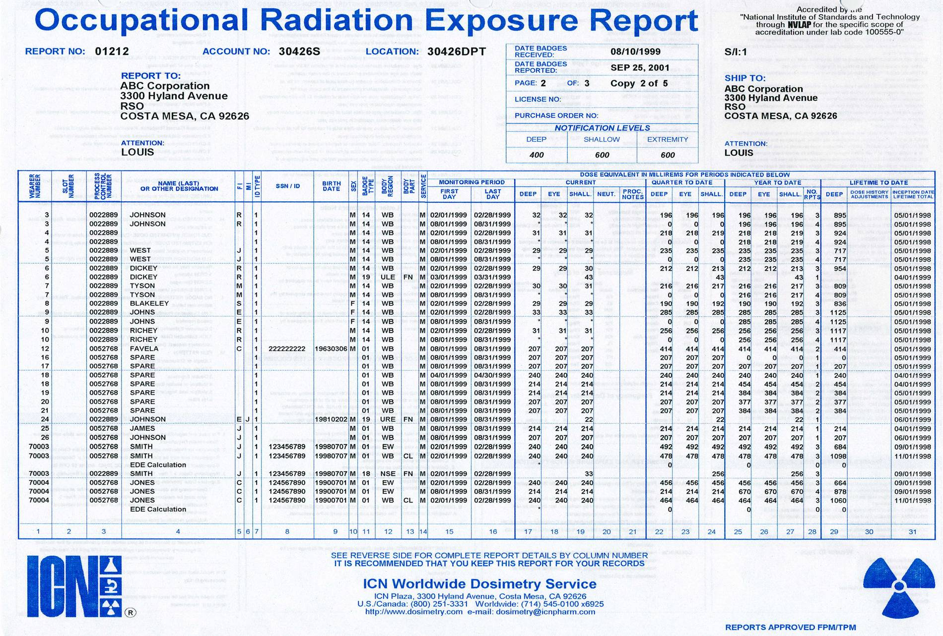
Dosimetry Report

Slide 106
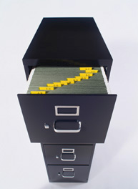
Dosimetry Report
Reports should be maintained on
file for two years and should be
readily available during semiannual
inspections.

Slide 107
Internal Exposure
All radionuclides present a potential for internal exposure if taken into the body. Entry into the body can occur by inhalation, ingestion, injection, or absorption.

Slide 108
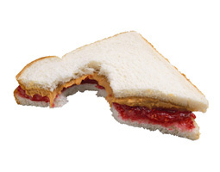
Modes of Entry
Inhalation
Ingestion
Injection
Absorption

Slide 109
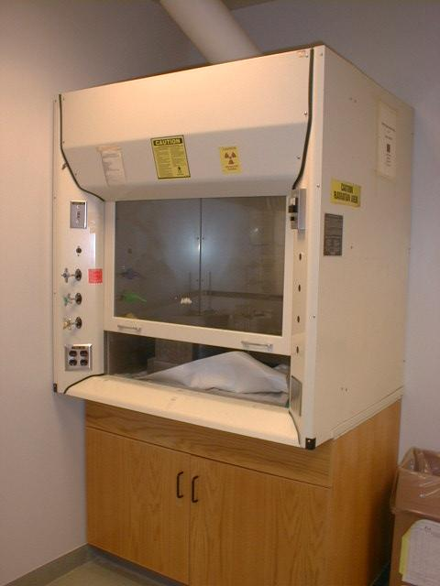
Inhalation Control
Control of inhalation is accomplished by working with volatile compounds in a fume hood.
Iodinations are the most common work involving volatile radioactivity in the lab.

Slide 110
Ingestion Control
Control is maintained by following general safe work habits:
identifying radiation use areas
controlling contamination
laboratory monitoring
practicing good housekeeping
No eating, drinking or smoking in laboratory

Slide 111
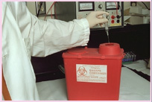
Injection Hazards
Always use sharp containers to dispose of needles and sharp objects.
NEVER try to:
Recap Needles
Bend Needles
Break Needles

Slide 112
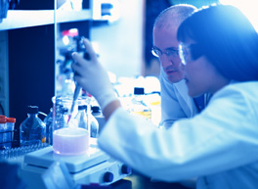
Absorption
Always wear proper protective equipment (PPE) when working in the laboratory. Always select the appropriate barrier for the material that you are handling.

Slide 113
These Are Not Allowed in the Lab
No eating, drinking, smoking, no pipetting by mouth or applying cosmetics (lipstick, chap stick, eyeliner, etc.) should take place in a posted area

Slide 114
Internal Exposure Monitoring
Internally deposited radioactive material can be monitored by measuring the radiation emitted from the body or by measuring the amount of radioactive material contained in the urine or feces. These monitoring techniques are called bioassays.

Slide 115
Bioassay Program
Purpose:
Monitor the internal radiation exposures of radiation workers

Slide 116
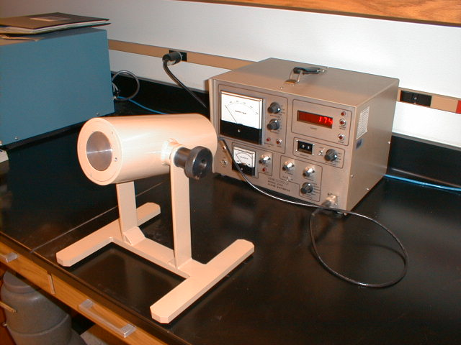
Bioassay Program
Types of Bioassays
Thyroid Bioassay
Urine Analysis

Slide 117
Bioassay Program
Participants
Personnel who perform Iodinations.
Personnel who use high amount of Tritium (mCi amounts).
Personnel who are involved in a major spill/accident.

Slide 118
Summary
Use Time, Distance, and Shielding to keep exposure ALARA
Recognize the internal exposure pathways
Control contamination
Use Proper Protective Equipment
Common Sense — Be safe.

Slide 119
Part VI -- What to Expect at UMB
We will discuss the following:
Individual Responsibility
Authorization Process
Receipt, Use and Transfer of RAM
Security
Postings and Signs
Inspection Process
Laboratory Safety
Change in Status
Miscellaneous Requirements
Emergency Procedures
Practical Instruction

Slide 120
Individual Responsibility
Radiation worker registration
Appropriate dosimeter usage
Radiation worker training
Familiarization with authorization
Regulations and standards

Slide 121
Authorization Process
Complete and Return “Application for the Possession and Use of Radioactive Material in Basic Research.” http://www.umaryland.edu/ehs/research-registration/
http://cicero.umaryland.edu
Application reviewed by Radiation Safety Officer and Basic Research Safety Committee
Committee reviews application
Authorization approved/disapproved

Slide 122
Authorization Process
Authorization Issuance
The modifications for the protocol will be made in Cicero based on BRSC recommendations .
The applicant has to attend a preauthorization conference with the Radiation Safety Officer before the official authorization is issued.
After attending the conference authorization is given to order and receive radioactive material.

Slide 123
Authorization

Slide 124
Standard Terms

Slide 125
Change in Status
Equipment
All equipment labeled with CRAM sign must be surveyed and wipe tested by RSD prior to repair, removal from lab and/or placement into trash.
Deletion of Room from Authorization
Any room listed on the authorization must be surveyed and wipe tested by RSD prior to removal of postings and deletion from authorization.
All modifications must be made in Cicero
All radioactive material and waste must be removed from room prior to performing surveys.

Slide 126
Change in Status
Leaving the Institution
Written notification must be provided to RSD.
All radioactive material and waste must be removed.
Dosimetry devices should be returned to RSD.
Surveys and wipe tests of all rooms listed on the authorization will be performed by RSD to permit unrestricted use of these rooms.
Addition of Room to the Authorization
Written notification along with a facility diagram, which outlines wipe test areas, must be provided to RSD indicating desire to add room (Cicero modification).
Proper postings will be supplied by RSD.

Slide 127
Change in Status
Inactivation
If long periods of non-use, user can request authorization to become inactive.
INI indicates that no material is on hand.
All radioactive material and waste must be removed.
Surveys and wipe tests will be performed by RSD before inactivation status can be granted.
Dosimetry devices should be returned to RSD.
Monthly wipe tests not required. In addition, will not be subject to semiannual inspections.
Changes to isotopes, possession limits or protocols
An amendment to the authorization must be requested by completing pertinent sections of the Basic Research Application (modification in Cicero).
Application will be submitted to RSO as well as Committee for review.

Slide 128
Absence of An Authorized User
If authorized user will be absent from the laboratory for one month or less
The use of radioactive material should be conducted under the supervision of a qualified technical staff member approved by the Radiation Safety Officer, or
Comply with the rules for absences greater than one month.

Slide 129
Absence of An Authorized User
If authorized user will be absent from the laboratory for greater than one month
Submit to the BRSC the name of the individual who will temporarily assume the responsibility for the use of radioactive material. This individual must meet the qualifications to be an authorized user, or
Suspend the use of radioactive material and ensure the material is in secured storage for the duration of the absence.

Slide 130
Sewer Disposal Permit
State regulations allow licensees to discharge limited quantities of radioactive material via the sanitary sewer.
To obtain permission, each authorized user must complete and submit a Sewer Disposal Application. Permits may not be shared between users.
Once submitted, the application will be reviewed by Radiation Safety and approved or disapproved.

Slide 131
Sewer Disposal Permit
The Permit expiration date is the same as that of the Radioactive Materials Authorization.
Amendments to Sewer Disposal Permits must be granted by the Radiation Safety.
The sewer disposal site and adjacent areas including the floor must be surveyed on a regular basis. Include these areas in the monthly contamination survey.

Slide 132
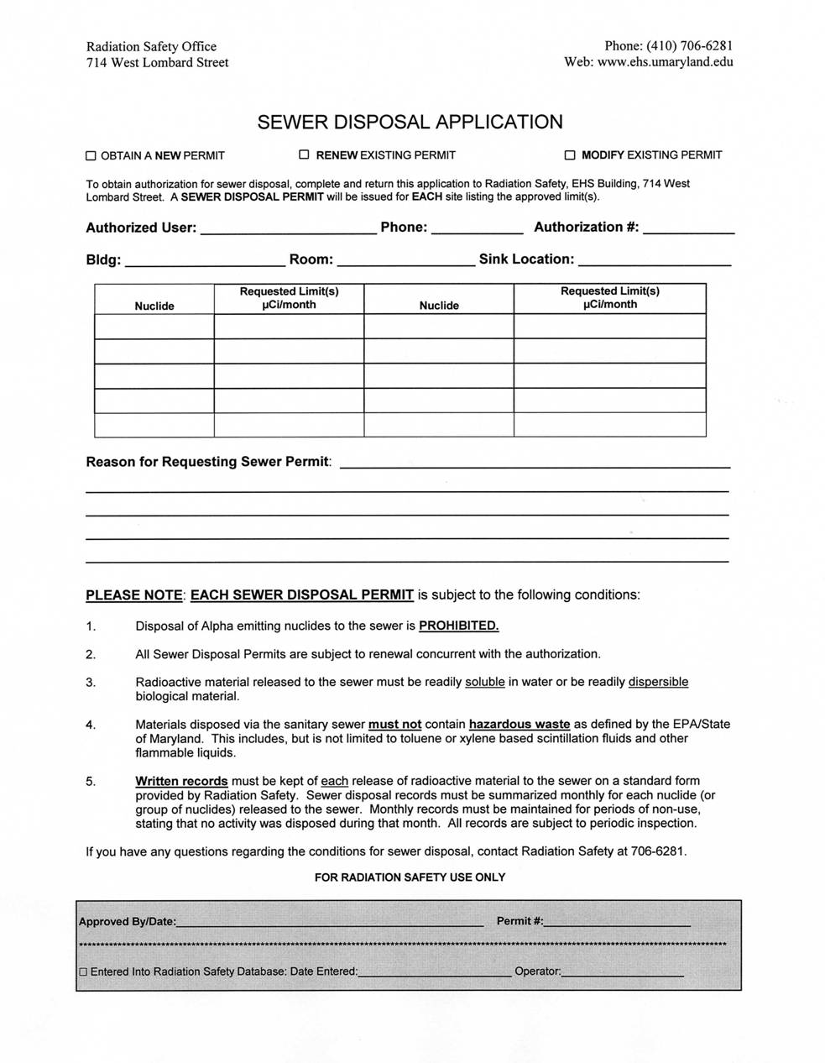
Sewer Disposal Permit Application

Slide 133
Sewer Disposal Permit

Slide 134
Assume this Site is Contaminated

Slide 135
Receipt, Use and Transfer
All requisitions require pre-approval
Receipts of RAM are by RSO only
Use in approved protocols only
All transfers require pre-approval
All shipments through RSO only

Slide 136
Package Process
Obtain a requisition number
Call vendor and order product
Await call from Radiation Safety Office
Pick up package at EHS building

Slide 137
Obtaining a Requisition Number
Obtain requisition number
Call RSD at 6-7055
Walk in PO requisition
Information required:
Authorized user’s name
Isotope
Activity
Vendor
Compound
Number of items ordered
Catalogue number
PO number or Visa information

Slide 138
Package Pick Up
To be picked up at room 111
714 W. Lombard Street
8:00 a.m. to 12:00 p.m.
Packages are delivered to UMBC on Tuesdays and Fridays
Items needed for Package Pickup
Photo ID
Assigned Dosimeter
Package Transport Requirements
Eating, drinking, smoking or applying cosmetics while transporting radioactive material is strictly prohibited
Packages shall be taken directly to your laboratory once they have been picked up

Slide 139
Receipt of Package in Lab
Before discarding the box into regular trash, obliterate all radiation labels and the words “Caution, Radioactive Materials,” which may be present on the outside of the box.

Slide 140
Receipt, Use and Disposal Form
RUD form will accompany each package received in the lab.
This form is used to track the use and disposal of the isotope.
Disposal should be recorded on the front of the sheet.
Form should be returned to EHS upon disposal or complete use of isotope.

Slide 141
Receipt, Use and Disposal Form
Each use of the isotope should be logged on the back of the form.

Slide 142
Transfer of Radioactive Material
Transfers of radioactive material to persons outside UMB must be conducted through this office.
Material may be transferred from UMB authorization to another user with prior approval from RSO.

Slide 143
Surveys
In this section we will discuss
Qualitative Surveys (meter surveys)
Quantitative Surveys (wipe tests)

Slide 144
Where and What to Survey
Survey work areas, storage areas, and areas where radioactive waste is stored. Also survey areas where contamination might be a concern. Such areas would include:
Floors, especially doorway thresholds
Bench tops and work surfaces
Common trash containers (insure no activity leaves the lab in this manner)
Fume hoods and incubators
Sinks
Centrifuges, LSC’s and other fixed equipment
Frequently handled items (pipettes, glassware, pens, telephones, door knobs, lab books, etc.)
Refrigerators and freezers
Rad waste storage areas
Personal protective equipment such as lab coats, safety glasses, etc.

Slide 145
Direct Survey (Qualitative)
Recommended:
Before procedure
After procedure
Once a month
During cleanup of a spill

Slide 146
What to do if Action Levels are Exceeded:
Direct Survey (above background):
Locate area of contamination (increased reading).
If area is covered, remove contaminated covering and resurvey area. Decontaminate if still contaminated.
If area/item is uncovered, decontaminate area/item.
Decontaminate until readings on meter no longer decrease.
Follow-up with wipe test to ensure that there is no removable contamination.

Slide 147
Survey Instruments
Calibrate
Before first use
Annually
Following repairs
Keep Records for 3 years
Meters are calibrated on a weekly basis at the Radiation Safety Office.
Upon completion of calibration, the lab will be notified via telephone.

Slide 148
Instrument Calibration
At UMB, UMMS, UMBI, COMB and MPRC, the meter along with an interdepartmental billing form should be brought to office for calibration.
Interdepartmental billing form and directions are at http://www.ehs.umaryland.edu/rad/instrumentcal.cfm
For calibration of meters at UMBC, please call our office for pick-up. A billing form is not needed.

Slide 149
Interdepartmental Billing Form

Slide 150
Calibration Sticker

Slide 151
Calibration Certificate

Slide 152
Indirect Survey (Quantitative)
Mandatory:
Once a month**
**no material, no waste, no wipe test required
Using >1 mCi of P-32
Working with H-3
During clean up of a spill
Recommended:
Before Procedure
After Procedure

Slide 153
Indirect Method - Materials
Filter Paper
Q-tip
Vial
Scintillation Cocktail

Slide 154
Contamination
Disintegrations per minute (DPM)
DPM = Counts per minute/ Efficiency
Action Level = 200 DPM

Slide 155
Contamination Survey Results

Slide 156
What to do if Action Levels are Exceeded:
Indirect Survey (above 200 dpm):
Recount wipe that is above limits to ensure accurate count. If results are still elevated then proceed as stated.
Identify area of contamination (increased wipe test reading)
If area is covered, remove contaminated covering and resurvey area. Decontaminate if still contaminated.
If area/item is uncovered, decontaminate area/item.
Repeat wipe test to ensure that there is no remaining removable contamination.

Slide 157
Security
Always ensure that all radioactive materials are locked when laboratory is unattended, or in your line of sight when in use.

Slide 158
Lab Postings and Signs
Caution Radioactive Materials Sign
No Eating, Drinking or Smoking Sign
Good Radionuclide Lab Practices
Notice to Employees
Radiation Emergency Procedures

Slide 159
Postings
Areas or Rooms
Caution
Radioactive Materials

Slide 162
Labeling
Containers of Licensed Material
Equipment
CAUTION
RADIOACTIVE MATERIALS

Slide 163
Good Lab Practices

Slide 164
No Eating, Drinking or Smoking Sign

Slide 165
Notice to Employees

Slide 166
Emergency Procedures

Slide 167
Emergency Procedures

Slide 168
Inspection Worksheet

Slide 169
Supplies Needed to Work with Radioactive Materials

Slide 170
Supplies Needed to Work with Radioactive Materials

Slide 171
Miscellaneous Requirements

Slide 172
Lasers
Register lasers with the EHS office by completing an Application For The Possession And Use Of Lasers In Basic Research.
SOP’s must be prepared for Class 3b and/or Class 4 lasers to include a total hazard evaluation that consider all safety measures.
PPE required for the safe operation of each laser must be provided and worn by employees and visitors.
Compliance maintained with ANSI Standard Z136.1 in order to ensure that any exposure to lasers remains below the Maximum Permissible Exposure (MPE) values.
Practical and SOP training must be provided for all users prior to initial operation of a laser.

Slide 173
Irradiators
Document the use of self-shielded irradiators in the basic research application so that their use is included on the authorization (Cicero).
All users must undergo FBI finger printing to be deemed Trustworthy & Reliable
Compliance must be maintained with State of Maryland Regulations .
All users must undergo training to access the irradiators

Slide 174
Central Iodination Facility (CIF)
Any procedure involving the use of 1 mCi or more of Iodine-125 or 1 Ci or more of H-3 must be conducted in the CIF, 331A HH.
Authorization must specifically have approval for the use of these isotopes and quantities.
Central Iodination Facility Registration Form must be completed at least 24 hours prior to the intended use.
http://www.umaryland.edu/ehs/programs/radiation-safety/forms/ (must have MyEHS account)
Individuals will be required to participate in the bioassay program.
Individuals must attend both Radiation Safety Training and Iodination Performance Training.

Slide 175
Radiation Producing Machines
Register machines with the EHS office by completing an application.
All machines must be registered with MDE. Failure to register machines can lead to fines from MDE
Periodic inspections will be conducted by the Radiation Safety Office.
Inspections will be performed by a Private State Inspector once every three years.
The radiation safety office requires a complete list of machine users
All users must undergo training.

Slide 176
Animal Facilities
Animal facilities should be indicated in the basic research application
Necropsy
Presents both contamination and irradiation hazards
Procedures for sample collection and waste disposal should be followed
Irradiation
Implement time, distance and shielding
Personnel monitoring devices should be used
Use of mechanical restraining devices

Slide 177
Emergency Response
What to Do If There Is An Emergency

Slide 178
Minor Spills
Spills with 10 uCi or less of radioactive material.
Remove gloves.
Wash hands if they were contaminated from the spill.
Put on clean gloves.
Cover liquid spill with absorbent material.
Restrict traffic to the area.
Monitor everyone before they leave the area.
Notify the RSO.
Decontaminate.

Slide 179
Major Spills
Spills of 10 uCi or more of radioactive material
Notify all personnel to vacate the area and monitor them before they leave
Call EHS immediately
Confine the spill if possible, DO NOT attempt to clean up the spill until assisted by EHS
NO ONE IS TO RE-ENTER THE AREA UNTIL APPROVED BY THE RSO.

Slide 180
Decontamination
Personnel
Facility
Equipment

Slide 181
Proper Lab Set-up

Slide 182
Proper Lab Set-up

Slide 183
Proper Lab Set-up

Slide 184
Proper Lab Set-up

Slide 185
Proper Lab Set-up

Slide 186
What’s wrong with this picture?

Slide 187
What’s wrong with this picture?

Slide 188
What’s wrong with this picture?

Slide 189
What’s wrong with this picture?

Slide 190
Radioactive Waste Containers -- Use and Disposal Guidelines
Operations Division
Environmental Health and Safety
University of Maryland, Baltimore

Slide 191
Section 1 The Radioactive Waste Forms

Slide 192
Caution Radioactive Material (CRAM) Label
Log Sheet
(Also Available Online)

Slide 193
Use the Log Sheet to record every addition to the waste container.
List chemicals by name and percentage for liquids & LSVs.
Do not use formulae or abbreviations.

Slide 194
CRAM Label
CRAM Labels are to be filled out when containers are full, prior to EHS pickup.

Slide 195
Q: What is the #1 Violation during Laboratory Audits? A: Improper labeling of radioactive waste containers! To reduce the number of violations, follow these simple guidelines:
1) Every addition to the waste container must be logged. Record each nuclide, activity, assay date, chemical (for liquids and LSVs), and your initials on the log sheet.
2) When the container is full, seal and close the container. Complete the “Caution Radioactive Material” label using the log sheet. List activities for each nuclide separately. The last addition will be the assay date recorded.
3) Contact EHS for waste removal, and replacement containers.

Slide 196
Correct CRAM Labels
Chemical Identification should reflect brand name of scintillation cocktail or, if a solution, chemical percentages. Do not use abbreviations.
Use the log sheet and total the activity. Write the isotope, total activity and the last date waste was added on to the CRAM label.

Slide 197
Incorrect CRAM Labels
This CRAM label is being used as a log sheet
Nothing was written to identify the nuclide, activity, or assay date of the waste.
The liquid has not been identified i.e. water.
The Liquid has been identified using an abbreviation for ethanol.

Slide 198
Section 2 The Radioactive Waste Containers

Slide 199
Dry Solid Box
Place only dry solids into this box.
No liquids, lead pigs, sharps, or hazardous chemicals.
Bags must be closed and sealed inside the boxes.
Full boxes must be closed and sealed with 2-inch packing tape.

Slide 200
1 gallon Liquid Jar
Use for liquids, or small quantities of dry solids.
Do not mix liquids and dry solids in the same jar.
Please remove the log sheet from the inside of the container before adding liquids.
Keep container closed at all times.

Slide 201
5 gallon Liquid Pail “ Closed-top pail ”
Use for liquids.
Do not overfill. Leave 3” of head space at the top of the pail.
Keep container closed at all times.

Slide 202
5 gallon LSV Pail “ Open-top Pail ”
Use for liquid scintillation vials (LSVs).
Bags must be closed and sealed inside the pail.
Do not overfill.

Slide 203
30 gallon LSV Drum
Use only for liquid scintillation vials.
Bags must be closed and sealed inside the drum.

Slide 204
Sharps Container
Use for contaminated needles, razor blades and other sharps.
EHS does not provide sharps containers.
We will provide you with a CRAM label.

Slide 205
Temporary Waste Storage
Labeled “Caution – Radioactive Material”
Labeled with Nuclide
Labeled with
Maximum Activity (uCi)
Emptied after each day/experiment

Slide 206
Radioactive Animals
Animals euthanized after being injected with radioactive materials must be sealed in a plastic bag, and put in a freezer before contacting EHS.
Attach a CRAM label and record the isotope, activity, and assay date. We can provide you with extra CRAM labels.
Specify that animal carcasses are being picked up on the pick-up request.

Slide 207
Mixing Isotopes / Nuclides
Only C-14 and H-3 may be mixed in the same container.
All other Isotopes / Nuclides must have a separate radioactive waste container.
No other nuclides may be mixed together without prior approval from EHS.

Slide 208
Plastic Pigs, Lead Pigs & Source Vials
Plastic Pigs Lead-Lined Plastic Pigs
Open the pig and place two halves into the Dry Solid Waste.
Turn in separately for disposal. Do not place in with the Dry Solid Waste. Lead is an EPA regulated hazardous waste.
Lead Pigs
Plastic Pigs
Source Vials - Estimate the remaining activity of a used source vial. Place the source vial into the dry solid container. Record this on the log sheet.

Slide 209
Mixed Waste
Mixed wastes are radioactive wastes that contain a chemical(s) that are regulated by the EPA.
Examples of mixed wastes are:
50% Methanol aqueous solution, containing 250 μCi of P-32.
Chromic Acid, containing 500 μCi H-3.
Hazardous Liquid Scintillation Cocktails, contaminated with H-3.

Slide 210
Management of Mixed Waste
Mixed wastes are difficult and expensive to manage because of half lives, conflicting state and federal regulations, and a scarcity of permitted facilities.
There may be no disposal options for certain mixed wastes.
Feel free to call the EMD at 6-7055 for suggestions on minimization of mixed waste production.
A list of EPA regulated chemicals can be found on the EHS website.

Slide 211
Use of Non-Regulated Scintillation Cocktails
Use only scintillation cocktails that are non-EPA regulated.
The column on the left lists non-EPA regulated cocktail manufacturers, brand-names, and phone #’s.
EHS does not advocate any one brand or manufacturer over another.
The right column lists EPA regulated cocktails.
This sheet is found in the rear of the training booklet.

Slide 212
Equipment Clearances
Liquid scintillation counters contain a source (usually Cs-137)
The source MUST be removed before disposal
MAKE SURE THE MACHINE IS NOT SHARED BY OTHER PIs!!
Equipment not containing sources must be decontaminated. Will be checked by EHS (i.e. refrigerator used for RAM storage)
Contact EHS by phone or email to request an equipment clearance

Slide 213
Section 3 How to request an EHS pickup and replacement containers.

Slide 217
Pickup Turn Around Time
EHS pickups are regularly completed within 3 business days
Please contact EHS @ 6-7055 if your pickup has not been completed within 3 days
Pickups for labs located off of the UMB campus are completed once a week

Slide 218
Remember Three Things:
Full radioactive containers must have a completed CRAM label attached.
Do not overfill containers. Full containers must be tightly closed / taped prior to EHS pickup.
We are here to help. Please give us a call with any questions or concerns. 410-706-7055

Slide 219
To ensure proper credit:
1) Sign in. Print name legibly.
2) Complete a ‘Radiation Worker Registration Form’, via:
www.ehs.umaryland.edu
3) Complete online exam via MyEHS > Online Training > Radiation Safety.
Two weeks from today – 70%

Slide 220
Any Questions?
Thank you for attending the training.

