Slide 1

Responsible Conduct of Research: IACUC
Graduate School Orientation 2021
Office of Animal Welfare Assurance (OAWA)
Janna Barcelo, MS, CPIA
Notes:
Hello! I am Janna Barcelo and I work in the Office of Animal Welfare Assurance. Today I will be giving you an overview of the IACUC’s oversight in the responsible conduct of research when working with animals.

Slide 2
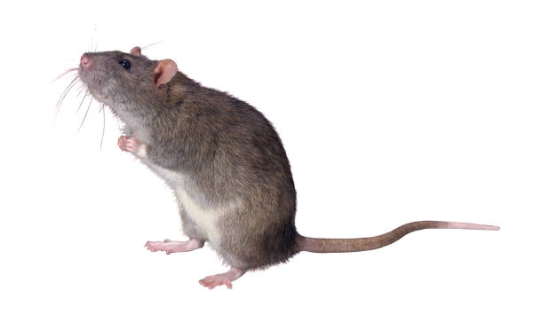
What is an ‘IACUC’?
Institutional Animal Care & Use Committee (IACUC)
A federally mandated committee of veterinarians, scientists, non-scientists and non-affiliated persons charged to oversee an institution’s animal care and use program, facilities and procedures.
  Ensure humane animal care and use & scientific quality
  Ensure regulatory compliance
Notes:
The Institutional Animal Care & Use Committee, or IACUC, is a federally mandated committee composed of veterinarians, scientists, non-scientists and non-affiliated persons which oversee the University’s animal care and use program, facilities and all procedures that occur on live animals. The committee is charged with ensuring humane care and use of the animals and ensuring compliance with federal, state and local regulations.

Slide 3
Responsible Conduct of Research: Animal Welfare
If using
animals Requires
or IACUC
animal Review
tissues
Notes:
If you plan on using animals or animal tissues within your career at UMB, the IACUC must review your proposed research before it is conducted.

Slide 4
What is the role of an IACUC?
  The IACUC is federally mandated to:
    Review Animal Use Protocols
    Review Animal Care & Use Program
    Inspect Facilities & Labs
    Prepare Reports for the Institutional Official (IO) and Regulatory / Accrediting Bodies
    Make Recommendations to Improve Animal Care
    Review Animal Welfare Concerns
    Suspend Animal Use Activities, if warranted
Notes:
The IACUC reviews and approves all animal use protocols and amendments and makes recommendations to improve animal welfare and care. They review the animal care & use program and inspect animal facilities and labs every 6 months, and they also prepare reports for the IO and our regulatory and accrediting agencies. Animal welfare concerns are reviewed by the IACUC, and they can suspend animal use activities for a given PI or protocol, if warranted.

Slide 5
Who is the IACUC?
The UMB IACUC serves as the IACUC of record for the UMB campus, inclusive of...
    *School of Medicine *School of Nursing
    *School of Dentistry *School of Pharmacy
    *Institute of Marine and Environmental Technology (IMET)
    *Baltimore VAMC
Notes:
The UMB IACUC serves as the IACUC of record for the UMB campus, including the Schools of Medicine, Dentistry, Nursing and Pharmacy, as well as IMET (which is where we have some of our fish and sharks). They are also the IACUC for animal work conducted through the Baltimore VA.

Slide 6
Office of Animal Welfare Assurance (OAWA)
  Supports the UMB Institutional Animal Care & Use Committee (IACUC) in fulfilling federal mandates
  All IACUC matters and animal welfare concerns should be directed to this office
  Contact Info:
    Website: http://www.medschool.umaryland.edu/IACUC/
    Email: iacuc@umaryland.edu
    Phone: 410-706-7859 / 8470
    Office: BRB, Mezzanine Ste. M023
    Hours: Mon –Fri; 8:30 am – 4:30 pm
Notes:
The Office of Animal Welfare Assurance, or the OAWA, supports the IACUC in fulfilling its federal mandates. Please contact our Office for all IACUC matters, including processes, guidelines, and animal welfare concerns.

Slide 7
Comparative Medicine & Veterinary Resources
  Procurement, Husbandry, Veterinary Care, and Technical Services
  Director & Attending Veterinarian: Tim Mandrell, DVM, DACLAM
    Website: http://medschool.umaryland.edu/vetmedicine
    Phone: 410-706-3540
    Mail / Office: MSTF G100
Notes:
The Comparative Medicine Program is responsible for procurement of animals, husbandry, veterinary care and technical services. If you have specific questions about the animal facilities or per diems you should contact Comparative Medicine.

Slide 8
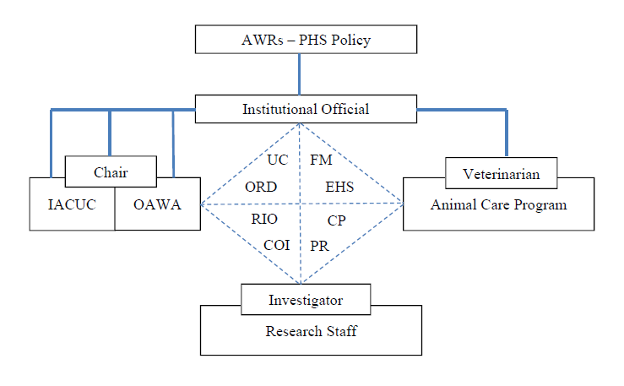

Animal Care & Use Program
UC = University Counsel
ORD = Research &
Development
RIO = Research Integrity Office
COI = Conflict of Interest
FM = Facilities Maintenance
EHS = Environmental
Health & Safety
CP = Campus Police
PR = Public Relations
Notes:
The Animal Care & Use Program encompasses several departments that all work in unison to ensure that we are adhering to the Animal Welfare Regulations and PHS Policy, as well as providing and maintaining appropriate facilities and resources to maintain the health and safety of the animals and those working with them.

Slide 9
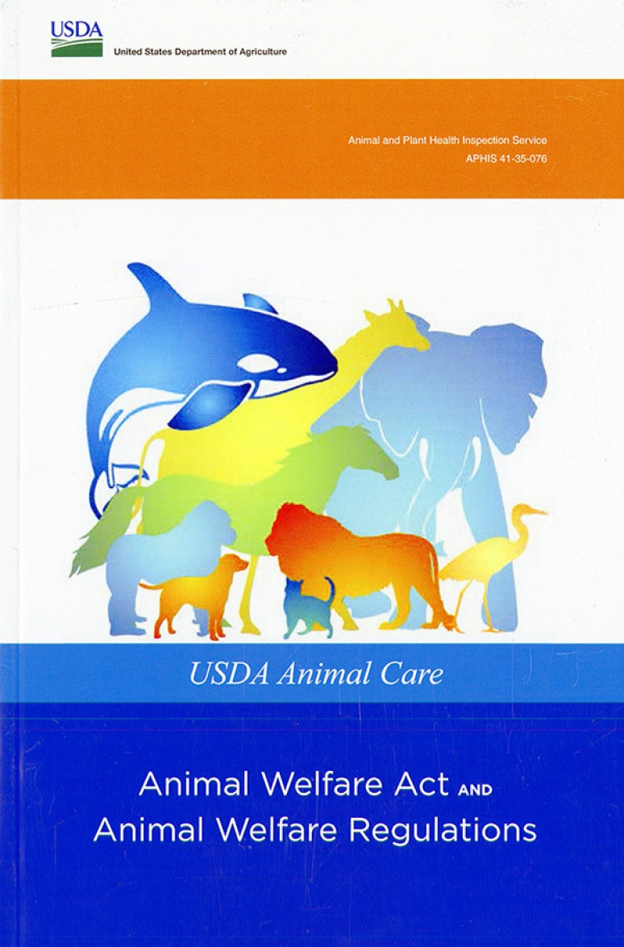
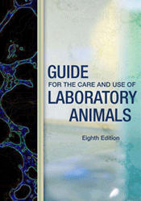
Regulatory Documents
URL: https://www.aphis.usda.gov/animal_welfare/downloads/AC_BlueBook_AWA_FINAL_2017_508comp.pdf
URL: http://grants.nih.gov/grants/olaw/references/PHSPolicyLabAnimals.pdf
URL: http://grants.nih.gov/grants/olaw/Guide-for-the-Care-and-Use-of-Laboratory-Animals.pdf
Notes:
The questions within an animal use protocol and amendment form satisfy information that the IACUC is required to collect per the Animal Welfare Act, PHS Policy and the Guide. These documents are available online if you wish to peruse them in your spare time.

Slide 10
Regulatory Documents
Additional Regulations:
  Veterans Health Administration (VHA)
  Department of Defense (DoD)
  Food and Drug Administration (FDA)
    Good Laboratory Practices (GLP)
    Animal Rule
Notes:
Additional regulations outside of our three main guidance documents may apply if research is conducted at the VA, with VA or DoD funding, or if the proposed work is being conducted under GLP. Please contact our Office if you have questions regarding animal use guidelines for these agencies.

Slide 11
Assuring Compliance
IACUC Review of all proposed animal use
Training
Post-Approval Monitoring
Grant / Protocol Comparisons
Attend national regulatory affairs meetings / workshops / conferences
Maintain AAALACi Accreditation (voluntary; yet recognized nationally and internationally as the ‘gold standard’ symbolizing quality, promoting scientific validity, and demonstrating accountability and commitment to humane animal care and use.)
Notes:
In order to ensure compliance within the institution, the IACUC reviews all proposed animal use, there is required training for personnel that work with animals (which we will cover a little later), and protocols and procedures are monitored and reviewed following approval as part of the Post-Approval Monitoring program. We perform grant / protocol congruency reviews to ensure that all of the animal work described in a grant is covered on one or more protocols. The IACUC and the OAWA staff stay up-to-date with the current regulatory environment by attending national meetings and conferences and implement changes when the regulations allow for them. And our institution has also been accredited by AAALAC International since 1983. This is a voluntary program, but it is considered a ‘gold standard’ symbolizing the demonstration of a high-quality animal care & use program.

Slide 12
Consequences of Non-compliance
Institution
  Required to report incident to Feds, AAALACi & Funding Agency
  Subject to Audits and / or fines
  Potential Loss of Animal Welfare Assurance, USDA Registration, and AAALACi Accreditation
    Loss of PHS Funding
    Loss of the privilege to use animals
    Loss of trust from the community
  Negative Public Relations
Notes:
The consequences of non-compliance within a protocol, procedure or animal care program can have a range of effects. The IACUC is required to report the non-compliance to the corresponding federal agencies, AAALAC and the agency that funded the non-compliant work. The institution can be subject to an increase in audits by federal agencies or be fined. The USDA can fine institutions by each violation, per animal affected by the violation, and by the total number of days that the violation continued. NIH can request that funds from a grant that supported non-compliant activities be returned to the agency. Non-compliance can result in the loss of our PHS Assurance (which allows us to acquire NIH funding for research), our USDA registration (which allows us to work with USDA-covered species), and our AAALAC accreditation. The negative PR would also have a substantial impact on our institution.

Slide 13
WHAT DO I NEED TO COMPLETE BEFORE I WORK WITH LABORATORY ANIMALS?
_______________________________________________________________________
Complete required IACUC training
  CITI Training (www.citiprogram.org): Working with the IACUC – Investigators, Staff & Students course and the appropriate species specific course for each species approved under the PI’s protocol.
Complete required laboratory animal exposure risk assessment
  Instructions and FAQs: http://www.medschool.umaryland.edu/iacuc/Education--Training/Laboratory-Animal-Exposure-Risk-Assessment-Program-LAERAP/
Notes:
So before you start working with live animals you need to complete some training. The first is CITI training, which consists of a Working with the IACUC course and then you will take the specific species course for each species approved on the PI’s protocol. You will also complete the Laboratory Animal Exposure Risk Assessment (or LAERAP), which is essentially an allergy questionnaire. The CITI training must be completed every 3 years and the LAERAP is required annually. A UMID is required to complete the LAERAP.

Slide 14
WHAT DO I NEED TO COMPLETE BEFORE I WORK WITH LABORATORY ANIMALS?
______________________________________________________________________
Complete IACUC Personnel Amendment Form (http://www.medschool.umaryland.edu/iacuc/Forms/) and have PI review and submit to the OAWA for IACUC approval prior to working with animals.
  PI is responsible for training personnel on protocol specific procedures
  PI should provide a copy of the IACUC approved protocol for review to ensure animal work being conducted adheres to what the IACUC approved.
Review IACUC Best Practice Standards (http://www.medschool.umaryland.edu/iacuc/Policies--Procedures/)
Notes:
The next step is completing the Personnel Amendment form, which you can find on our website. When completing the form, ensure that you and the PI have completed the PI and Research Staff Certification sections. The PI is responsible for training lab members on protocol specific procedures, and they should provide you with a copy of the approved protocol for you to review so that you can ensure you are adhering to what the IACUC has approved. You should also review the IACUC Best Practice Standards, which can be found on our website.

Slide 15
IACUC Resources:
PI Manual – Under ‘Policies & Procedures’ page
IACUC Guidelines – Under ‘Guidelines’ page
Documentation Templates – Under ‘Forms’ page
The Guide – Under ‘Policies & Procedures’ page
OAWA Website: http://medschool.umaryland.edu/iacuc/
***In web browser of choice, add website to your Favorites***
Notes:
Our website has several resources to help you with submitting protocols and amendments. All of our protocol forms, IACUC-approved guidelines (which you can copy/paste directly into your protocol or amendment), and templated surgical and animal monitoring logs are all available on the website.

Slide 16
Need Assistance?
Contact an IACUC Analyst in the OAWA:
Stacey McCulle 410-706-7859
Juliana Medina 410-706-8470
Email the OAWA: iacuc@umaryland.edu
OAWA Website: http://medschool.umaryland.edu/iacuc/
***In web browser of choice, add website to your Favorites***
Notes:
If you have questions regarding the submission of protocols or amendments, please contact our office. And if you have any questions regarding this presentation, we are happy to answer them! One of our analysts will get in touch with you when you email the OAWA email listed on this slide. Thank you for your time and have a great day!

